Slide 1
HOPES AND DREAMS
https://www.youtube.com/watch?v=fBjVZ16XMng

Slide 2
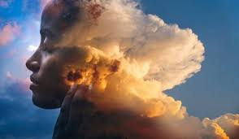
WhAT ARE YOUR HOPES AND DREAMS
What are your dreams for the future?

Slide 3
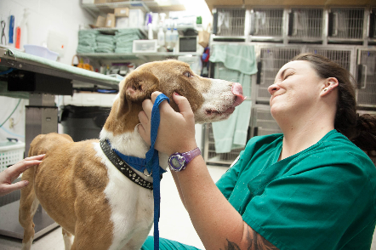
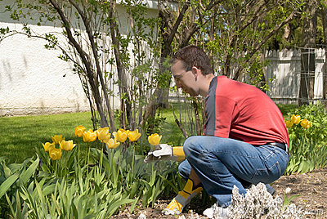
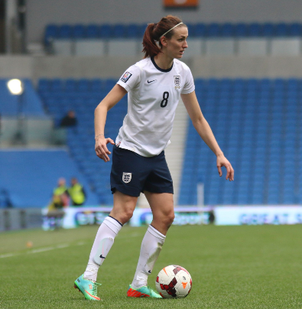
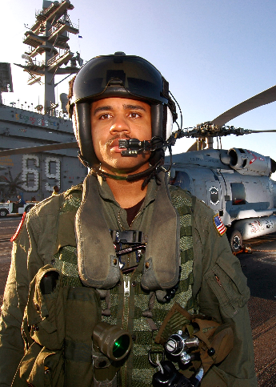
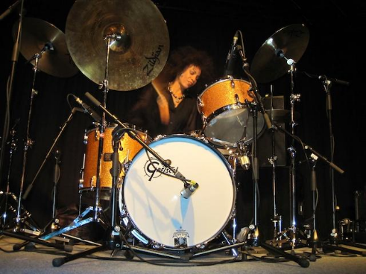
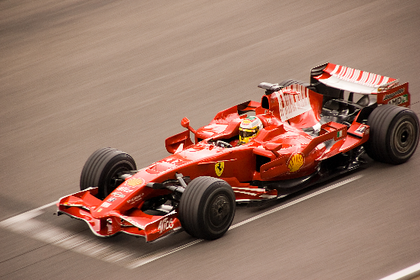
What do you hope to do when you grow up?
Notes:
Teacher notes:
Give pupils time to talk to their partner to share ideas
Would they share the images on the slide? Why? How?
Which ones would they not want to share? Why?

Slide 4
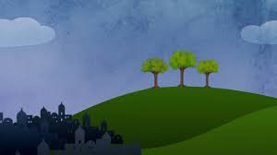
The three trees
the story today is a traditional folk tale about three trees that had plans and dreams about their future.
https://www.youtube.com/watch?v=z5qRzTOpOnk

Slide 5

TIME TO THINK
Think about our story. All three trees started off living very ordinary lives. The first two wanted to be made into grand and impressive objects. But it turned out that they all ended up being made into very simple objects which played a very important part in the life and death of someone very special and extraordinary.

Slide 6
Question and answer
Who could that person be?
Can you remember what the first tree was made into?
What happened to the second tree?
What became of the third tree?

Slide 7

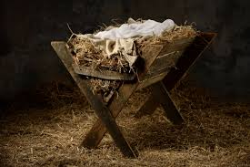
Reflect
The first tree, the animal’s feedbox or manger, realised that it was holding the greatest treasure in the world and of course that treasure was the baby Jesus.

Slide 8
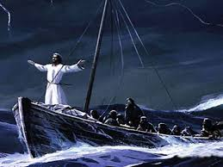
The second tree, the little boat, knew it was carrying the King of heaven and earth and of course that king was Jesus when he was a man.

Slide 9
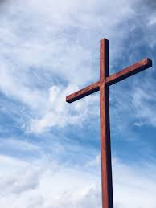
Now let’s think about the third tree which was made into a cross. That tree felt ugly, harsh and cruel on Friday when Jesus died on it, but something amazing and extraordinary happened to Jesus on the Sunday morning, when the sun rose.
I wonder who can tell me what that amazing event was?
If you were that tree, how would you feel?

Slide 10
The story says that the tree knew that God’s love had changed everything. We know that special Sunday was Easter day. We see the symbol of the cross in lots of places round the world. The cross reminds us that Jesus came alive again and to think of God. (Show large cross). Have a think about where else you might see crosses. They come in all kinds of shapes and sizes.

Slide 11
In the story, each tree had a plan for its future, but it seemed that God had a different plan for them. Initially, God’s plan did not seem as exciting as their original plans, but, eventually, God used each one of them to play an important part in the life of Jesus, from his birth to his death. We all have hopes and dreams for our futures and that is a good thing. If appropriate, add that Christians believe, if they ask God, he will show them his plans for their future.

Slide 12
prayer
Dear God.
Help us to follow the example of the three trees, to understand that we don’t have to be the best in order to do our best for other people. We don’t have to look impressive or grand in order to show kindness. The trees were made into simple things and they were not grand or impressive but had a great purpose
Help us to remember that we have dreams for ourselves and whatever we become GOD WILL GUIDE US.
Amen.

Slide 13

https://www.youtube.com/watch?v=cti8308y4VY

