Slide 1

https://vimeo.com/496812718

Slide 3
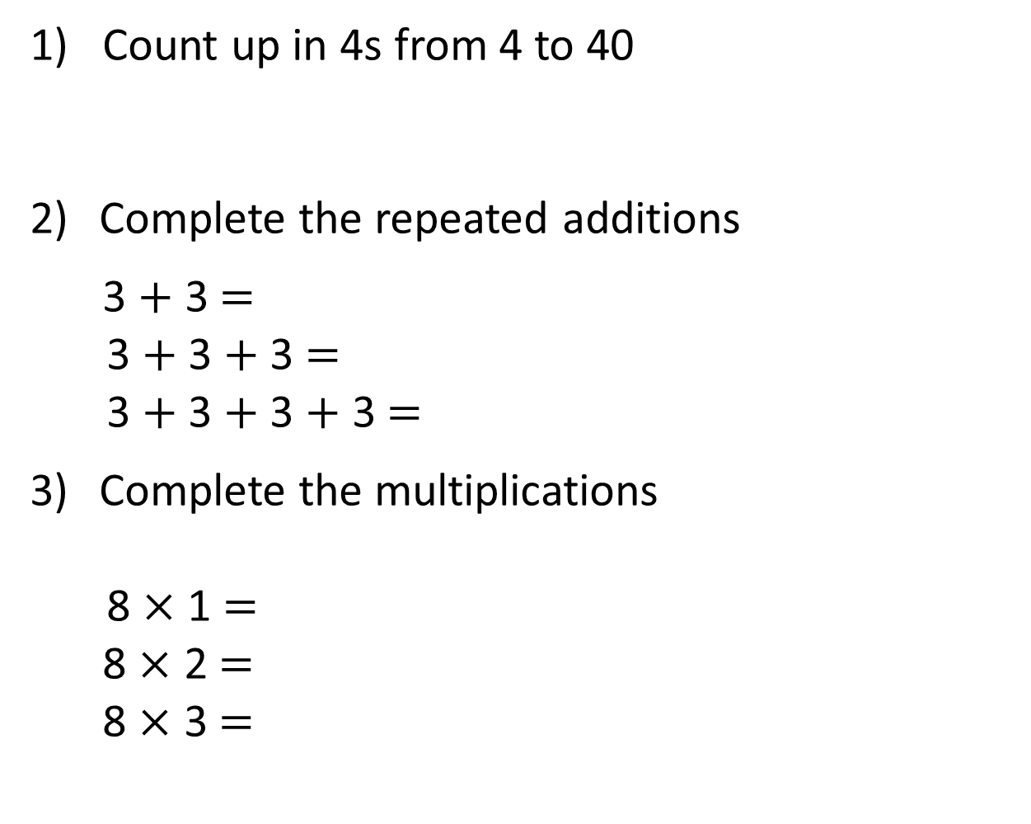
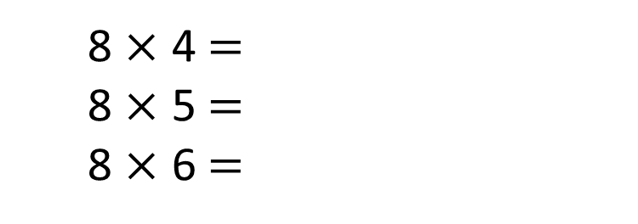
1) Count up in 4s from 4 to 40
Complete the repeated additions
3 $+$ 3 $=$
3 $+$ 3 $+$ 3 $=$
3 $+$ 3 $+$ 3 $+$ 3$=$
Complete the multiplications
8 $×$ 1 $=$
8 $×$ 2 $=$
8 $×$ 3 $=$
8 $×$ 4 $=$
8 $×$ 5 $=$
8 $×$ 6 $=$

Slide 4
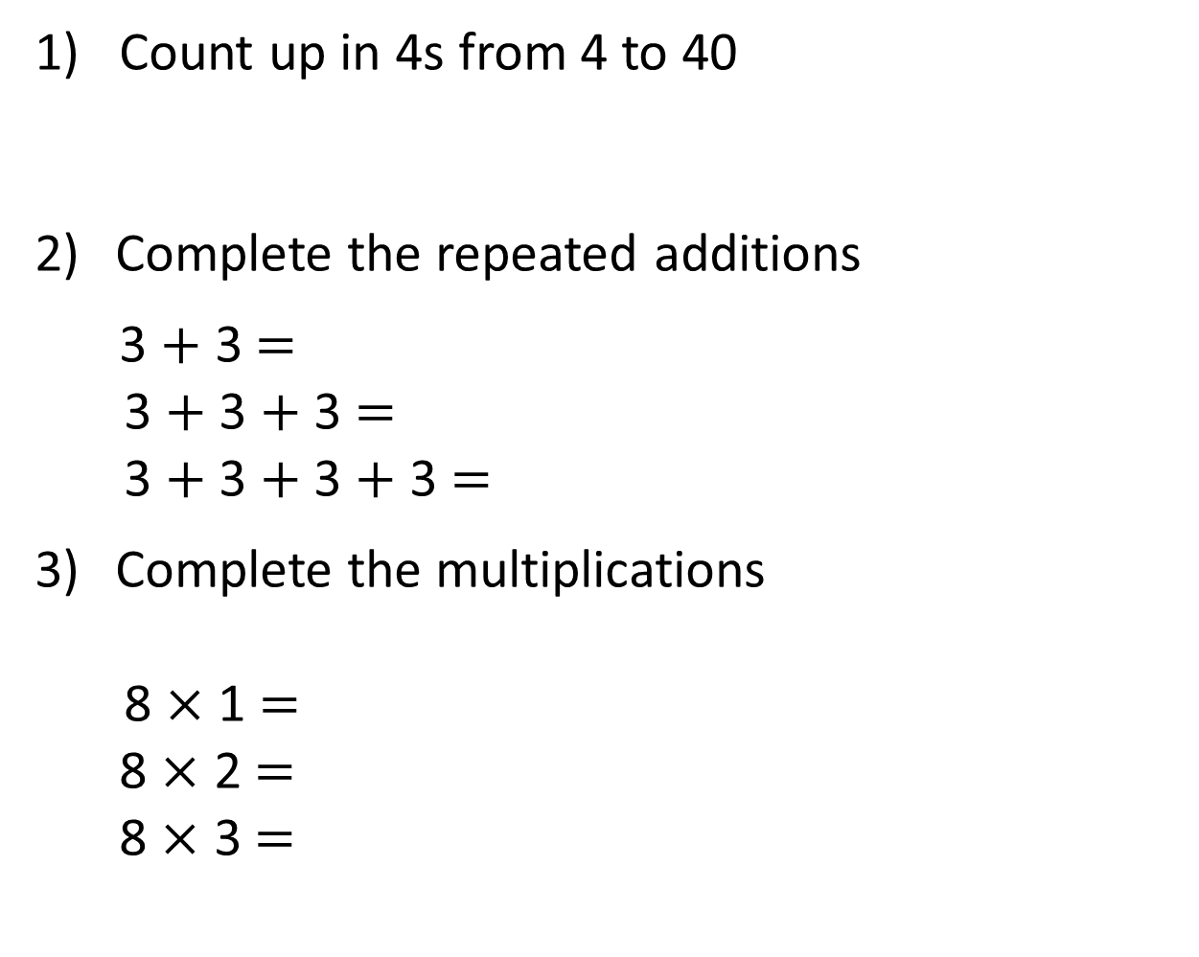
1) Count up in 4s from 4 to 40
Complete the repeated additions
3 $+$ 3 $=$
3 $+$ 3 $+$ 3 $=$
3 $+$ 3 $+$ 3 $+$ 3 $=$
Complete the multiplications
8 $×$ 1 $=$
8 $×$ 2 $=$
8 $×$ 3 $=$
4, 8, 12, 16, 20, 24, 28, 32, 36, 40
6
9
12
32
8
8 $×$ 4 $=$
8 $×$ 5 $=$
8 $×$ 6 $=$
16
40
24
48

Slide 6
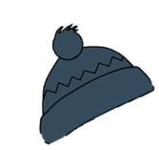
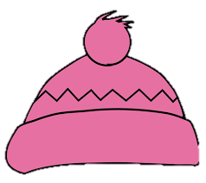


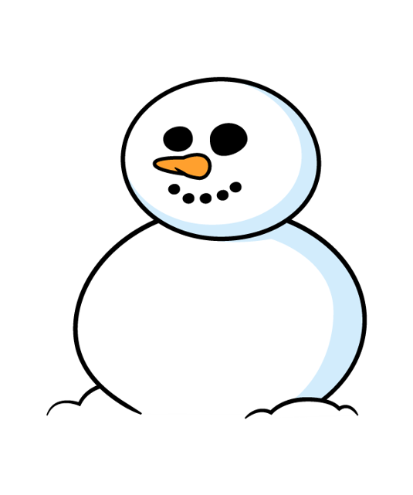

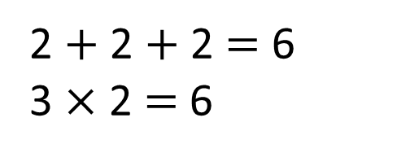
The children are dressing the snowman.
They have 3 hats and 2 scarves to choose from.
How many different combinations could they use?
Hat | Scarf
blue
green
blue
blue
green
green
green
blue
pink
green
pink
blue
2 $+$ 2 $+$ 2 $=$ 6
3 $×$ 2 $=$ 6
Have a think

Slide 7
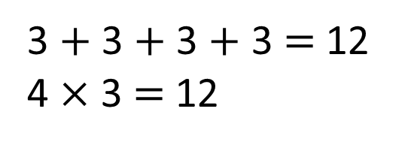
What if they have 4 hats and
3 scarves to choose from?
How many different combinations could they use?
Hat | Scarf
blue
green
blue
blue
blue
yellow
green
green
green
blue
green
yellow
pink
green
3 $+$ 3 $+$ 3 $+$ 3 $=$ 12
4 $×$ 3 $=$ 12
pink
blue
pink
yellow
grey
green
grey
blue
Have a think
grey
yellow

Slide 8
Have a go at questions 1 and 2 on the worksheet

Slide 9

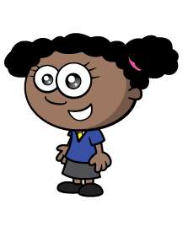




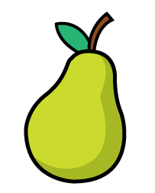
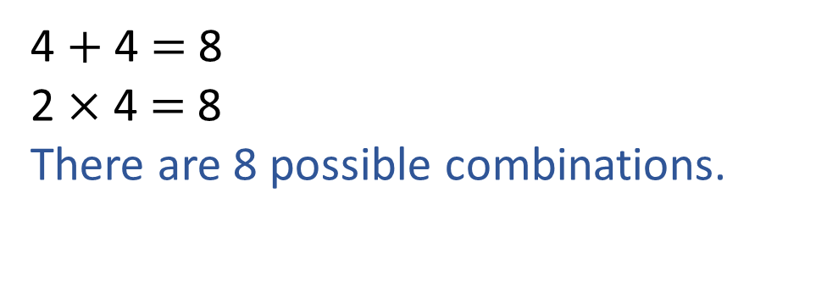
Whitney is choosing a piece of fruit and a drink.
How many different possible combinations
are there?
Have a think
4 $+$ 4 $=$ 8
2 $×$ 4 $=$ 8
There are 8 possible combinations.

Slide 10

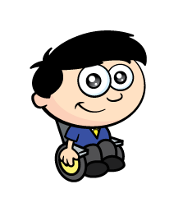
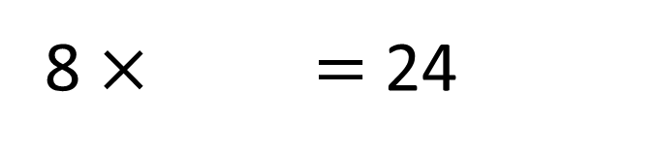
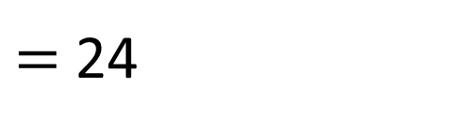
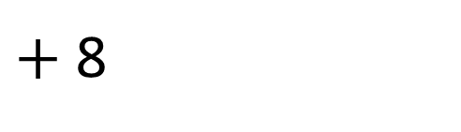
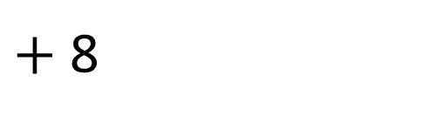

Dexter is choosing an ice-cream.
He chooses one flavour of ice-cream and one sauce.
There are 8 different ice-cream flavours.
How many different sauces are there?
8 $×$ 1 $=$ 8
8 $×$ 2 $=$ 16
8 $×$ 3 $=$ 24
3
8 $×$ $=$ 24
$=$ 24
$+$ 8
8
$+$ 8
There are 24 different possible combinations.
Have a think

Slide 11
Have a go at the rest of the questions on the worksheet

