Slide 1

https://vimeo.com/497936690

Slide 3
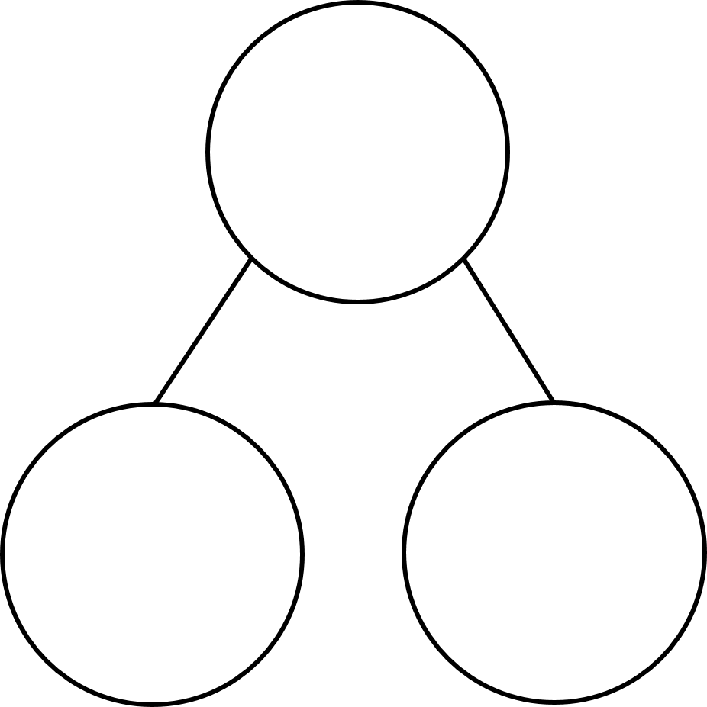

13 $÷$ 3 $=$
Complete the part whole models
5 $+$ 4 $=$ 10 $+$ 4 $=$
15 $+$ 4 $=$ 20 $+$ 4 $=$
25 $+$ 4 $=$ 30 $+$ 4 $=$
35 $+$ 4 $=$
73
73
3
60

Slide 4
13 $÷$ 3 $=$
Complete the part whole models
5 $+$ 4 $=$ 10 $+$ 4 $=$
15 $+$ 4 $=$ 20 $+$ 4 $=$
25 $+$ 4 $=$ 30 $+$ 4 $=$
35 $+$ 4 $=$
4 remainder 1
73
13
73
70
3
60
9
14
19
24
29
34
39

Slide 6


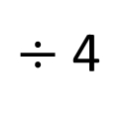
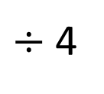
87 ÷ 4 =
21
remainder 3
87
Tens | Ones
80
7
$÷$ 4
$÷$ 4
20
1 r 3

Slide 7

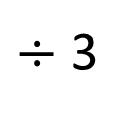
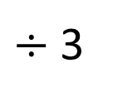
73 ÷ 3 =
24
remainder 1
Have a think
73
Tens | Ones
60
13
$÷$ 3
$÷$ 3
20
4 r 1

Slide 8
Have a go at questions 1 – 3 on the worksheet

Slide 9
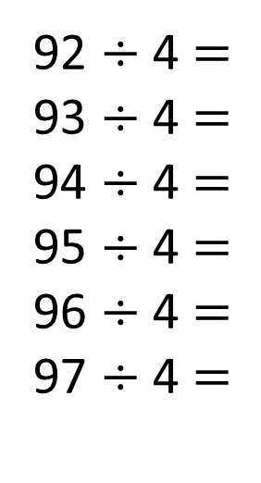

Have a think
72 ÷ 3 $=$
73 ÷ 3 $=$ 24 r 1
74 ÷ 3 $=$
75 ÷ 3 $=$
76 ÷ 3 $=$
92 ÷ 4 $=$
93 ÷ 4 $=$
94 ÷ 4 $=$
95 ÷ 4 $=$
96 ÷ 4 $=$
97 ÷ 4 $=$
23
23 r 1
23 r 2
23 r 3
24
24 r 1
24
24 r 2
25
24 r 3
25 r 1
The remainder must be less than the divisor.

Slide 10


72 ÷ 3 $=$
73 ÷ 3 $=$ 24 r 1
74 ÷ 3 $=$
75 ÷ 3 $=$
76 ÷ 3 $=$
92 ÷ 4 $=$
93 ÷ 4 $=$
94 ÷ 4 $=$
95 ÷ 4 $=$
96 ÷ 4 $=$
97 ÷ 4 $=$
23
23 r 1
23 r 2
23 r 3
24
24 r 1
24
24 r 2
25
25 r 1
Have a think
The remainder must be less than the divisor.
If 75 $÷$ 5 $=$ 15, what will 78 $÷$ 5 be?
15 r 3
If 92 $÷$ 7 $=$ 13 r 1, what will 99 $÷$ 7 be?
14 r 1

Slide 11
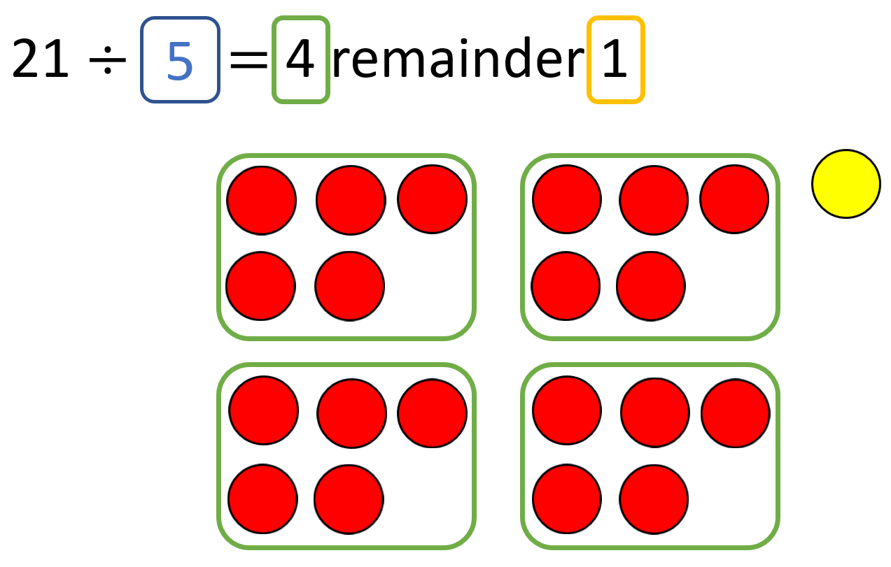
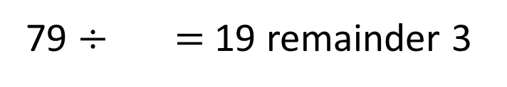
79 $÷$ $=$ 19 remainder 3
4
Have a think

Slide 12
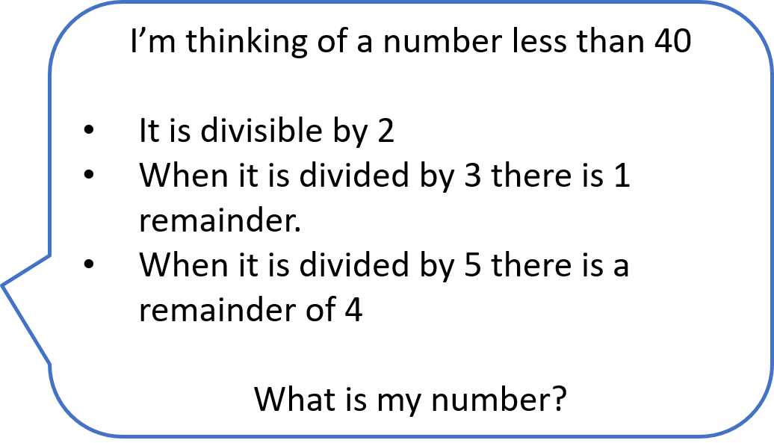

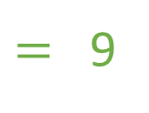
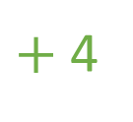

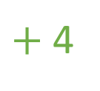
I’m thinking of a number less than 40
It is divisible by 2
When it is divided by 3 there is 1 remainder.
When it is divided by 5 there is a remainder of 4
What is my number?
5
$+$ 4
$=$ 9
10
$+$ 4
$=$ 14
r 2
34
19
24
r 0
29
34
r 1
39

Slide 13
Have a go at the rest of the questions on the worksheet

