Slide 1
Protecting
Local Habitats

Slide 2
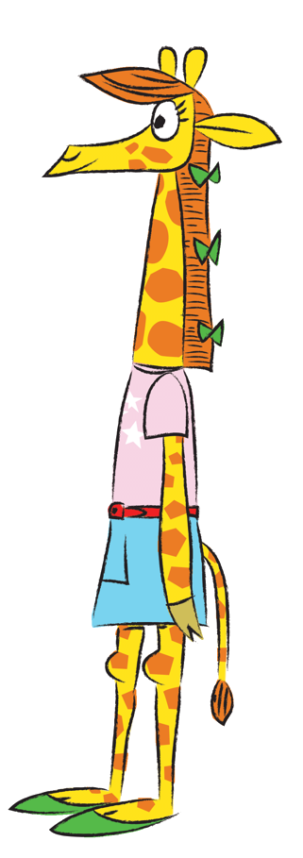
In this lesson we will be learning about the habitats of the UK and what you can do to help protect them.
2
© Young Citizens
Notes:
Images: Clipart

Slide 3
Learning Objectives
By the end of this lesson, I will:
understand the term habitat;
identify habitats in the UK and animals which are suited to them;
understand the effects of habitat loss;
get involved in local habitat renewal.
3
© Young Citizens
Notes:
Images: Clipart

Slide 4
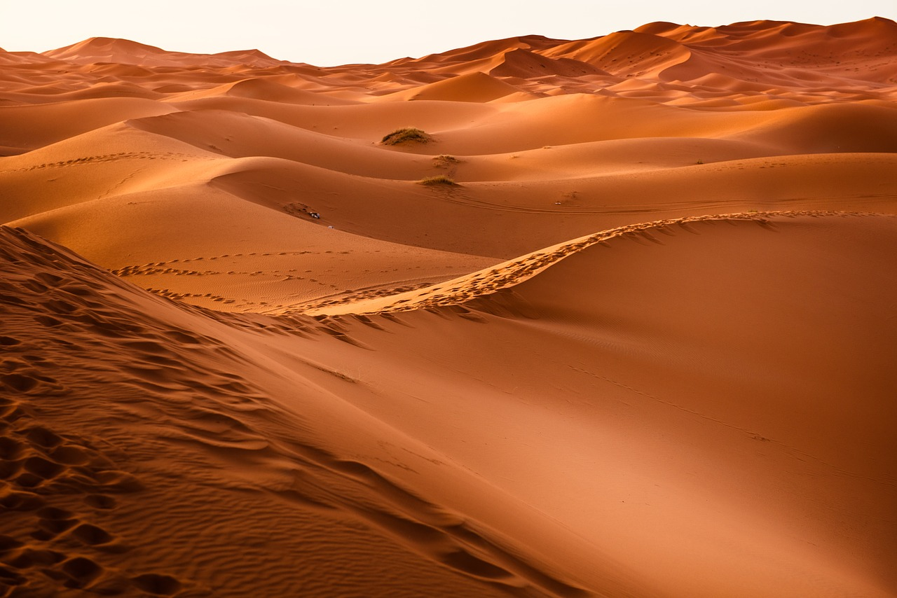
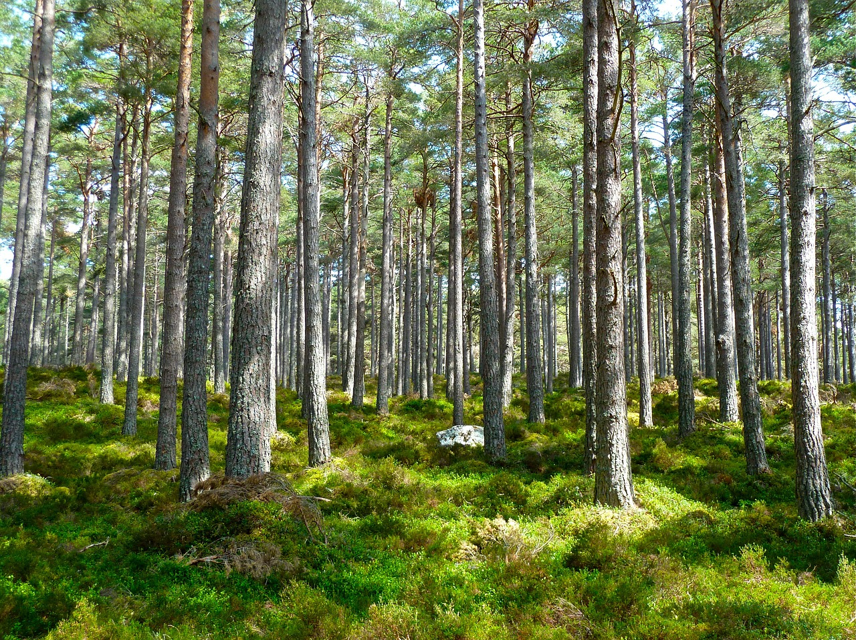
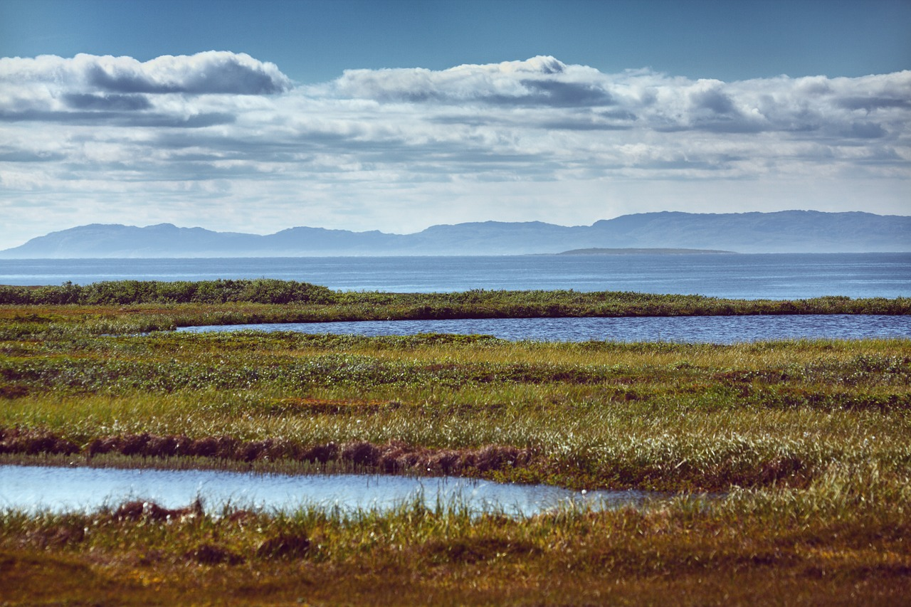
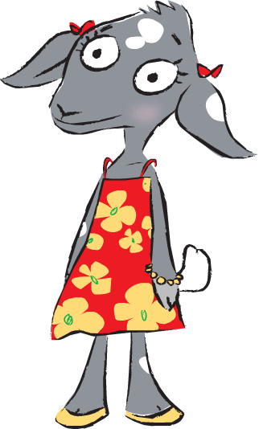
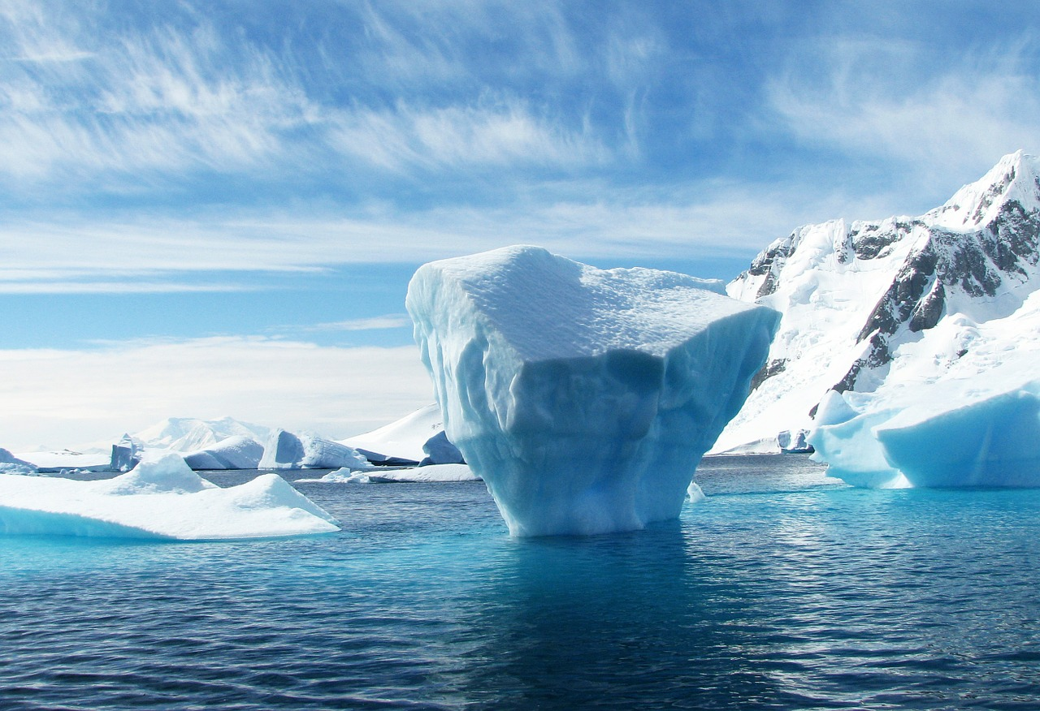
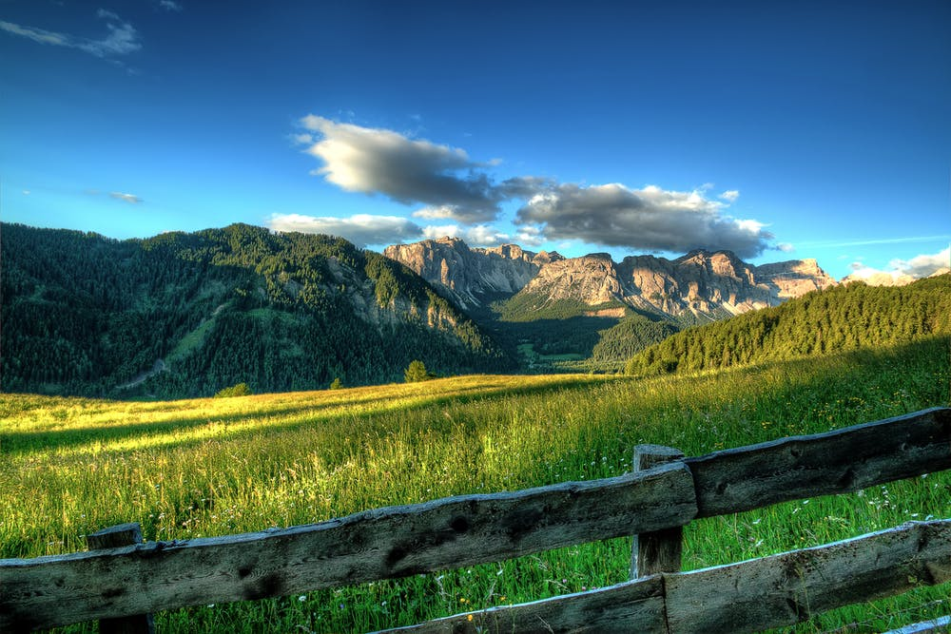
Here are some pictures of habitats.
But what are habitats?
4
© Young Citizens

Slide 5
A habitat is the natural home of an animal, plant or any other living thing.
A habitat gives a living thing shelter and food.
5
© Young Citizens

Slide 6
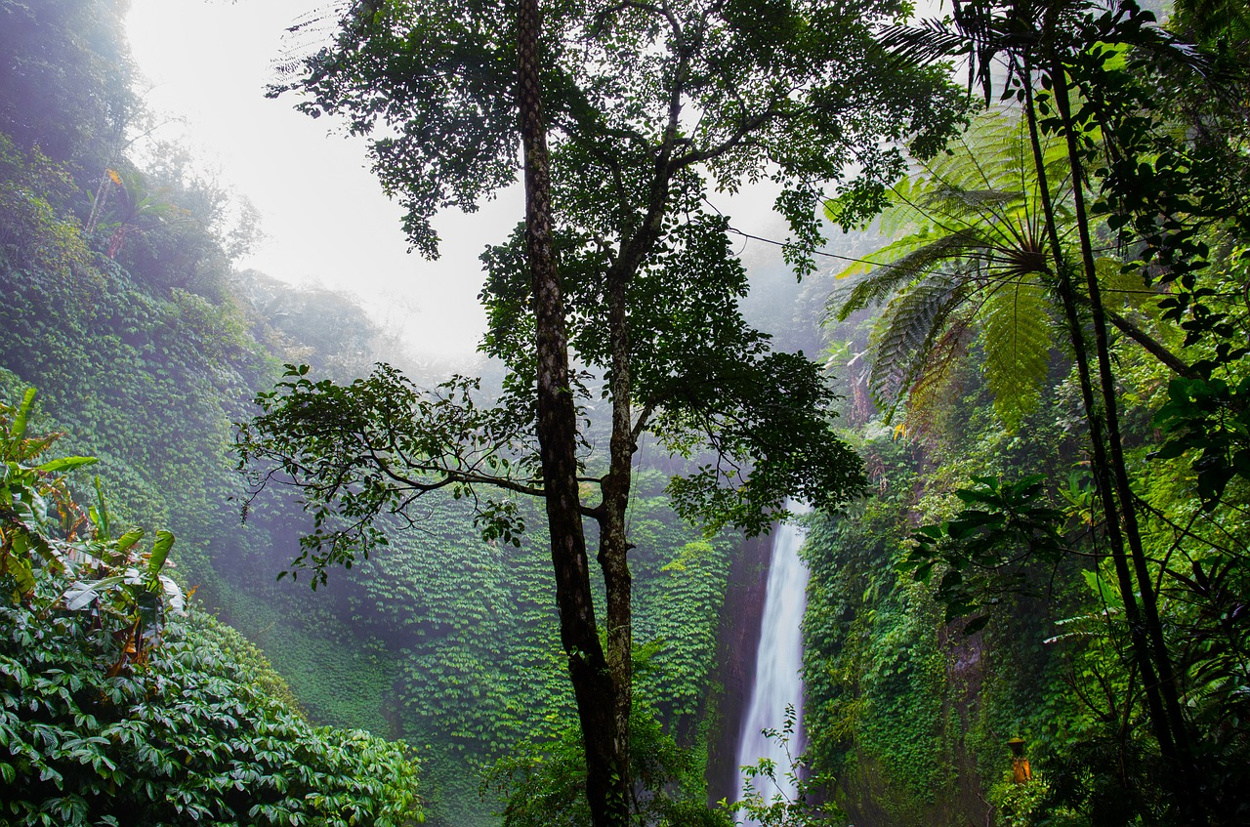
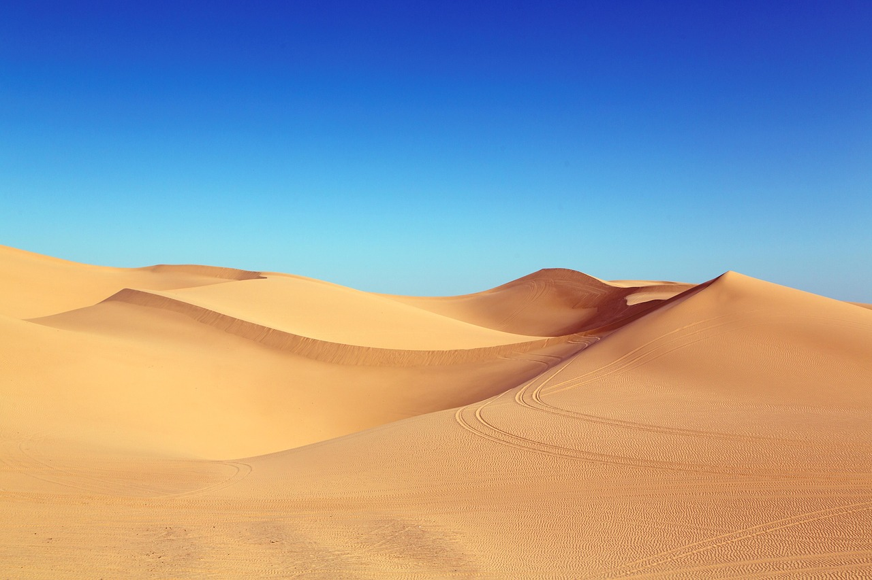
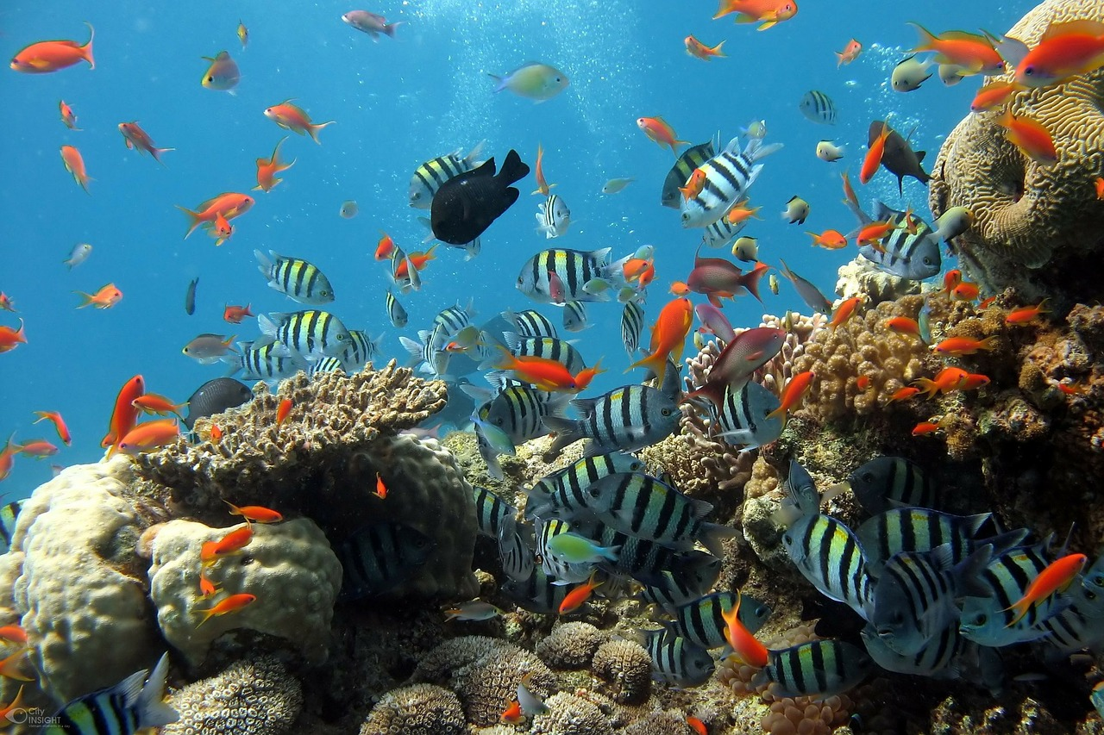
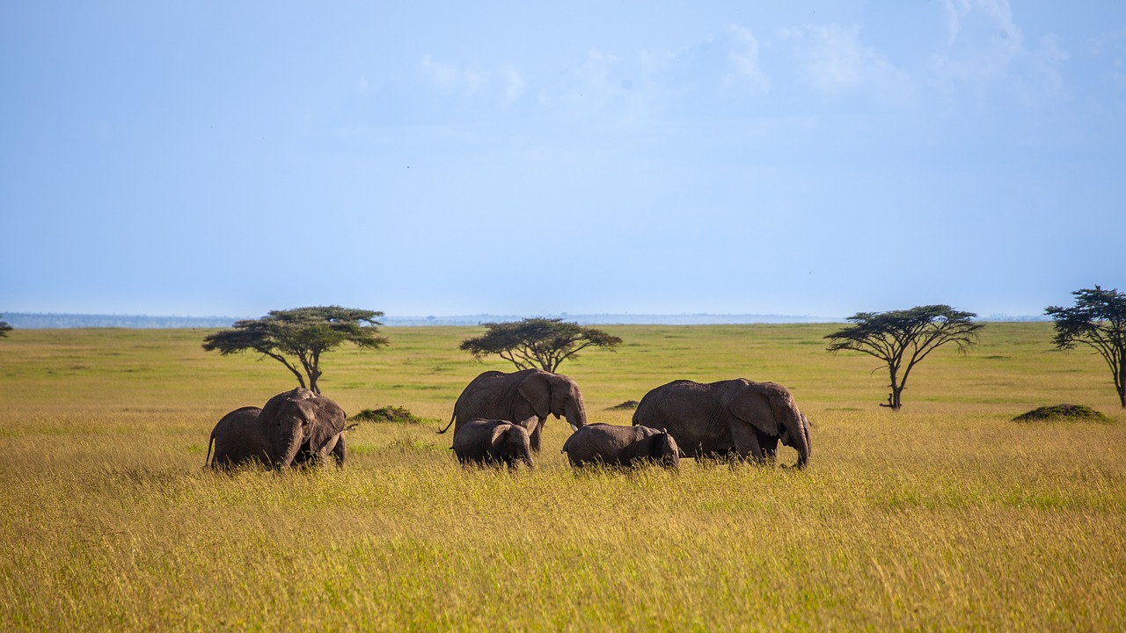
Habitats are very different as you travel around the World!
Warm, wet rainforests
Hot, dry deserts
Coral Reef
Polar ice
Savannah grasslands
6
© Young Citizens

Slide 7
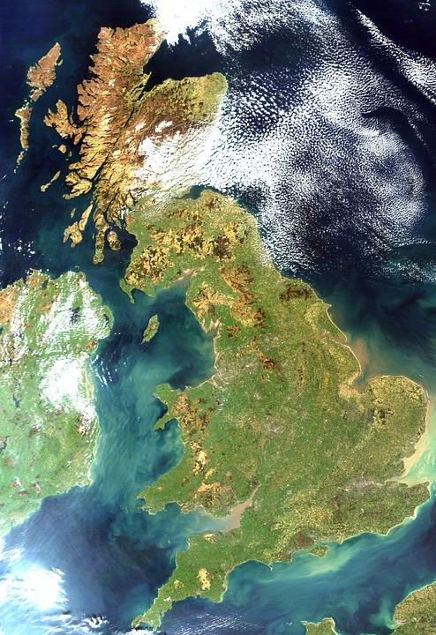
The UK might not be a big country but it has many different habitats.
7
© Young Citizens

Slide 8
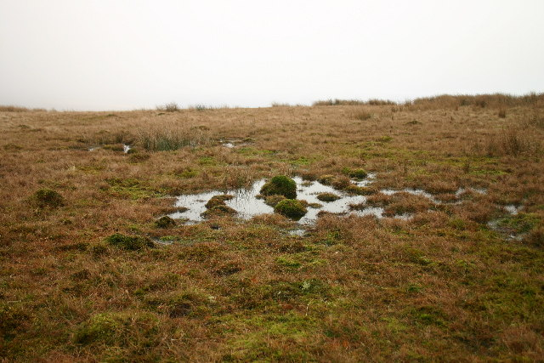
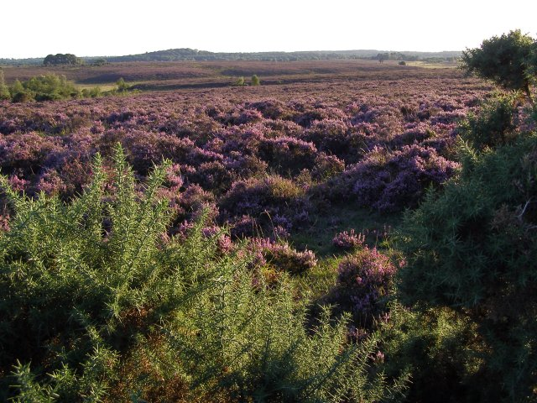
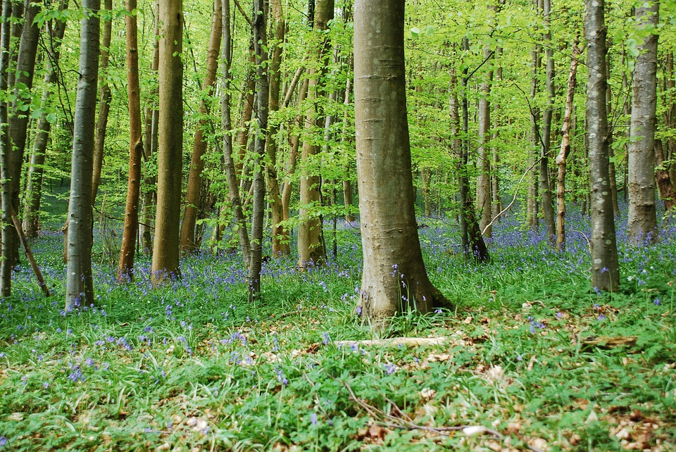
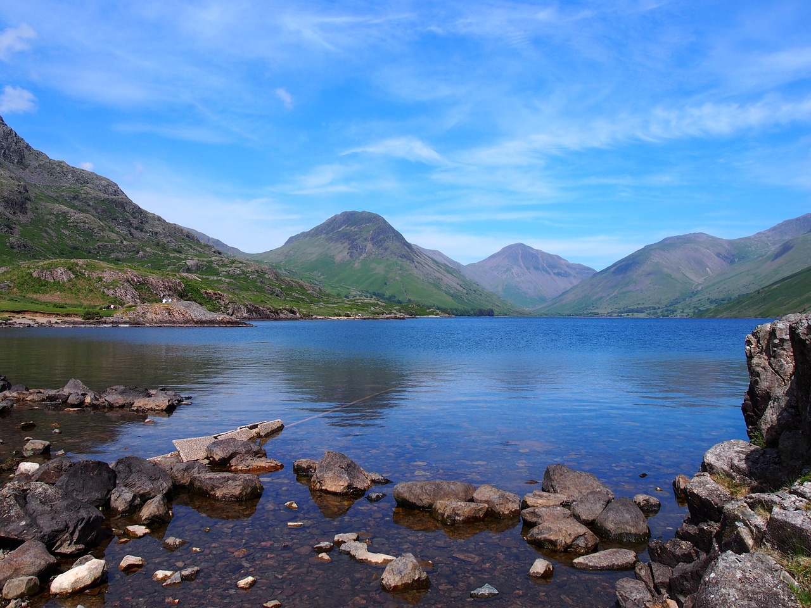
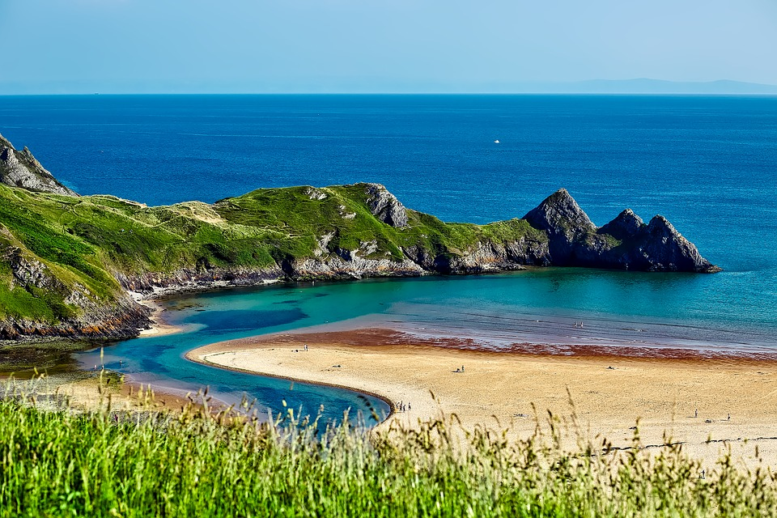
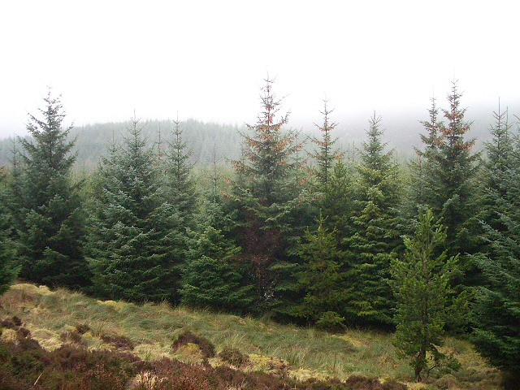
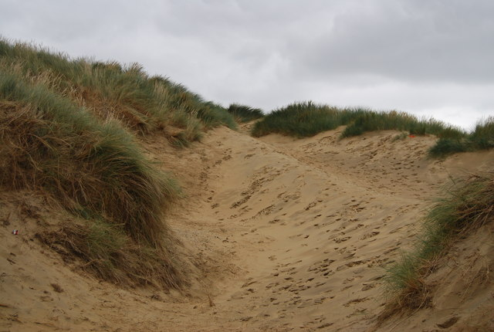
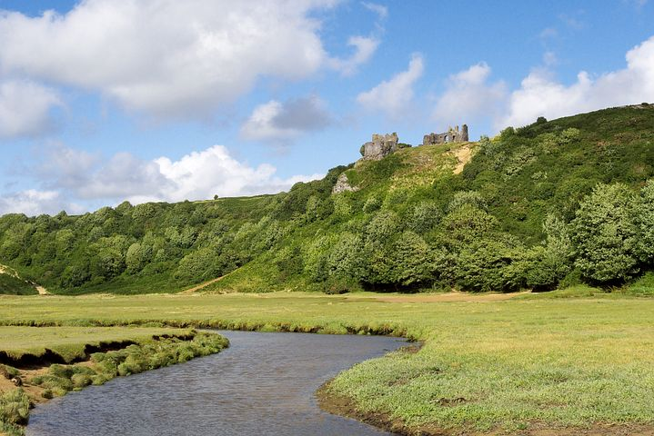
3
1
2
4
5
7
8
6
8
© Young Citizens
Notes:
Photos:
Description English: Sphagnum Bog, Ponsonby Fell. Close to the summit - a small raised bog.
Date 14 January 2006 Source From geograph.org.uk Author Bob Jenkins Attribution (required by the license) Bob Jenkins / Sphagnum Bog, Ponsonby Fell / CC BY-SA 2.
Description English: Gorse and heather on Yew Tree Heath, New Forest. Looking towards Woodfidley (the tree covered hill in the distance), with gorse and blooming heather in the foreground. The light green areas are dried-out boggy bottoms.
Date 21 August 2006 Source From geograph.org.uk Author Jim Champion Attribution (required by the license) Jim Champion / Gorse and heather on Yew Tree Heath, New Forest / CC BY-SA 2.0
https://pxhere.com/en/photo/1028420
https://www.goodfreephotos.com/england/other-england/cumbria-uk-landscape-with-lake-and-mountains.jpg.php
Description English: Blow out, Camber Sands Sand Dune Erosion as removed the marram grass & exposed the sand to the wind.
Date 16 September 2009 Source From geograph.org.uk Author Nigel Chadwick

Slide 9
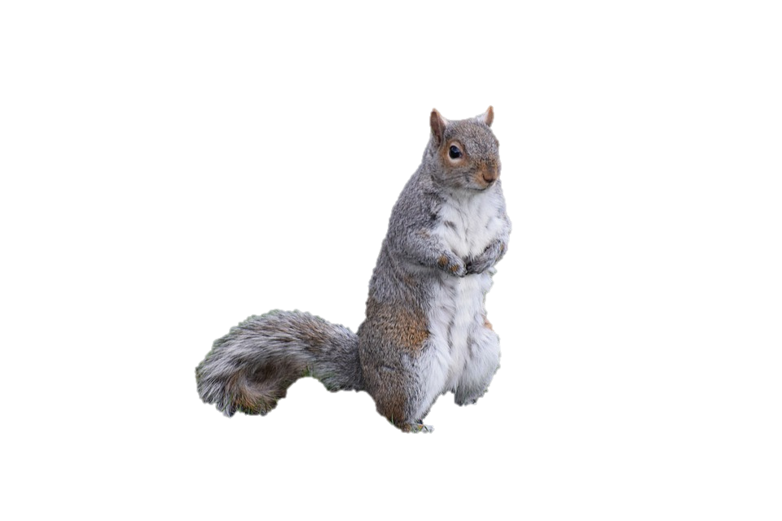
Why is this squirrel unhappy?
9
© Young Citizens

Slide 10
Living things are suited to their habitat.
The squirrel cannot find the food and shelter it needs at the beach.
10
© Young Citizens

Slide 11
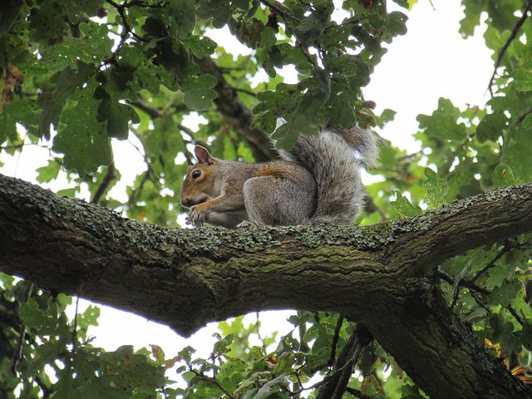
Squirrels are suited to habitats like woodland and parks. Where they can find nuts, seeds and berries to eat.
They can use bark, leaves and twigs to make their homes which are called dreys.
11
© Young Citizens

Slide 12
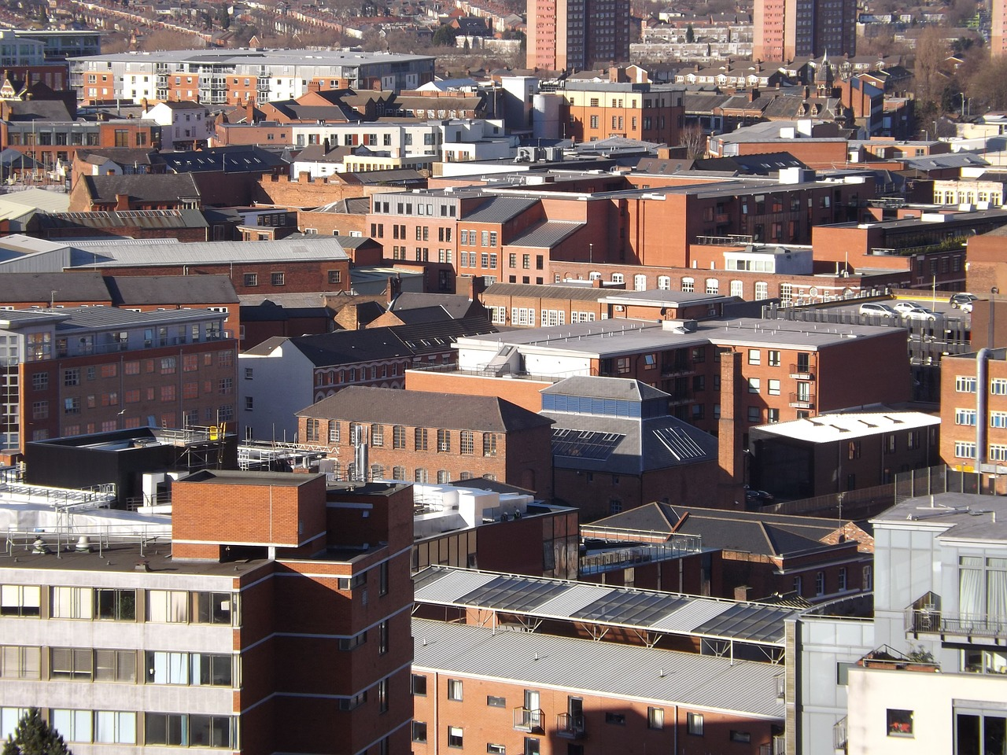
Woodland
Moor
Can you match the animals to their habitat?
Towns
River
Seashore
12
© Young Citizens
Notes:
Description English: Gorse and heather on Yew Tree Heath, New Forest. Looking towards Woodfidley (the tree covered hill in the distance), with gorse and blooming heather in the foreground. The light green areas are dried-out boggy bottoms.
Date 21 August 2006 Source From geograph.org.uk Author Jim Champion Attribution (required by the license) Jim Champion / Gorse and heather on Yew Tree Heath, New Forest / CC BY-SA 2.0
https://pxhere.com/en/photo/1028420

Slide 13
Woodland
Moor
Name: Common seal
Diet: Fish, squid, shellfish
Shelter: Sandy beaches, rocky shores
Towns
River
Seashore
13
© Young Citizens

Slide 14
Woodland
Moor
Name: Great spotted woodpecker
Diet: Insect like ants, nuts and berries in winter
Shelter:
Holes in trees
Towns
River
Seashore
14
© Young Citizens
Notes:
Description English: Gorse and heather on Yew Tree Heath, New Forest. Looking towards Woodfidley (the tree covered hill in the distance), with gorse and blooming heather in the foreground. The light green areas are dried-out boggy bottoms.
Date 21 August 2006 Source From geograph.org.uk Author Jim Champion Attribution (required by the license) Jim Champion / Gorse and heather on Yew Tree Heath, New Forest / CC BY-SA 2.0
https://pxhere.com/en/photo/1028420

Slide 15
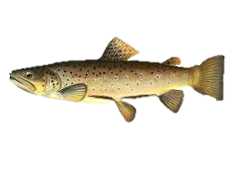
Woodland
Moor
Name: Brown trout
Diet: Flying insects, insect larvae and small fish
Shelter: Fast flowing fresh water
Towns
River
Seashore
15
© Young Citizens
Notes:
Description English: Gorse and heather on Yew Tree Heath, New Forest. Looking towards Woodfidley (the tree covered hill in the distance), with gorse and blooming heather in the foreground. The light green areas are dried-out boggy bottoms.
Date 21 August 2006 Source From geograph.org.uk Author Jim Champion Attribution (required by the license) Jim Champion / Gorse and heather on Yew Tree Heath, New Forest / CC BY-SA 2.0
https://pxhere.com/en/photo/1028420
it]
Artist Sherman Foote Denton
Description English: Watercolor of the brown trout by SF Denton.
Date 1 January 1897 Source/Photographer Annual Report of the Commissioners of Fish, Game, and Forests of the State of New York, 1896

Slide 16
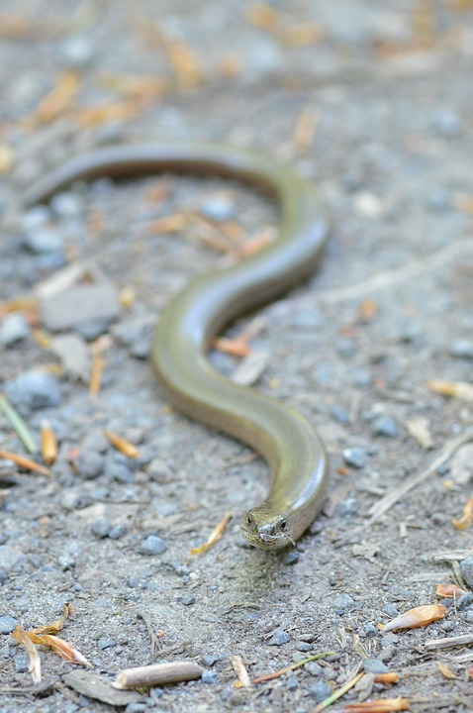
Woodland
Moor
Name: Slow-worm
Diet: Slugs, snails, earthworms, spiders, insects
Shelter: Under
leaves and roots.
They like to lie in
the sun.
Towns
River
Seashore
16
© Young Citizens
Notes:
Description English: Gorse and heather on Yew Tree Heath, New Forest. Looking towards Woodfidley (the tree covered hill in the distance), with gorse and blooming heather in the foreground. The light green areas are dried-out boggy bottoms.
Date 21 August 2006 Source From geograph.org.uk Author Jim Champion Attribution (required by the license) Jim Champion / Gorse and heather on Yew Tree Heath, New Forest / CC BY-SA 2.0
https://pxhere.com/en/photo/1028420

Slide 17
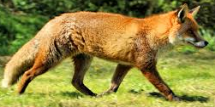
Woodland
Moor
Name: Red fox
Diet: Small mammals like mice, birds, frogs, earthworms, berries, fruit, foods that other animals have left.
Shelter: They bury underground.
Towns
River
Seashore
17
© Young Citizens
Notes:
Photos:
Description Fox - British Wildlife Centre
Date 22 April 2015, 10:15 Source Fox - British Wildlife Centre Author Airwolfhound from Hertfordshire, UK
Description English: Sphagnum Bog, Ponsonby Fell. Close to the summit - a small raised bog.
Date 14 January 2006 Source From geograph.org.uk Author Bob Jenkins Attribution (required by the license) Bob Jenkins / Sphagnum Bog, Ponsonby Fell / CC BY-SA 2.
Description English: Gorse and heather on Yew Tree Heath, New Forest. Looking towards Woodfidley (the tree covered hill in the distance), with gorse and blooming heather in the foreground. The light green areas are dried-out boggy bottoms.
Date 21 August 2006 Source From geograph.org.uk Author Jim Champion Attribution (required by the license) Jim Champion / Gorse and heather on Yew Tree Heath, New Forest / CC BY-SA 2.0
https://pxhere.com/en/photo/1028420
https://www.goodfreephotos.com/england/other-england/cumbria-uk-landscape-with-lake-and-mountains.jpg.php
Description English: Blow out, Camber Sands Sand Dune Erosion as removed the marram grass & exposed the sand to the wind.
Date 16 September 2009 Source From geograph.org.uk Author Nigel Chadwick

Slide 18
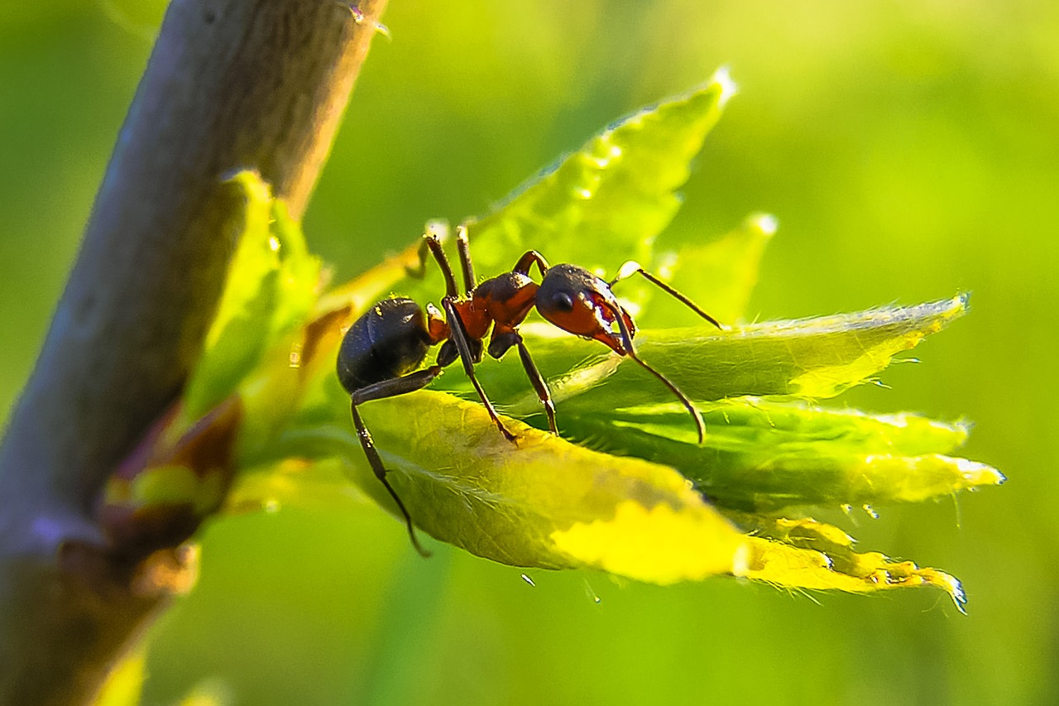
Animals who are very small can live in very small habitats.
These are called
micro-habitats.
Micro means small.
18
© Young Citizens

Slide 19
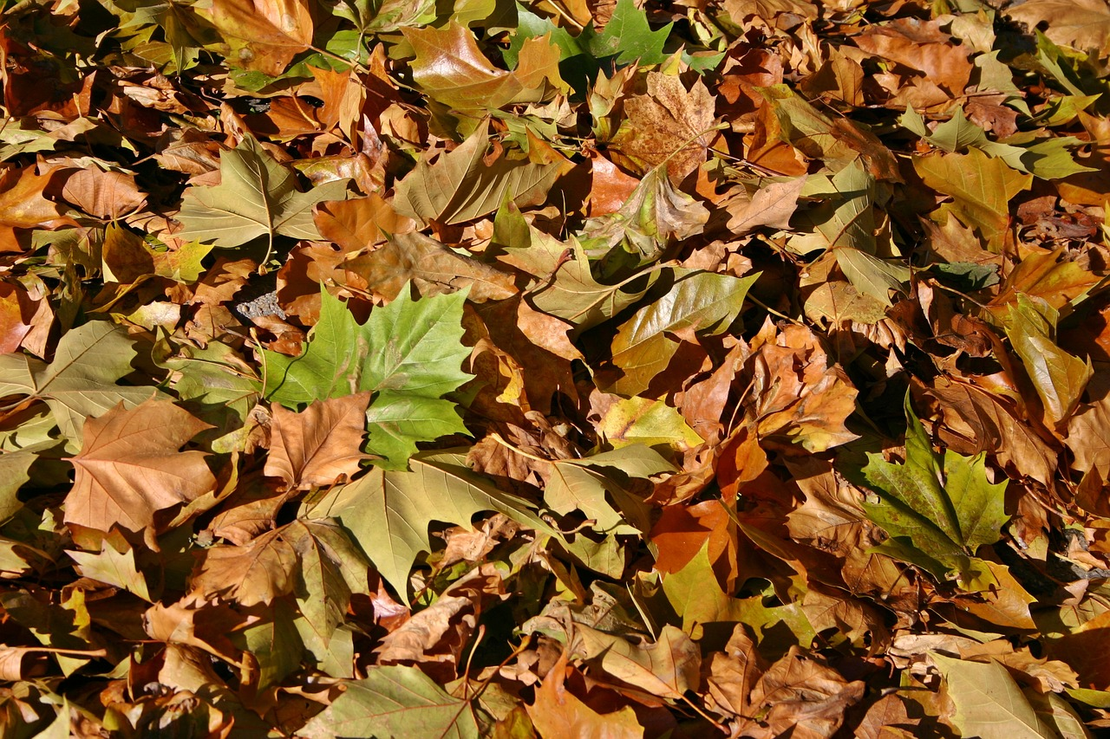
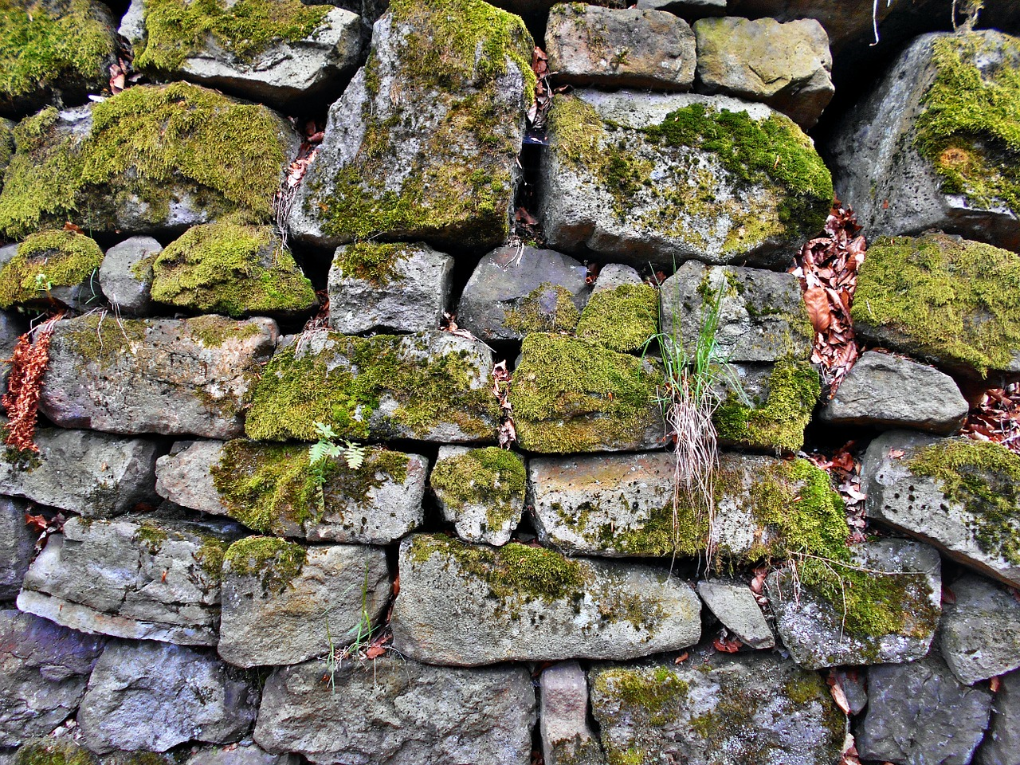
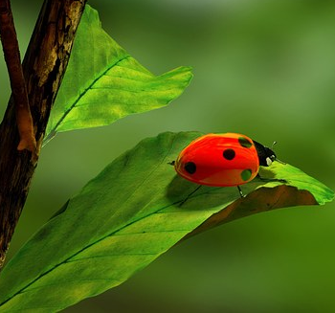
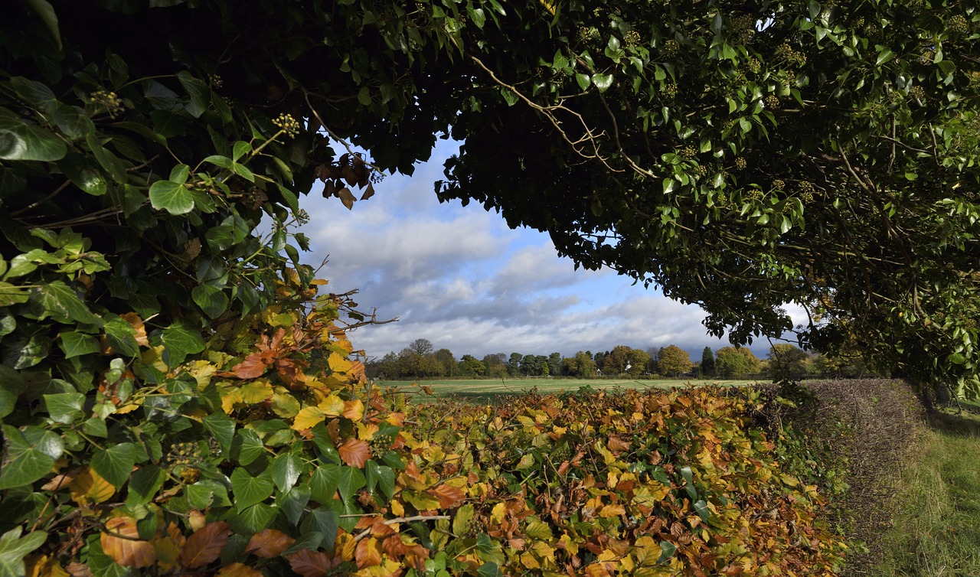
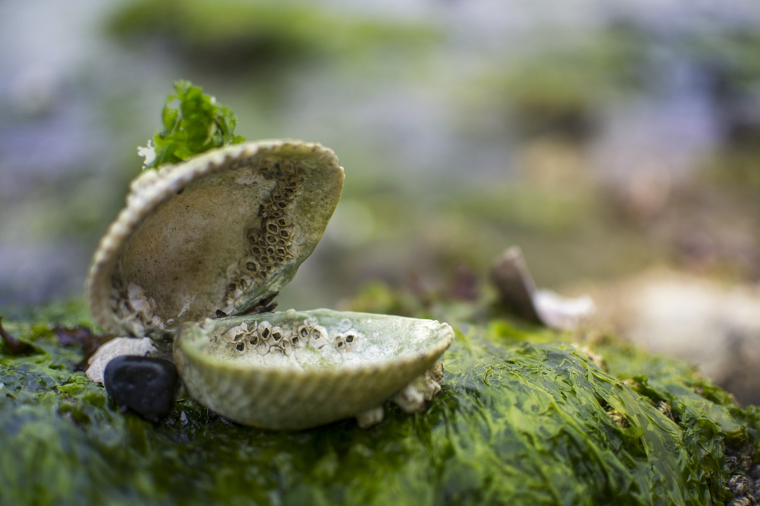
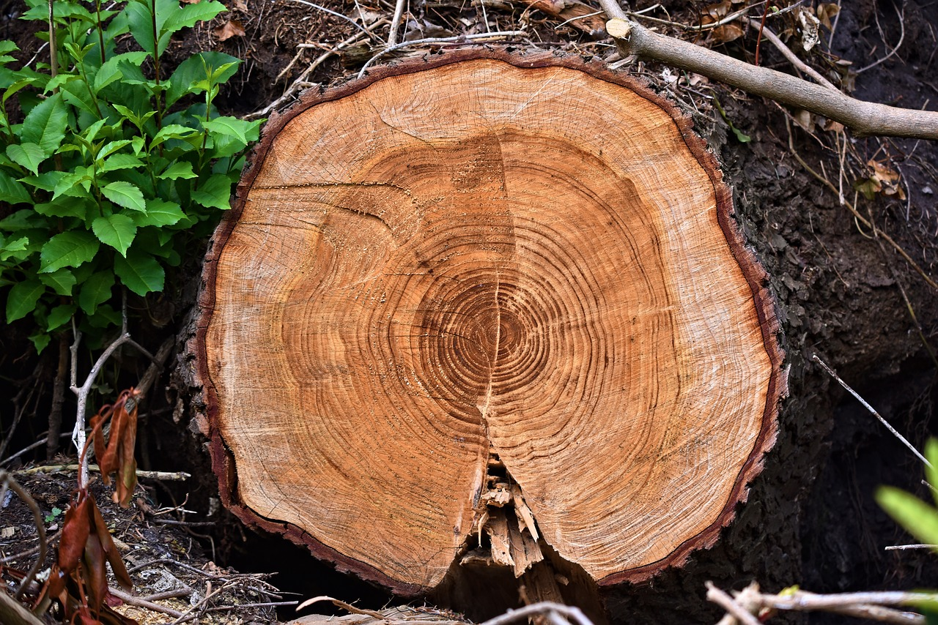
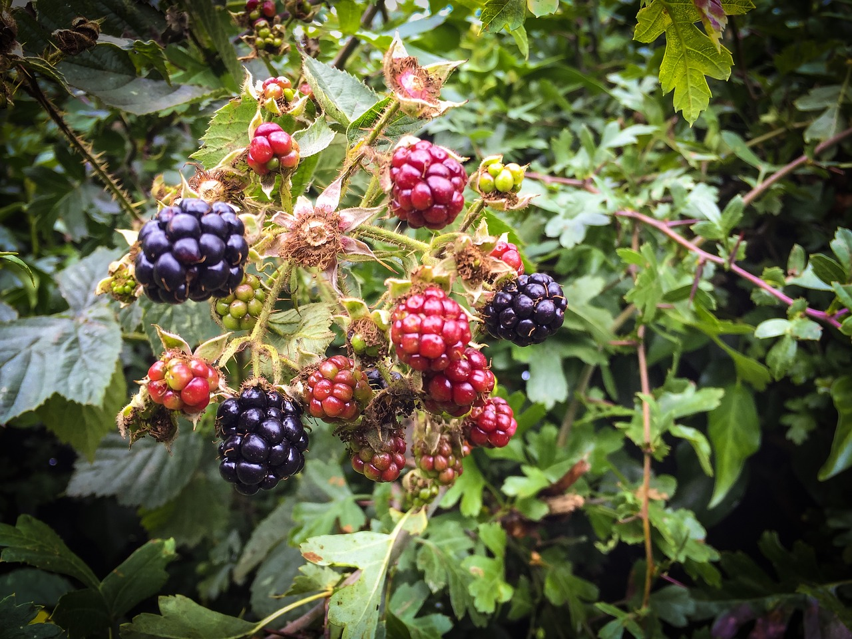
Walls
Leaves
What habitats can you see in your area?
Here are some examples of micro-habitats.
Hedgerows
Logs and tree stumps
Rockpools
19
© Young Citizens

Slide 20
The UK has wonderful habitats but there is a problem...
20
© Young Citizens
Notes:
Photos:
Description English: Sphagnum Bog, Ponsonby Fell. Close to the summit - a small raised bog.
Date 14 January 2006 Source From geograph.org.uk Author Bob Jenkins Attribution (required by the license) Bob Jenkins / Sphagnum Bog, Ponsonby Fell / CC BY-SA 2.
Description English: Gorse and heather on Yew Tree Heath, New Forest. Looking towards Woodfidley (the tree covered hill in the distance), with gorse and blooming heather in the foreground. The light green areas are dried-out boggy bottoms.
Date 21 August 2006 Source From geograph.org.uk Author Jim Champion Attribution (required by the license) Jim Champion / Gorse and heather on Yew Tree Heath, New Forest / CC BY-SA 2.0
https://pxhere.com/en/photo/1028420
https://www.goodfreephotos.com/england/other-england/cumbria-uk-landscape-with-lake-and-mountains.jpg.php
Description English: Blow out, Camber Sands Sand Dune Erosion as removed the marram grass & exposed the sand to the wind.
Date 16 September 2009 Source From geograph.org.uk Author Nigel Chadwick

Slide 21
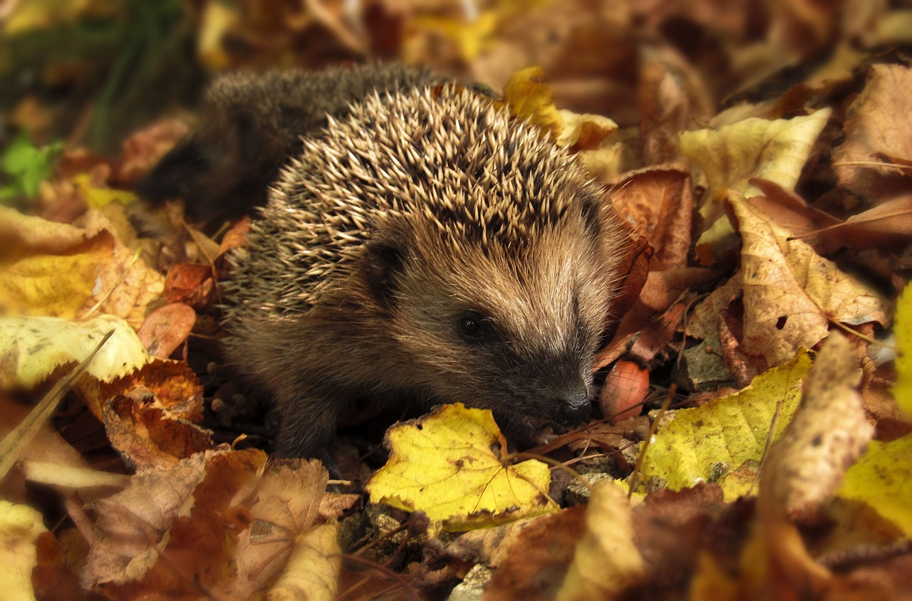
Role play shrinking habitats to learn more!
21
© Young Citizens

Slide 22
Humans are building on habitats.
Towns and cities are growing.
Other habitats are shrinking.
22
© Young Citizens

Slide 23
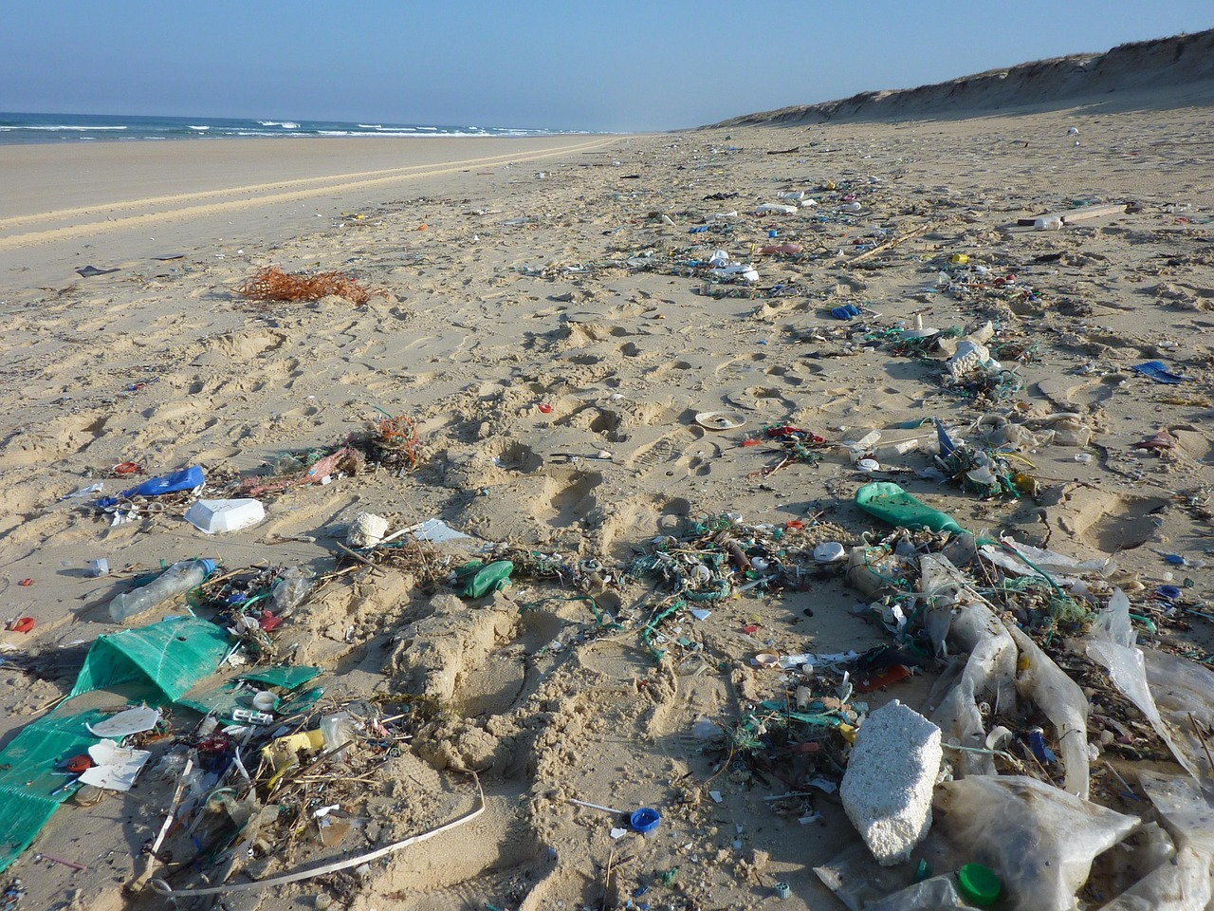
Humans are polluting habitats.
Rubbish is harming the plants and animals who live in a habitat.
23
© Young Citizens

Slide 24
But humans can also help habitats!
Look at the following examples.
What could you do?
24
© Young Citizens

Slide 25
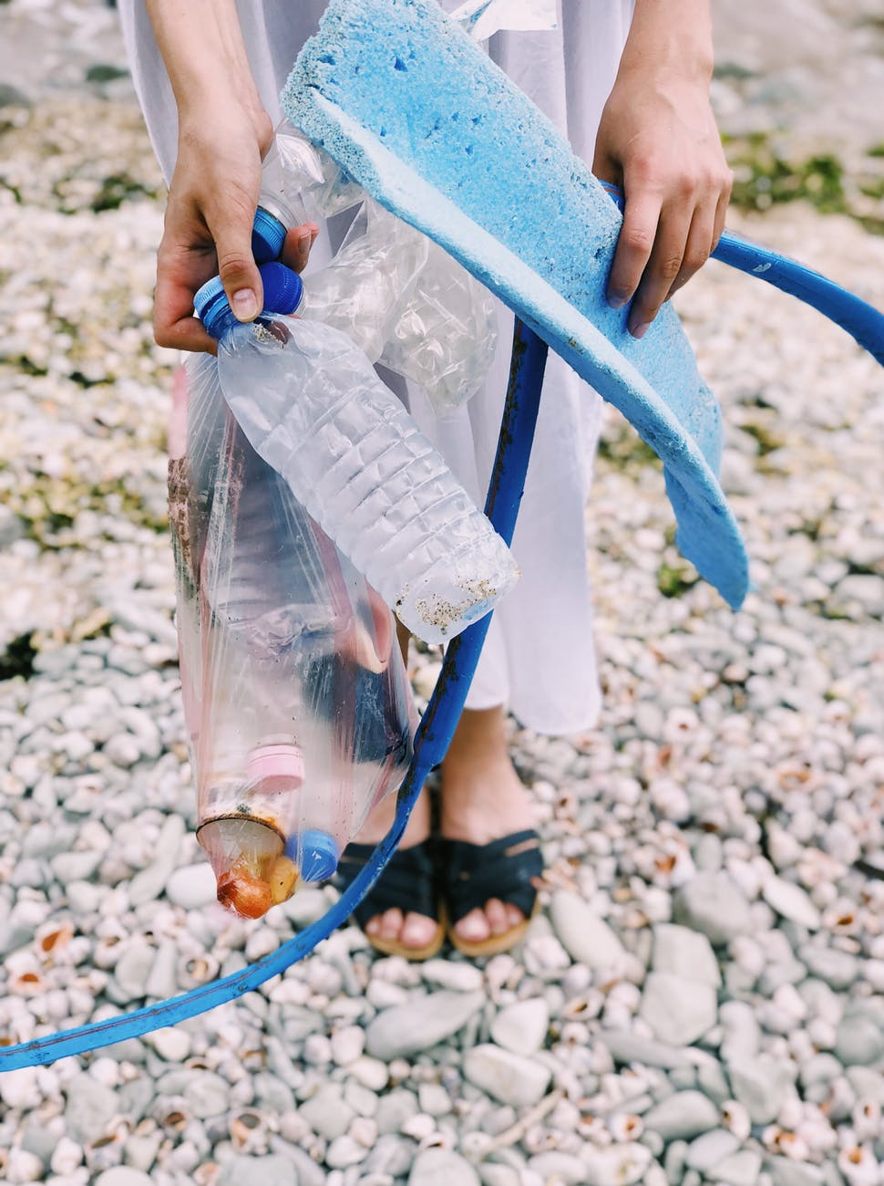
Help keep a habitat clean.
Litter picks are great!
25
© Young Citizens

Slide 26
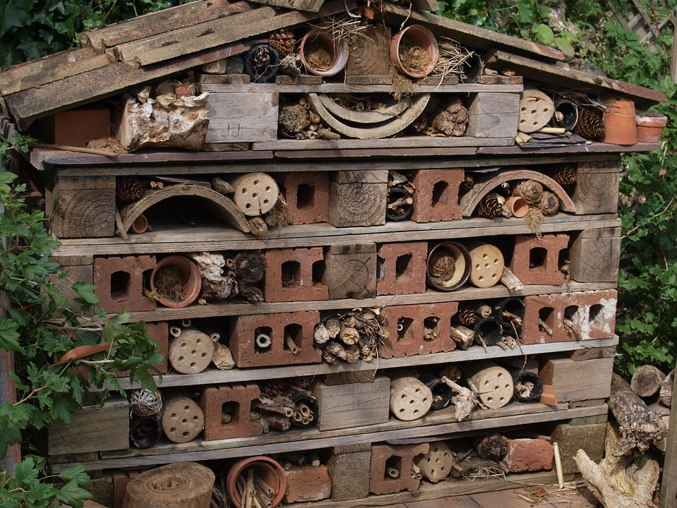
Create
micro-habitats in your school playground, parks and gardens.
Like this amazing bug hotel!
26
© Young Citizens

Slide 27
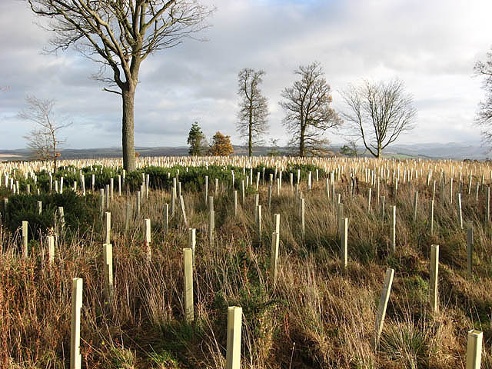
Support people and charities who care for and grow big habitats.
Look at all these newly planted trees!
27
© Young Citizens
Notes:
https://www.geograph.org.uk/photo/625802
© Copyright Walter Baxter and licensed for reuse under this Creative Commons Licence.

Slide 28
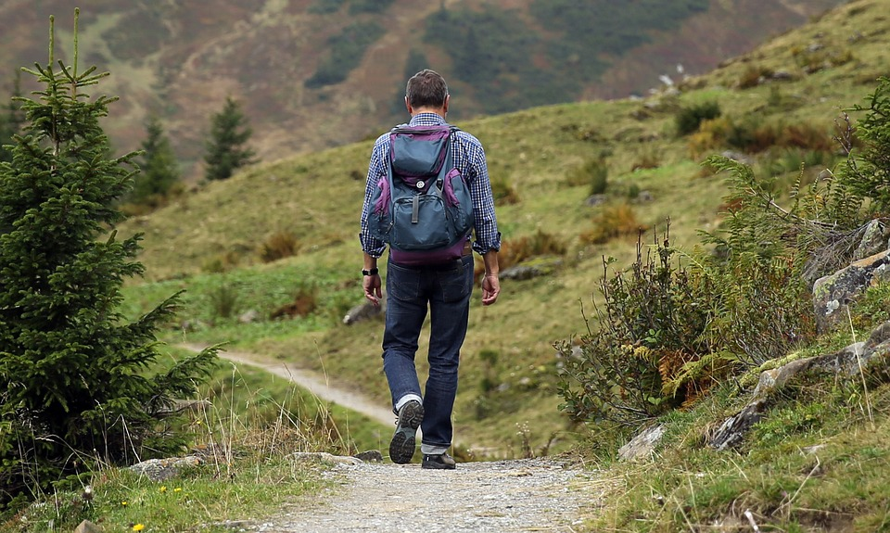
Don’t disturb habitats.
Stick to the paths when you are exploring wild areas.
28
© Young Citizens

Slide 29
Learn about habitats and teach others about the wonderful wildlife we could lose.
29
© Young Citizens

Slide 30
What will you do to help a habitat?
30
© Young Citizens

