Slide 1
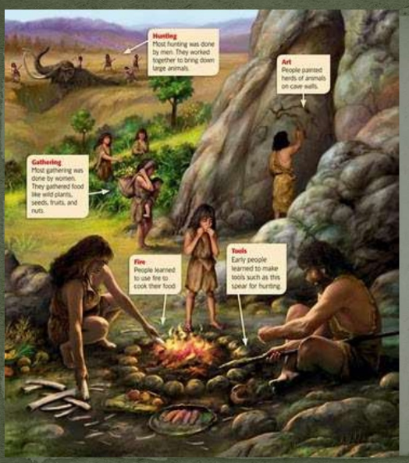
Describe a setting
What activities
can you see
happening in
the picture?
Hunting
Cave for shelter
Gathering food
Fire
Tools
How is this
different to
your home?
Stone Age people were the first people to settle and to survive by using the land. When they set up camp they required only basics to survive shelter, warmth and food.

Slide 2

Lets recap our learning on sentences
Rachael wrote the email.
The subject is Rachael because it is about her.
The verb is Rachael because it is about her.
Sophie walked down the street.
I looked for John and Sam in the playground.
Jack and Mark went home and waited for their parents to arrive.

Slide 3


Slide 4
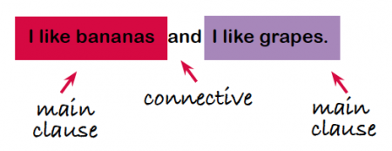
Example compound sentence:
We also use compound sentences so we can improve the flow
of our words.

Slide 5
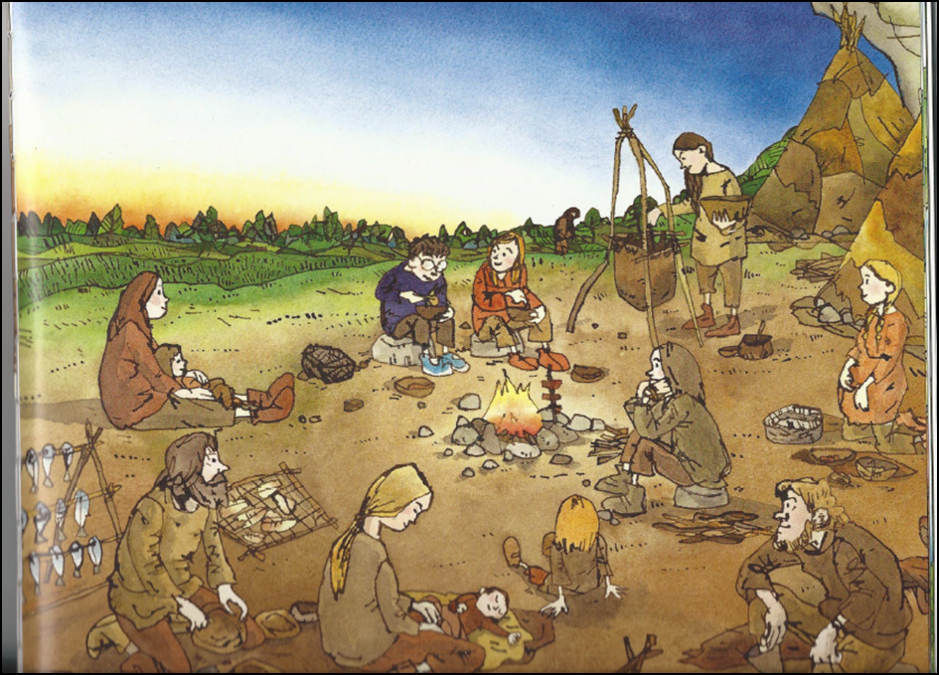
Topic vocabulary
fire flint stone
fish spit tools
clay pot animal
hind camp cave
animal skins shelter
Lets look at the picture. What is going on?
The woman is changing the baby's clothes.
The boy ate his stew while Om smiled at him.
The man, who had a bushy brown beard, shaped clay into bowls.

Slide 6
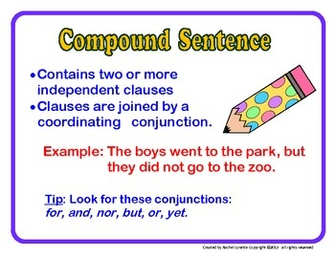
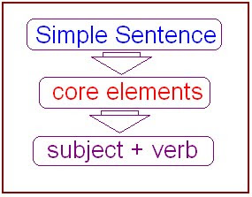
Describe the setting
Yellow Challenge Use the writing template to write your
Simple and compound sentences. Try to include expanded noun phrases
Green Challenge
Stick the picture in your books.
Use a range of
simple, compound and complex sentences. Use a variety for effect.
Remember to include expanded noun phrases
Red Challenge
Use the writing template and include simple sentences in your work
Topic vocabulary
fire flint stone
fish spit tools
clay pot animal
hind camp cave
animal skins shelter
Challenge – use a thesaurus to up-level your word choice.

