Slide 1

https://vimeo.com/491282075

Slide 3





Use the number 2, 12 and 24 to complete
the fact family.
2) 1 $×$ 18 $=$
2 $×$ 9 $=$
3 $×$ 6 $=$
3) Double 28
$× =$
$× =$
$÷ =$
$÷ =$

Slide 4
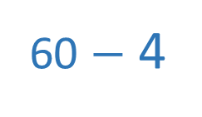
Use the number 2, 12 and 24 to complete
the fact family.
2) 1 $×$ 18 $=$
2 $×$ 9 $=$
3 $×$ 6 $=$
3) Double 28
$× =$
24
$× =$
2
12
12
2
24
$÷ =$
2
$÷ =$
24
12
24
2
12
18
18
18
56
60 $−$ 4

Slide 6

What is a factor?
factor
2 rows of 3 are equal to 6
2 × 3 = 6
factor
product
3 columns of 2 are equal to 6
3 × 2 = 6
2 and 3 are factors of 6
Have a think
Are there any other factors of 6?

Slide 7
factor
1 row of 6 is equal to 6
1 × 6 = 6
factor
product
6 columns of 1 are equal to 6
6 × 1 = 6
1 and 6 are factors of 6
The factors of 6 are: 1, 2, 3 and 6

Slide 8
Using counters, make arrays to find all the factors of 24
factor
1 and 24
Have a think
1 × 24 = 24
factor
product

Slide 9
Using counters, make arrays to find all the factors of 24
factor
1 and 24
2 × 12 = 24
2 and 12
factor
product

Slide 10
Using counters, make arrays to find all the factors of 24
factor
1 and 24
1 × 24 = 24
2 and 12
3 and 8
factor
product
4 and 6

Slide 11

Using counters, make arrays to find all the factors of 24
factor
1 and 24
1 × 24 = 24
2 and 12
3 and 8
factor
product
4 and 6

Slide 12
Have a go at questions
1 - 2 on the worksheet

Slide 13
18 × 1
9 × 2
Factor pair
18
3 × 6
6 × 3
The factors of 18 are: 1, 2, 3, 6, 9 and 18

Slide 14
Have a go at questions
3 - 4 on the worksheet

Slide 15

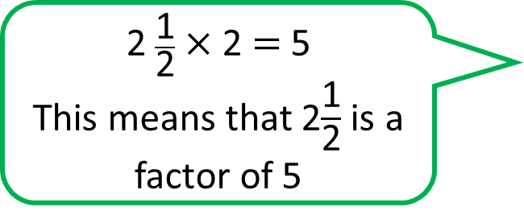
2 $\frac{\text{1}}{\text{2}}$ × 2 = 5
This means that 2$\frac{\text{1}}{\text{2}}$is a factor of 5
Factors have to be integers (whole numbers).
Have a think
What are the factors of 5?
1 and 5

Slide 16
List the factors of these numbers:
5
2
17
What do you notice?
29
1 and 5
Have a think
1 and 2
What other numbers can you find with only have 2 factors?
1 and 17
1 and 29
They all only have 2 factors

Slide 17
5
6
2
24
17
18
29
There is always
an even number
of factors
Have a think
1 and 5
1 and 6
2 and 3
1 and 2
1 and 24
2 and 12
3 and 8
1 and 17
4 and 6
1 and 18
1 and 29
2 and 9
3 and 6

Slide 18
25 × 1
25
5 × 5
1, 5, 5 and 25
1, 5 and 25
The factors of 25 are: _________________
What other numbers can you find with an odd number of factors?

Slide 19
Have a go at the rest of the worksheet

