Slide 2
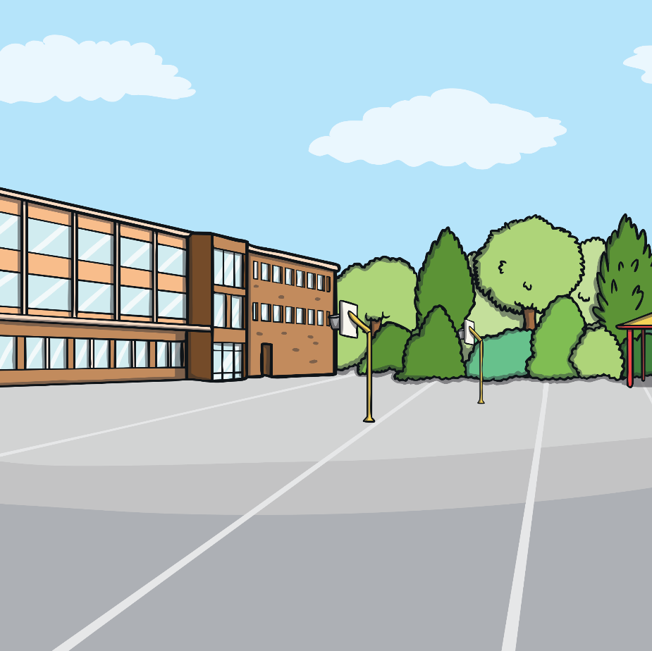
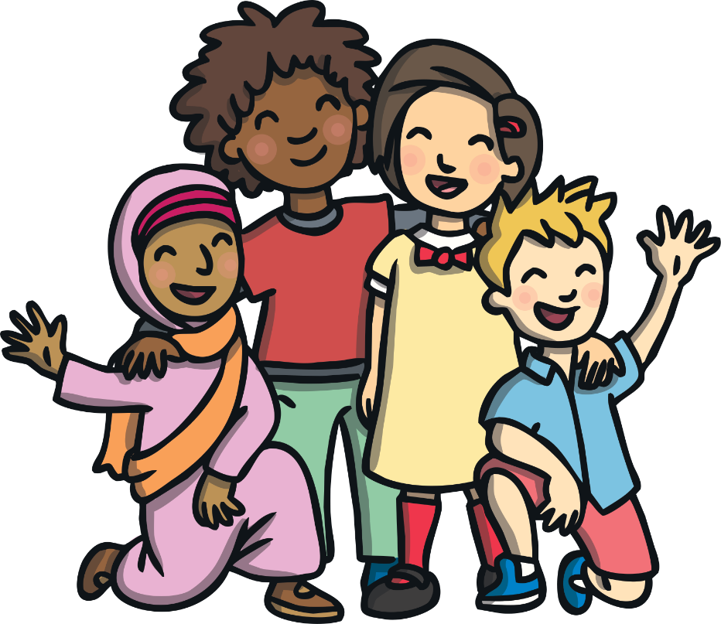
Friends
Friends are very special.
Who are your friends?
What do you like doing together?
Today we are going to learn
about a group of people who did
something very special for their
friend.

Slide 3
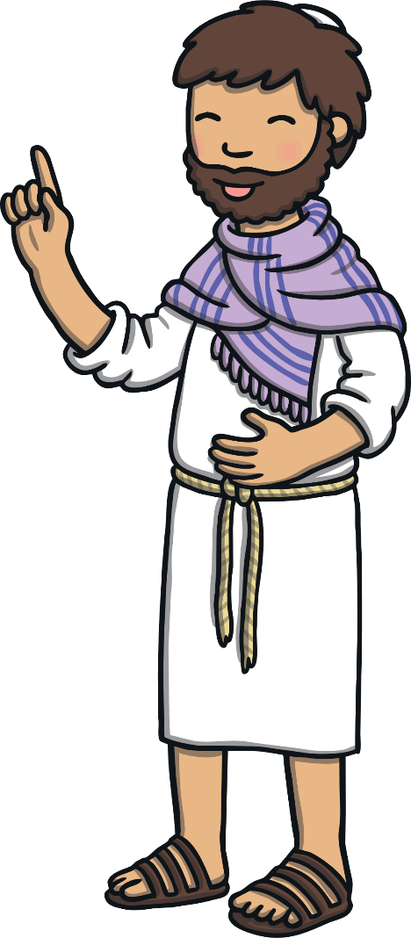
Who Was Jesus?
Talk
About
It
What do you already know about Jesus?
Tell a partner.
Jesus is a very important person to Christians. They
believe Jesus is the son of God and that he did many wonderful things when he lived on earth.
Christians believe that Jesus performed miracles. A miracle is a
special action which can’t be explained in a normal way.
Christians believe that Jesus performed miracles such as:
feeding 5000 people
helping a blind man to see
bringing a girl back to life

Slide 4
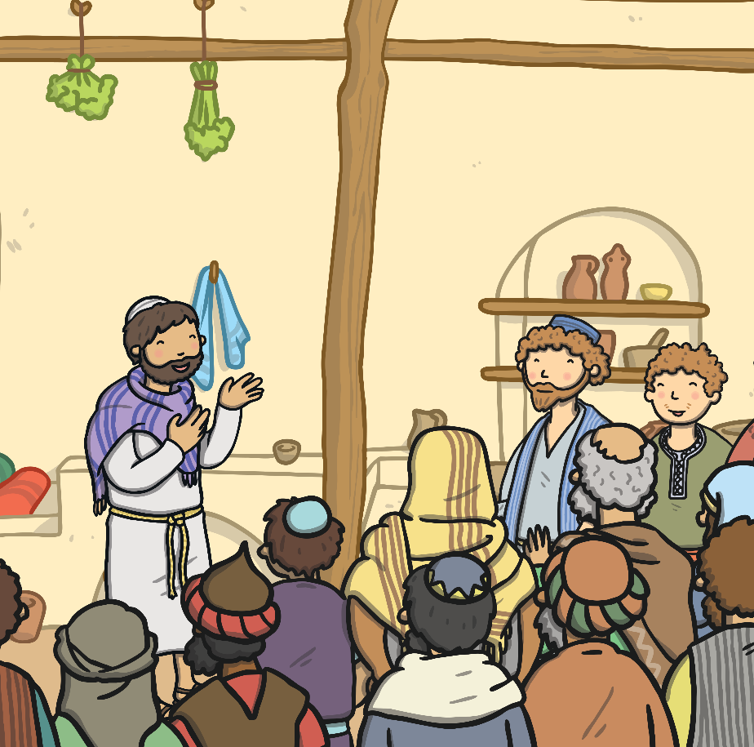
Everyone Wants to See Jesus
Wherever Jesus went, huge crowds of people followed him. They were interested to see what he would do next!
One day, Jesus was in a house in a town called Capernaum. A lot of people wanted to meet him, so many that the house soon filled up with people. There was no room at all, even the doorway to the house was filled with people wanting to hear Jesus speak.

Slide 5
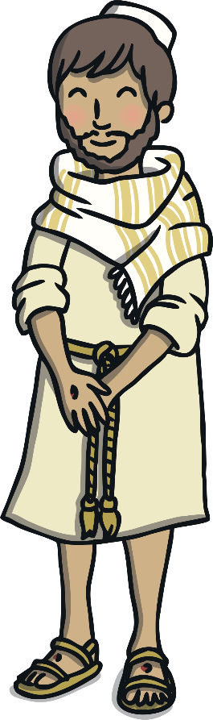
The Paralysed Man
Among the people who wanted to see Jesus was a paralysed man. Paralysed means he couldn’t walk or use his legs at all. This meant that the man had no way of getting to Jesus through the crowds of people.
Talk
About
It
How do you think the man felt?
Talk
About
It
Today, most buildings are designed so disabled people can get to all the different places. Are there any parts of your school that have been specially designed to help disabled people?

Slide 6
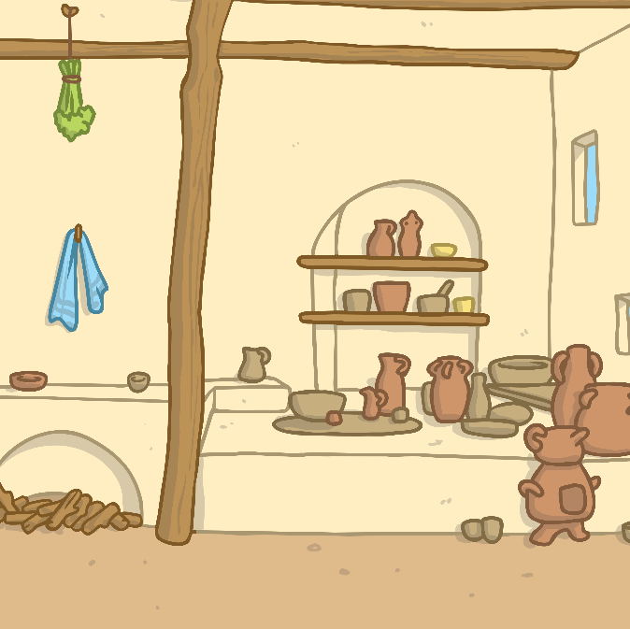
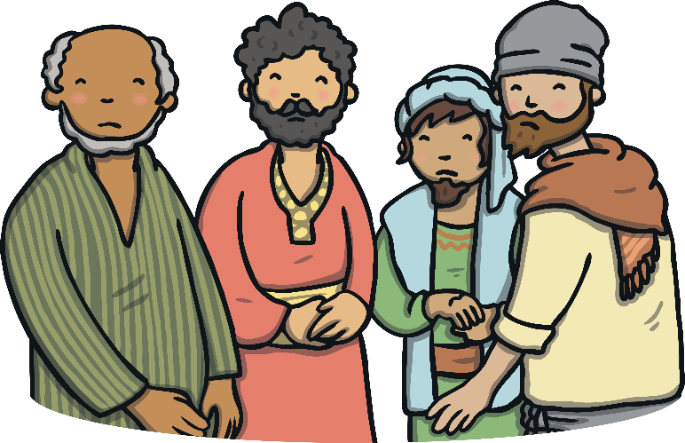
An Idea
The man’s friends knew he felt sad. They wanted to help their friend. All of a sudden, one of them had an idea. He gathered his friends together and whispered his plan to them.
“That sounds crazy!”
laughed one of them.
“There’s no way it’ll work,”
stated another.
“Let’s try it!” said another,
“We need to help our friend get to Jesus.”
Talk
About
It
Tell your partner about a time you helped a friend.

Slide 7

What Is Happening?
Inside the room where Jesus was talking, there was a loud noise.
Dust and bits of the ceiling started falling to the ground.
Everyone looked up in amazement to see spades
appearing through the ceiling, digging a hole!
Suddenly, there was a rectangle-shaped hole in
the ceiling.
Talk
About
It
Can you guess what the friends’ plan was?

Slide 8
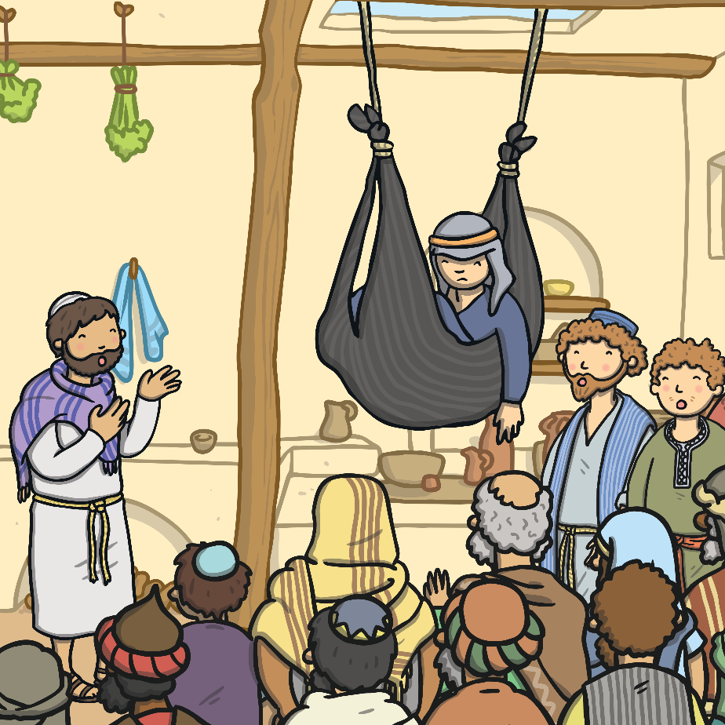
Who Is That?
A face appeared at each corner of the hole. Then, people watched a mat being lowered by ropes through the hole. Laying on the mat was the paralysed man.
As the man’s friends gently lowered him to the floor, the crowd of people made space.

Slide 9
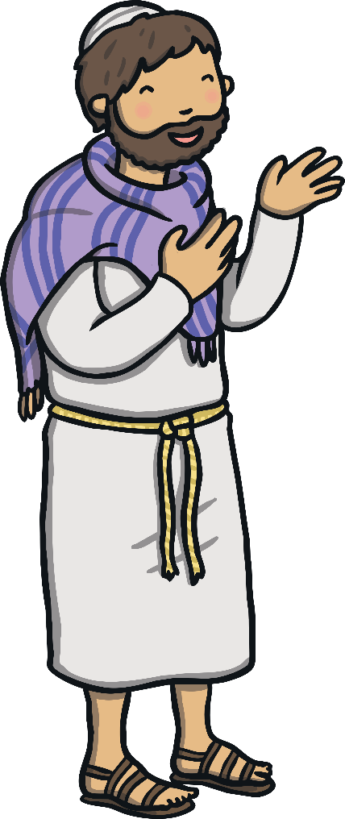
What Did Jesus Do?
Jesus walked up to the paralysed man and then looked up through the hole in the ceiling. Jesus was very pleased with what the friends had done.
He looked at the paralysed man and said, “You are forgiven for everything you have done wrong.”

Slide 10
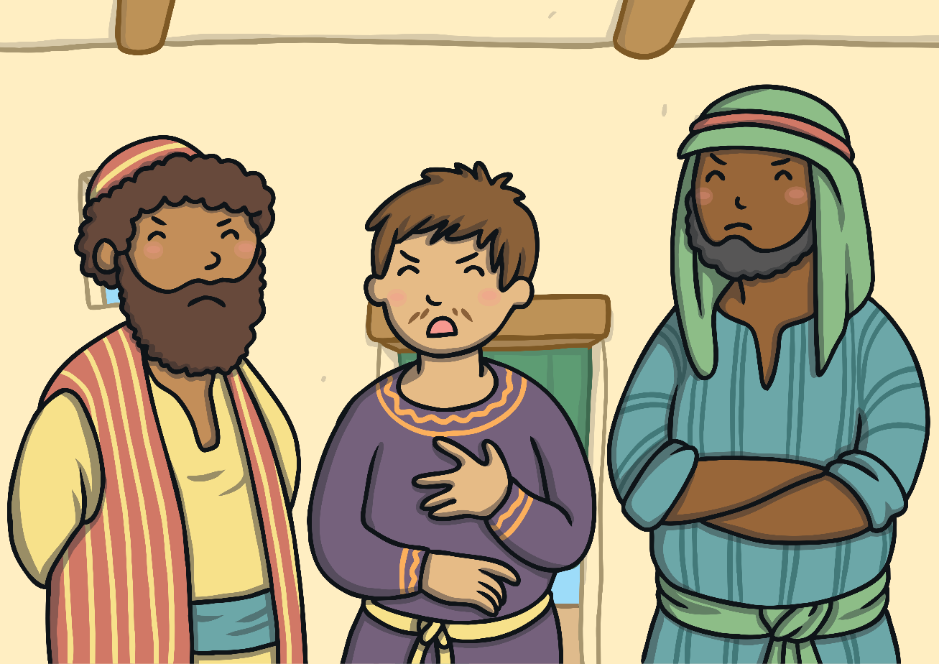
Some People Are Cross
Some important people were watching what had happened.
“Who does Jesus think he is?” thought one of them angrily.
“Only God can tell people they are forgiven for the wrong things they
have done!” thought another person.

Slide 11
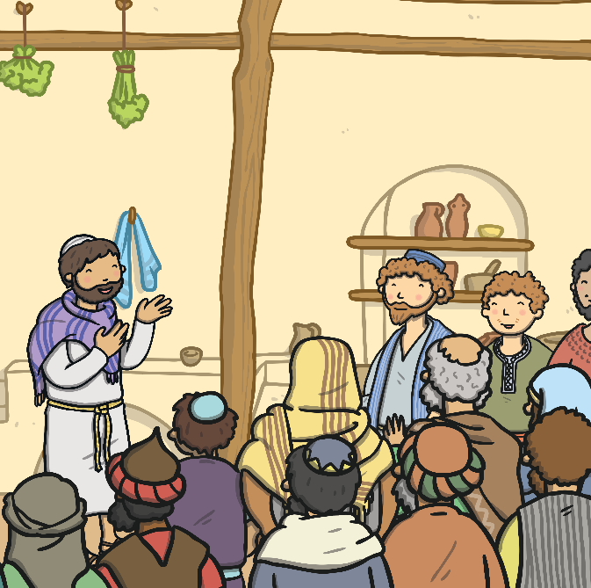
Jesus Knows
Jesus was very special so he knew what the important people were thinking.
“Why are you thinking these things?” he asked.
“What would be easier for me to say?
You are forgiven or get up and walk?”
Talk
About
It
What do you think is going to happen next?

Slide 12
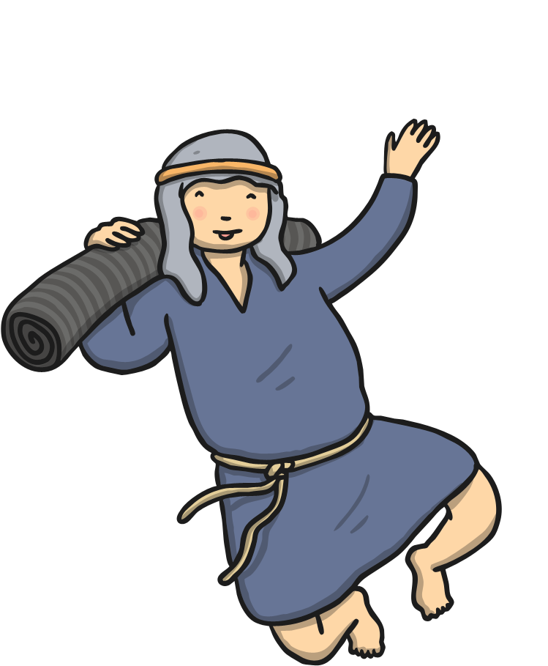
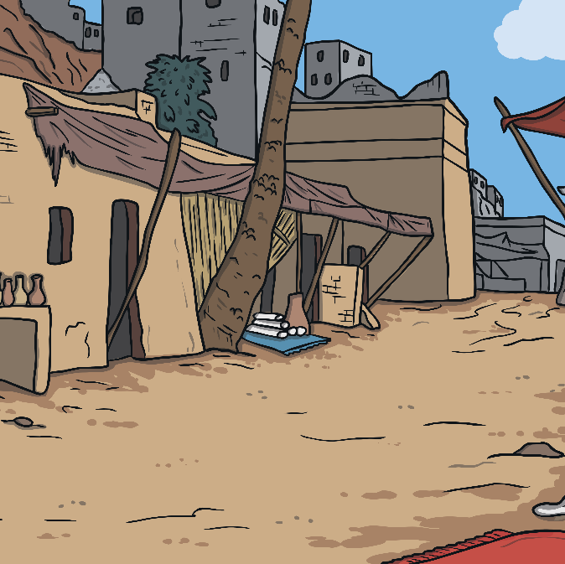
Get Up!
Jesus turned to the paralysed man lying on his mat and said, “Get up, take your mat and walk home.”
To the astonishment of everyone watching, the man did exactly that! He was able to get up by himself and walk.
Talk
About
It
How do you think the man felt?

Slide 13
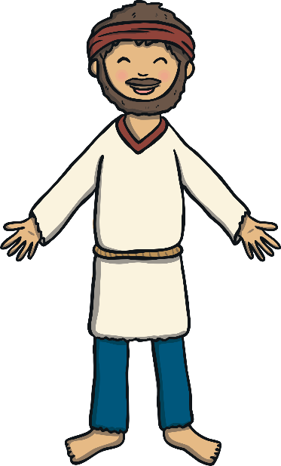
Everyone Is Amazed
“We have never seen anything like this before!” cheered one person.
“God is good!” said another.
It was a very special day.
Talk
About
It
What do you think the man said to Jesus and his friends who had helped him?

