Slide 1
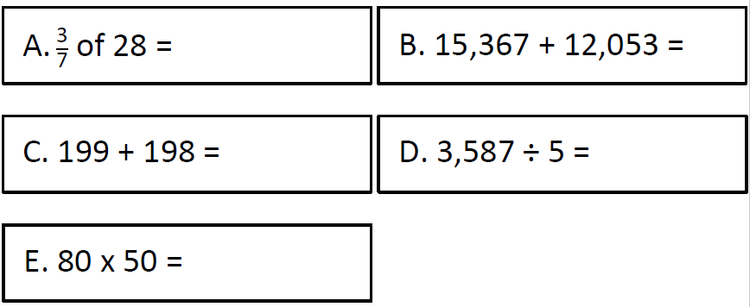
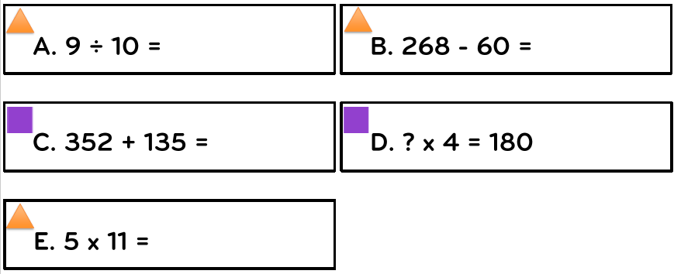
Yellow Green
Red

Slide 3
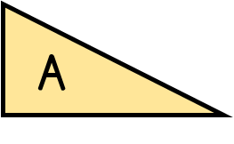
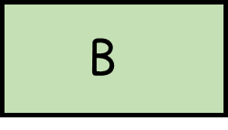
Year 4 | Week 6 | Day 2

Slide 5
1) 5 $−$ 3 $=$
5 thousands $−$ 3 thousands $=$
2) What is the difference between 9 and 3?
3) When adding fractions, add the
and keep the the same.
4) $\frac{\text{3}}{\text{9}}$ $=$ $\frac{\text{1}}{\text{3}}$ $\frac{\text{6}}{\text{10}}$ $=$ $\frac{\text{3}}{\text{5}}$

Slide 6
1) 5 $−$ 3 $=$
5 thousands $−$ 3 thousands $=$
2) What is the difference between 9 and 3?
3) When adding fractions, add the
and keep the the same.
4) $\frac{\text{3}}{\text{9}}$ $=$ $\frac{\text{1}}{\text{3}}$ $\frac{\text{6}}{\text{10}}$ $=$ $\frac{\text{3}}{\text{5}}$
2
2 thousands
6
numerators
denominators
1
3
5

Slide 8
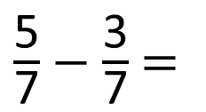
$\frac{\text{5}}{\text{7}}$ $−$ $\frac{\text{3}}{\text{7}}$ $=$
$\frac{\text{2}}{\text{7}}$
Have a think
Reduction – when something is being removed or taken away.

Slide 9
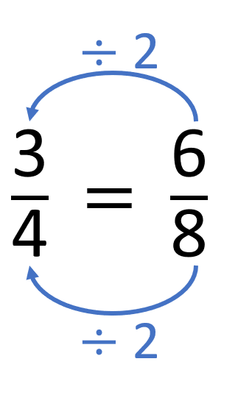
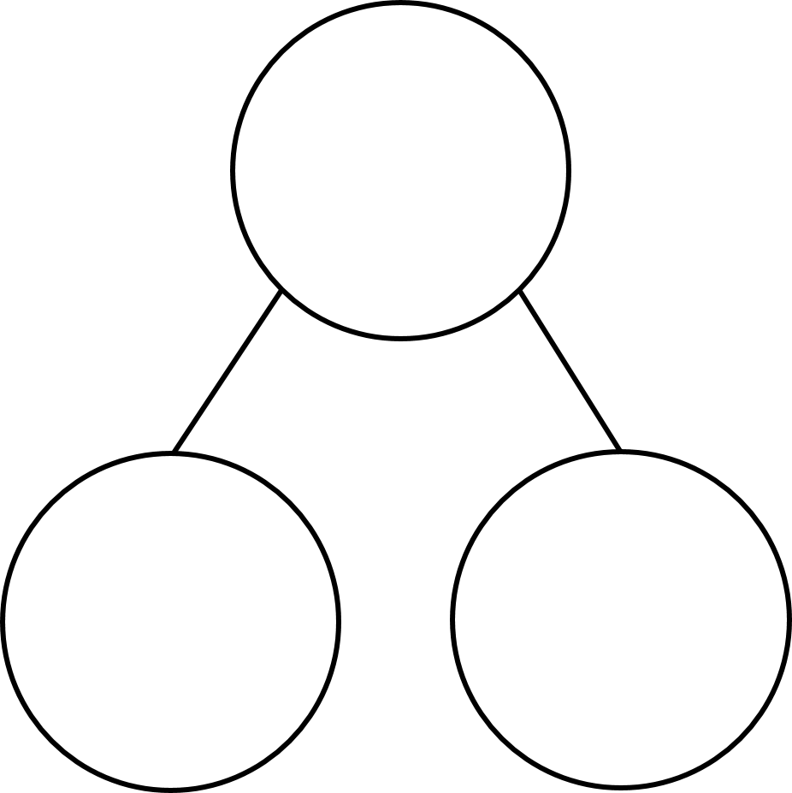
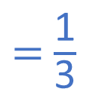
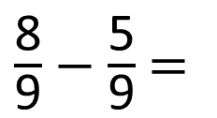
$\frac{\text{8}}{\text{9}}$ $−$ $\frac{\text{5}}{\text{9}}$ $=$
$\frac{\text{3}}{\text{9}}$
$=$ $\frac{\text{1}}{\text{3}}$
Have a think
$\frac{\text{8}}{\text{9}}$
Partitioning – splitting the whole into two or more parts
$\frac{\text{5}}{\text{9}}$
$\frac{\text{3}}{\text{9}}$

Slide 10
Have a go at questions 1 – 5 on the worksheet

Slide 11
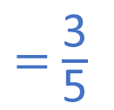

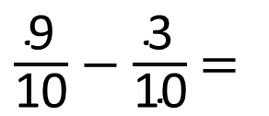
$\frac{\text{9}}{\text{10}}$ $−$ $\frac{\text{3}}{\text{10}}$ $=$
$\frac{\text{6}}{\text{10}}$
$=$ $\frac{\text{3}}{\text{5}}$
Have a think
Difference – a comparison between two sets - how much more or less/fewer

Slide 12
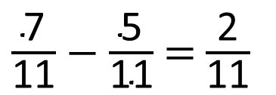
5
$\frac{\text{7}}{\text{11}}$ $−$ $\frac{\text{5}}{\text{11}}$ $=$ $\frac{\text{2}}{\text{11}}$
Have a think

Slide 13
10
$\frac{\text{10}}{\text{11}}$ $−$ $\frac{\text{3}}{\text{11}}$ $=$ $\frac{\text{2}}{\text{11}}$ $+$ $\frac{\text{5}}{\text{11}}$
Have a think

Slide 14
Have a go at the rest of the questions on the worksheet

