Slide 1


Slide 3
How many tenths in 1?
How many hundredths in 1?
How many hundredths in 1 tenth?
Write 1 tenth as a decimal?

Slide 4
How many tenths in 1?
How many hundredths in 1?
How many hundredths in 1 tenth?
Write 1 tenth as a decimal?
10
100
10
0.1

Slide 6

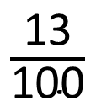
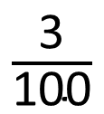
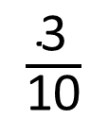
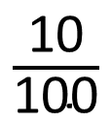
Match the representations to the numbers.
$\frac{\text{10}}{\text{100}}$
$\frac{\text{3}}{\text{10}}$
1
$\frac{\text{3}}{\text{100}}$
$\frac{\text{13}}{\text{100}}$
Represent the numbers using place value counters.
Can any of the numbers be shown in more
than one way?
Have a think

Slide 7
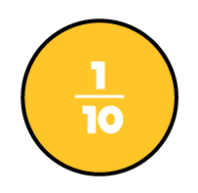

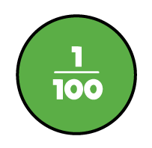
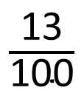
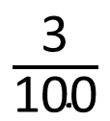
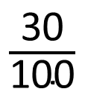
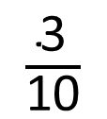
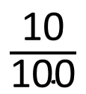
$\frac{\text{3}}{\text{100}}$
$\frac{\text{3}}{\text{10}}$
1
$\frac{\text{10}}{\text{100}}$
$\frac{\text{13}}{\text{100}}$
$\frac{\text{30}}{\text{100}}$

Slide 8
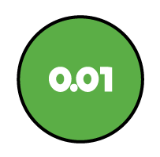

$\frac{\text{3}}{\text{100}}$
1
$\frac{\text{10}}{\text{100}}$
$\frac{\text{3}}{\text{10}}$
.0
$\frac{\text{13}}{\text{100}}$
0.03
0.3
How do you write these numbers as decimals?

Slide 9
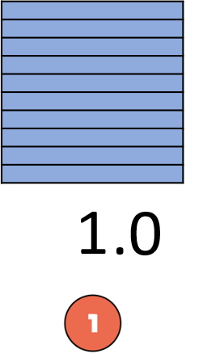
$\frac{\text{10}}{\text{100}}$
0.010
0.1

Slide 10
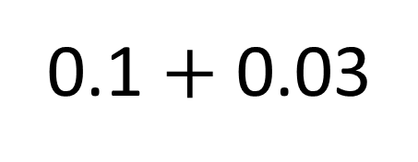
$\frac{\text{13}}{\text{100}}$
0.1 $+$ 0.03
0.13

Slide 11
Have a go at questions 1 - 3 on the worksheet

Slide 12
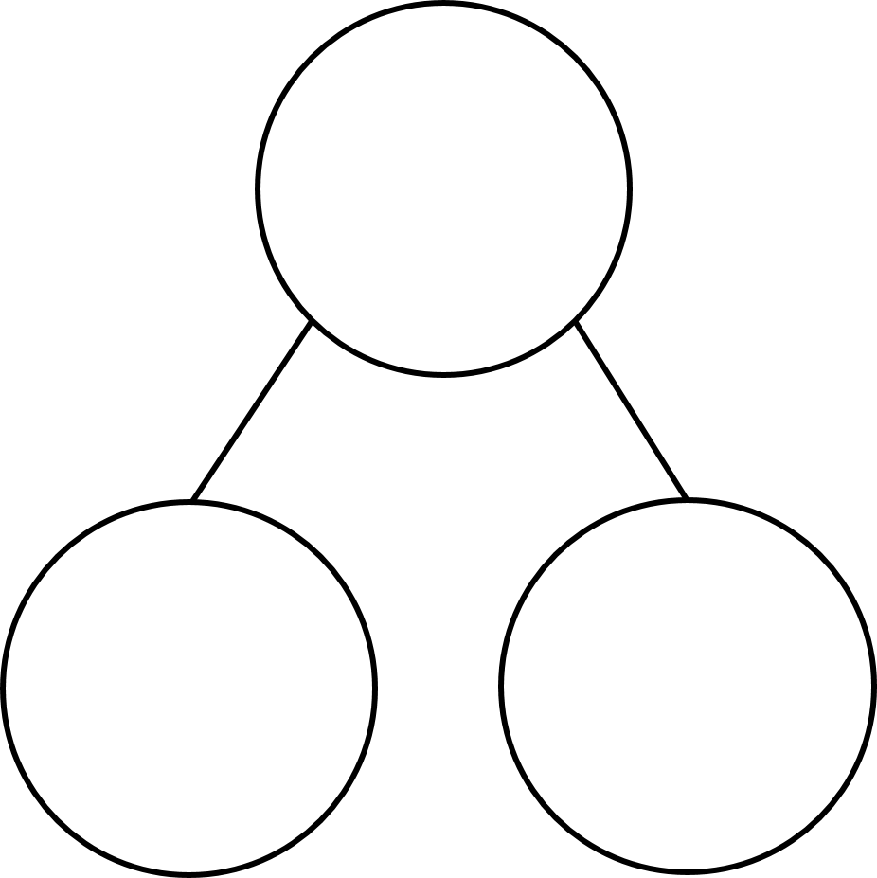


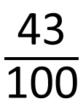


How many different ways can you write and represent forty three hundredths?
Have a think
$\frac{\text{43}}{\text{100}}$
0.43
$\frac{\text{43}}{\text{100}}$
0.43
$\frac{\text{4}}{\text{10}}$
$\frac{\text{3}}{\text{100}}$
$\frac{\text{40}}{\text{100}}$
0.4
0.03

Slide 13
How many different ways can you partition forty three hundredths as decimals?
Have a think
0.43
0.43
0.43
0.43
0.4
0.03
0.3
0.13
0.2
0.23
0.1
0.33

Slide 14
Have a go at the rest of the questions on the worksheet

