Slide 3
Which shape has one half shaded?
2) Which shape has one third shaded?
3) Which shape has one quarter shaded?

Slide 4
Which shape has one half shaded?
2) Which shape has one third shaded?
3) Which shape has one quarter shaded?

Slide 6
What fraction of these squares has been shaded?
numerator
1
How many parts are shaded?
denominator
4
How many equal parts?

Slide 7
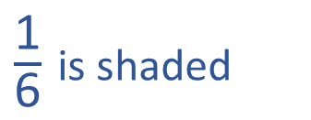
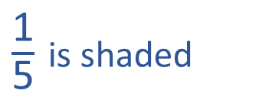
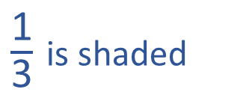
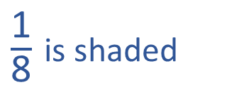
Can you see what fraction of each shape is shaded?
Have a think
$\frac{\text{1}}{\text{3}}$ is shaded
$\frac{\text{1}}{\text{5}}$ is shaded
1
3
1
5
___ out of ___
equal parts is shaded.
___ out of ___
equal parts is shaded.
$\frac{\text{1}}{\text{6}}$ is shaded
$\frac{\text{1}}{\text{8}}$ is shaded
1
6
1
8
___ out of ___
equal parts is shaded.
___ out of ___
equal parts is shaded.

Slide 8
$\frac{\text{1}}{\text{3}}$ is shaded
$\frac{\text{1}}{\text{5}}$ is shaded
What’s the same?
What’s different?
These fractions all have a numerator of 1
These are called unit fractions.
$\frac{\text{1}}{\text{6}}$ is shaded
$\frac{\text{1}}{\text{8}}$ is shaded

Slide 9
Numerator
1
How many parts we are looking at?
of the shapes are triangles.
4
Denominator
How many equal parts are there?
Have a think
1
of the shapes are green.
5

Slide 10
A unit fraction is a fraction where the numerator is 1
1
4
?
Have a think
Does this represent a unit fraction?

Slide 11
A unit fraction is a fraction where the numerator is 1
1
2
?
Have a think
Does this represent a unit fraction?

Slide 12
A unit fraction is a fraction where the numerator is 1
1
?
Have a think
Does this represent a unit fraction?
1
2

Slide 13
A unit fraction is a fraction where the numerator is 1
1
?
Have a think
Does this represent a unit fraction?
1
10

Slide 14
A unit fraction is a fraction where the numerator is 1
1
?
Have a think
Does this represent a unit fraction?
1
73

Slide 15
A unit fraction is a fraction where the numerator is 1
1
?
Have a think
Does this represent a unit fraction?
2
73

Slide 16
A unit fraction is a fraction where the numerator is 1
1
?
Have a think
Does this represent a unit fraction?
2
3

Slide 17
A unit fraction is a fraction where the numerator is 1
1
?
Have a think
Does this represent a unit fraction?

Slide 18
A unit fraction is a fraction where the numerator is 1
1
3
?
Have a think
Does this represent a unit fraction?

Slide 19
A unit fraction is a fraction where the numerator is 1
1
3
?
Have a think
Does this represent a unit fraction?
2
6

Slide 20
A unit fraction is a fraction where the numerator is 1
1
2
?
Have a think
Does this represent a unit fraction?
3
6

Slide 21
Have a go at the questions on the worksheet

