Slide 3
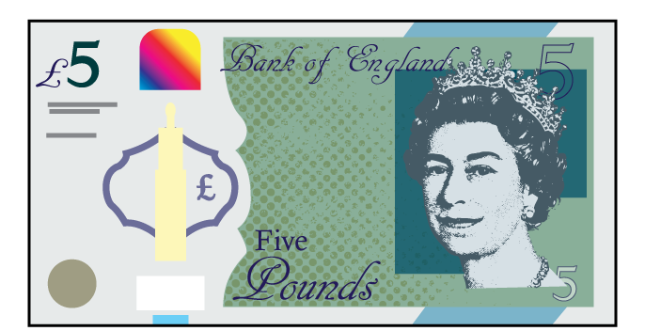

1) Use $<, >$ or $=$ to complete the comparisons.
5 kg 2kg
3 apples 7 apples
Look at the fractions below.
What’s the same? What’s different?

Slide 4
1) Use $<, >$ or $=$ to complete the comparisons.
5 kg 2kg
3 apples 7 apples
Look at the fractions below.
What’s the same? What’s different?
$$>$$
$$>$$
$$<$$
$\frac{\text{1}}{\text{6}}$
$\frac{\text{1}}{\text{5}}$

Slide 6
$\frac{\text{5}}{\text{7}}$ $\frac{\text{2}}{\text{7}}$
$$>$$
$\frac{\text{5}}{\text{7}}$ is ___ $\frac{\text{2}}{\text{7}}$
greater than

Slide 7
$\frac{\text{3}}{\text{10}}$ $\frac{\text{7}}{\text{10}}$
$$<$$
$\frac{\text{3}}{\text{10}}$ is $\frac{\text{7}}{\text{10}}$
less than

Slide 8
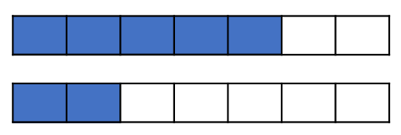
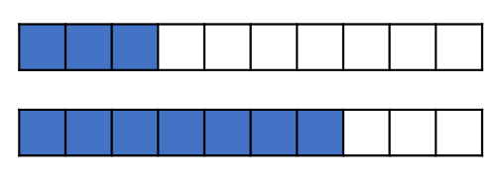
What do you notice?
When the denominators are the same,
the the numerator, the the fraction.
greater
greater
smaller
smaller
Have a think

Slide 9
Have a go at questions 1 and 2 on the worksheet

Slide 10
$\frac{\text{1}}{\text{4}}$ $\frac{\text{1}}{\text{3}}$
$$<$$
$\frac{\text{1}}{\text{4}}$ is ______ $\frac{\text{1}}{\text{3}}$
smaller than

Slide 11
Have a think
$\frac{\text{1}}{\text{7}}$ $\frac{\text{1}}{\text{5}}$
$$<$$
$\frac{\text{1}}{\text{7}}$ is ______ $\frac{\text{1}}{\text{5}}$
smaller than

Slide 12
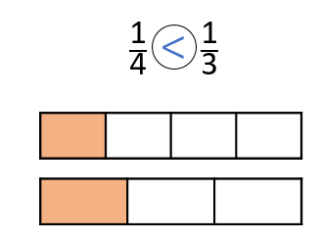
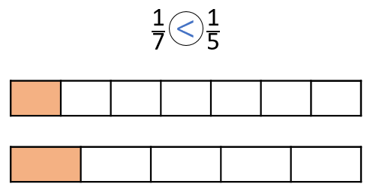
What do you notice?
When the numerators are the same,
the the denominator, the the fraction.
greater
smaller
smaller
greater
Have a think

Slide 13
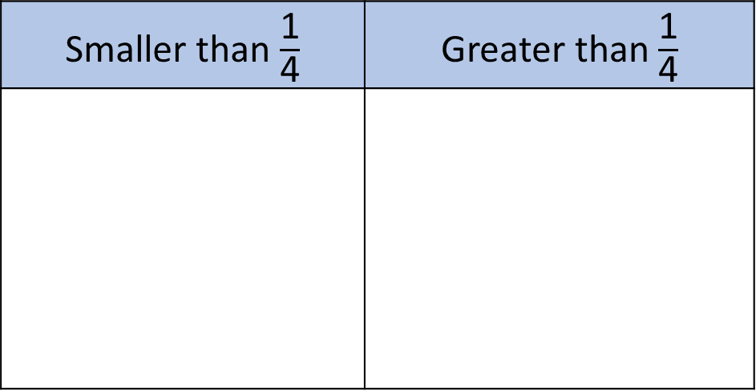

Tiny has sorted the fractions into the table.
Is Tiny correct?
Have a think
That means $\frac{\text{1}}{\text{5}}$, $\frac{\text{1}}{\text{7}}$ and $\frac{\text{1}}{\text{10}}$ are smaller than $\frac{\text{1}}{\text{4}}$
Smaller than $\frac{\text{1}}{\text{4}}$ | Greater than $\frac{\text{1}}{\text{4}}$
$\frac{\text{1}}{\text{3}}$
$\frac{\text{1}}{\text{2}}$
$\frac{\text{3}}{\text{4}}$
$\frac{\text{1}}{\text{10}}$
$\frac{\text{1}}{\text{7}}$
$\frac{\text{1}}{\text{5}}$
When the numerators are the same,
The smaller the denominator, the greater the fraction.

Slide 14
Have a go at the rest of the questions on the worksheet

