Slide 3
Complete the equivalent fractions
1)
2)
3)
$\frac{\text{1}}{\text{4}}$ $=$ $\frac{\text{2}}{\text{8}}$
$\frac{\text{1}}{\text{4}}$ $=$ $\frac{\text{3}}{\text{12}}$
$\frac{\text{3}}{\text{4}}$ $=$ $\frac{\text{9}}{\text{12}}$

Slide 4
Complete the equivalent fractions
1)
2)
3)
$\frac{\text{1}}{\text{4}}$ $=$ $\frac{\text{2}}{\text{8}}$
$\frac{\text{1}}{\text{4}}$ $=$ $\frac{\text{3}}{\text{12}}$
$\frac{\text{3}}{\text{4}}$ $=$ $\frac{\text{9}}{\text{12}}$

Slide 6
$\frac{\text{6}}{\text{7}}$ $\frac{\text{4}}{\text{7}}$
$$>$$
When the denominators are the same,
the the numerator, the the fraction.
greater
greater
smaller
smaller

Slide 7
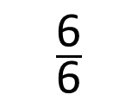
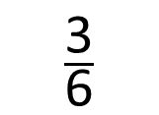
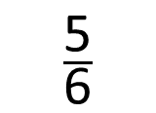
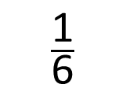
Put the fractions in order from smallest to greatest.
$\frac{\text{5}}{\text{6}}$
$\frac{\text{3}}{\text{6}}$
$\frac{\text{6}}{\text{6}}$
$\frac{\text{1}}{\text{6}}$
When the denominators are the same, the greater the numerator, the greater the fraction.
Have a think

Slide 8
Have a go at questions 1 and 2 on the worksheet

Slide 9
$\frac{\text{1}}{\text{2}}$ $\frac{\text{1}}{\text{3}}$
$$>$$
$\frac{\text{1}}{\text{9}}$ $\frac{\text{1}}{\text{5}}$
$$<$$
When the numerators are the same,
the the denominator, the the fraction.
greater
smaller
smaller
greater

Slide 10




Put the fractions in order from greatest to smallest.
When the numerators are the same, the greater
the denominator, the smaller the fraction.
$\frac{\text{1}}{\text{4}}$
$\frac{\text{1}}{\text{6}}$
$\frac{\text{1}}{\text{5}}$
$\frac{\text{1}}{\text{9}}$

Slide 11
Have a go at questions 3 and 4 on the worksheet

Slide 12
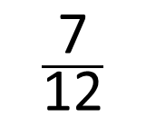
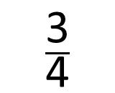
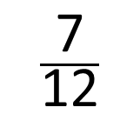
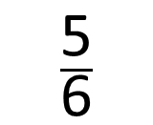
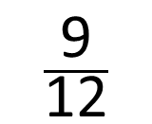
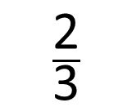
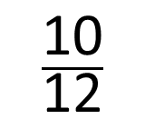
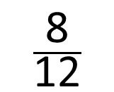
Put the fractions in order from smallest to greatest.
$\frac{\text{2}}{\text{3}}$
$\frac{\text{5}}{\text{6}}$
$\frac{\text{3}}{\text{4}}$
$\frac{\text{7}}{\text{12}}$
$\frac{\text{8}}{\text{12}}$
$\frac{\text{10}}{\text{12}}$
$\frac{\text{9}}{\text{12}}$
$\frac{\text{7}}{\text{12}}$

Slide 13
Have a go at questions 5 and 6 on the worksheet

Slide 14
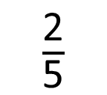
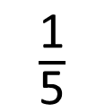
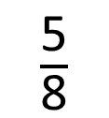
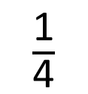
Put the fractions in order from smallest to greatest.
$\frac{\text{2}}{\text{5}}$
$\frac{\text{1}}{\text{4}}$
$\frac{\text{5}}{\text{8}}$
$\frac{\text{1}}{\text{5}}$
I know that $\frac{\text{1}}{\text{4}}$ is equivalent to $\frac{\text{2}}{\text{8}}$ and $\frac{\text{2}}{\text{8}}$ is smaller than $\frac{\text{2}}{\text{5}}$
I know that $\frac{\text{1}}{\text{5}}$ is smaller than $\frac{\text{1}}{\text{4}}$
I can put these in order without using a bar model.
Only one of these is more than $\frac{\text{1}}{\text{2}}$
so that must be the greatest.
When the numerators are the same, the greater
the denominator, the smaller the fraction.
$\frac{\text{2}}{\text{8}}$
Have a think

Slide 15
Have a go at question 7 on the worksheet

