Slide 3
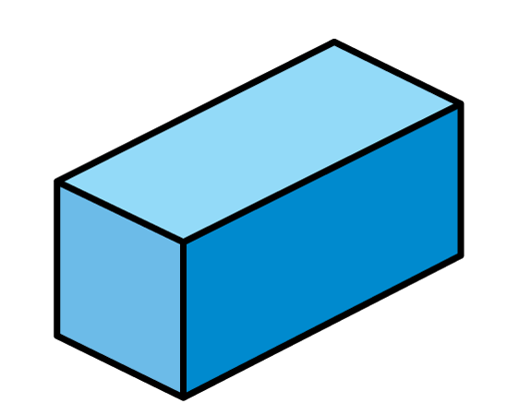
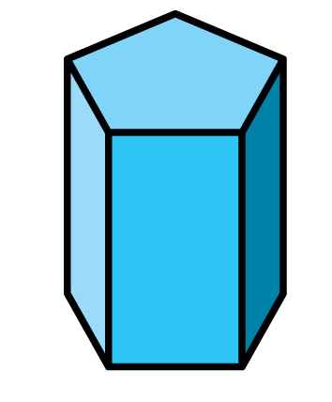
Which shapes have the easiest vertices to count, and why?

Slide 4
Which shapes have the easiest vertices to count, and why?

Slide 6
Sorting rules:
What is the same?
What is different?

Slide 7
Sorting rule - shape
Cones Cylinders Cuboids

Slide 8
Sorting rule - shape
Cones Cylinders Cubes
Have a think

Slide 9
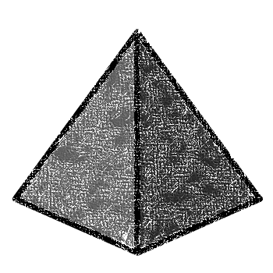
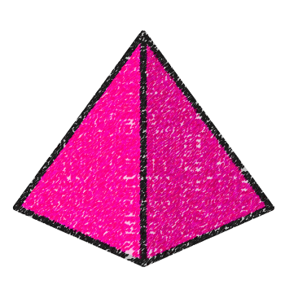
Sorting rule - shape
Sphere Pyramid Cuboid

Slide 10
Sorting rule - shape
Sphere Pyramid Cuboid
Have a think

Slide 11
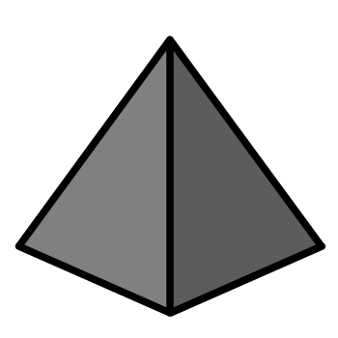
Sorting rule - colour
Have a think

Slide 12
Sorting rule - stack

Slide 13
Sorting rule - roll
Have a think

Slide 14
Have a go at questions 1 and 2 on the worksheet

Slide 15
Odd number of faces
Have a think
Even number of faces

Slide 16
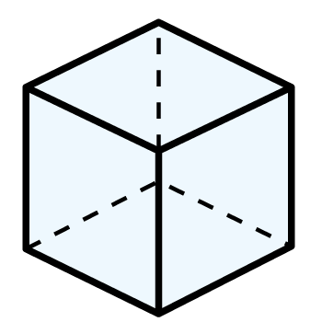
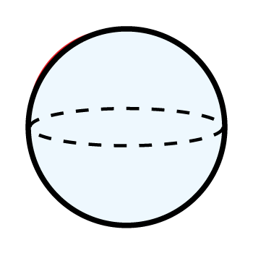
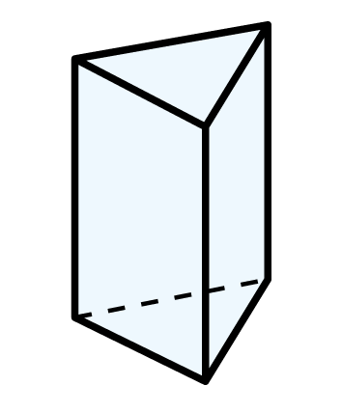
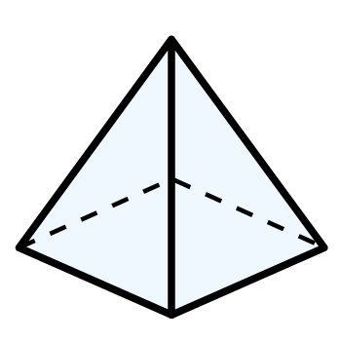
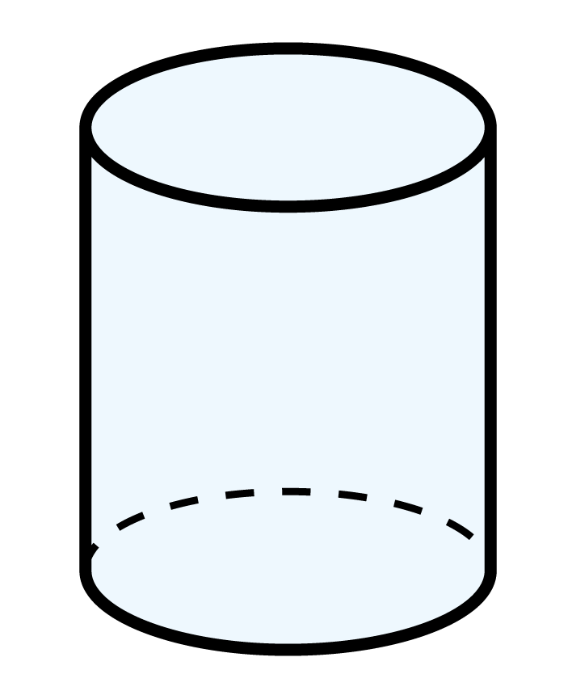
Have a think
Odd number of vertices
Even number of vertices

Slide 17
Have a go at the rest of the questions on the worksheet

