Slide 1
Starter - Which European countries do these flags belong to?

Slide 2
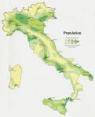
ITALY

Slide 3
What do you think of when you think of Italy?

Slide 4
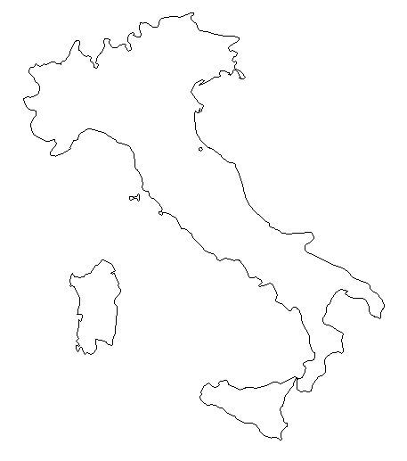
Task:
Add the following locations on to your map
Rome
Naples
Milan
San Marino
Sardinia
Sicily
Bologna
Venice
Pisa
Notes:
Students will add features as you do on this diagram on the board.
Colour coastline in blue. Label key cities eg. Rome, Milan, Turin, Label Sciliy.
Draw in mountains eg. Alps and volcanoes – Vesuvius

Slide 5
Unique Italy
Italy for kids

Slide 6
Plenary - Rearrange these words to find the places in Europe
ITALY
SPAIN
UK
PORTUGAL
GERMANY
FRANCE
KU
RNCFAE
MANYGER
PAINS
UPORTGAL
TAYIL

