Slide 2
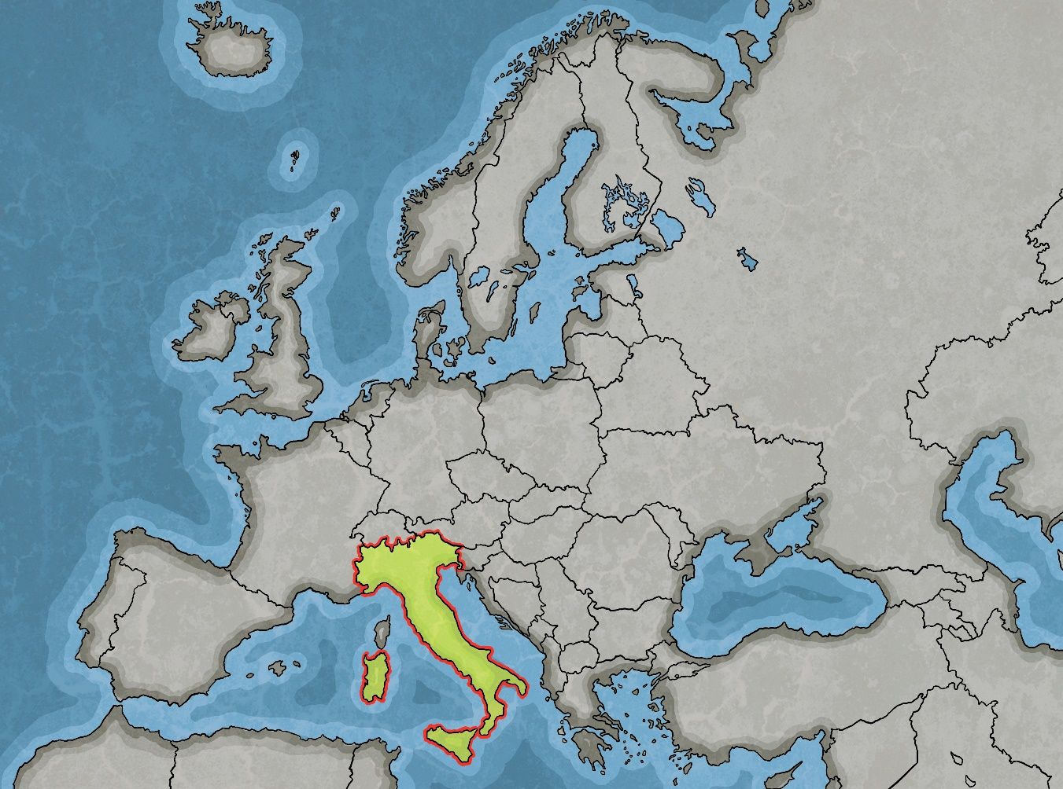
Italy’s Location
Italy is located to the south of Europe and is at the north of the Mediterranean Sea. It has land borders with France, Austria, Switzerland and Slovenia.
San Marino and Vatican City are ‘enclaves’ of Italy (surrounded by Italian lands).

Slide 3
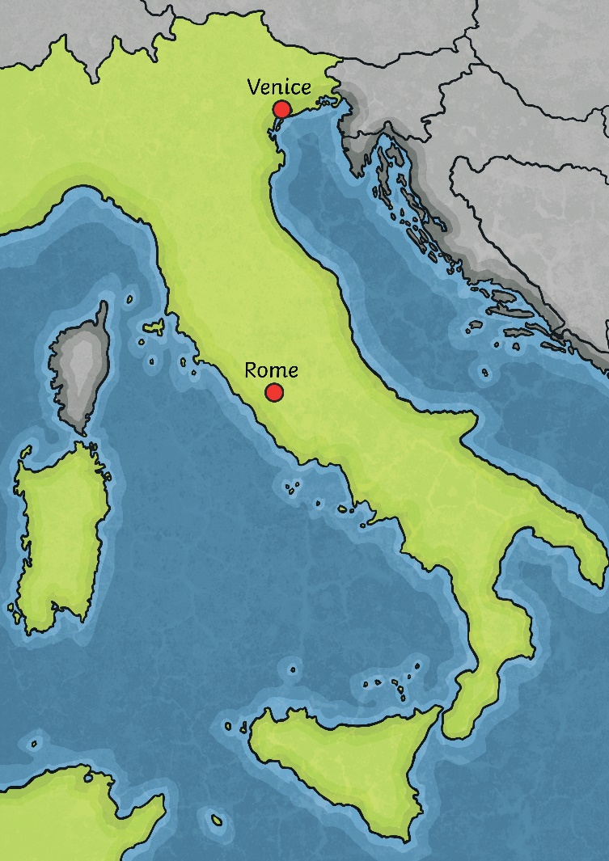
Facts About Italy
Continent: Europe
Main Cities: Rome (Capital), Milan, Venice, Naples, Florence.
Population: 60.4 million
Official Language: Italian
Major Religion: Roman Catholic
Currency: Euro (€)
Landmarks: Colosseum, Leaning Tower of Pisa, Cinque Terre, Cathedral of Santa Maria del Fiore, Pantheon, Trevi Fountain.

Slide 4
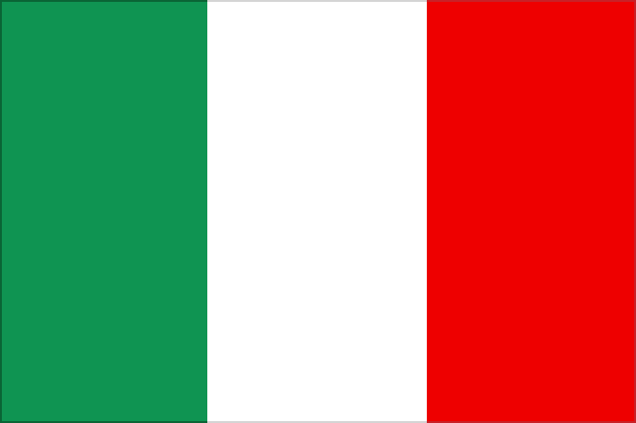
Flag
The national flag of Italy is called ‘il Tricolore’.
It is made up of a three vertical lines of colour; green, white and red.
Each colour represents a different aspect of Italy, though there are two different interpretations:
faith
hope
charity
Mediterranean Landscape
blood spilled for Italian independence
snow-capped Alps

Slide 5
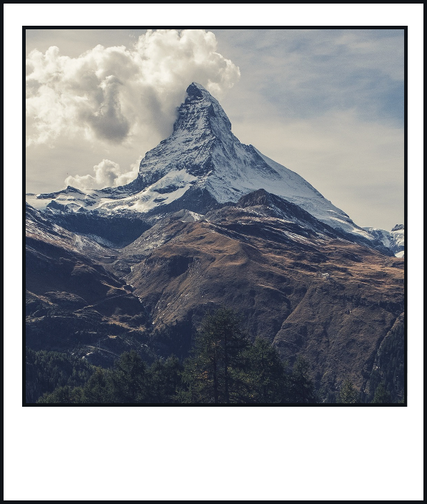
Geography
Italy is a peninsula which is said to have a shape that represents a boot. It is connected to mainland Europe to the north and sticks out into the Adriatic Sea and Mediterranean Sea, among other waters.
At the north of Italy are the Alps, a mountain range which crosses over many other countries, including Austria, Switzerland and France. The largest mountain in the Italian area of the Alps is the Matterhorn, which straddles the border with Switzerland and is 4,478 metres high.
Peninsula – A piece of land almost surrounded by water or sticking out into a body of water.

Slide 6
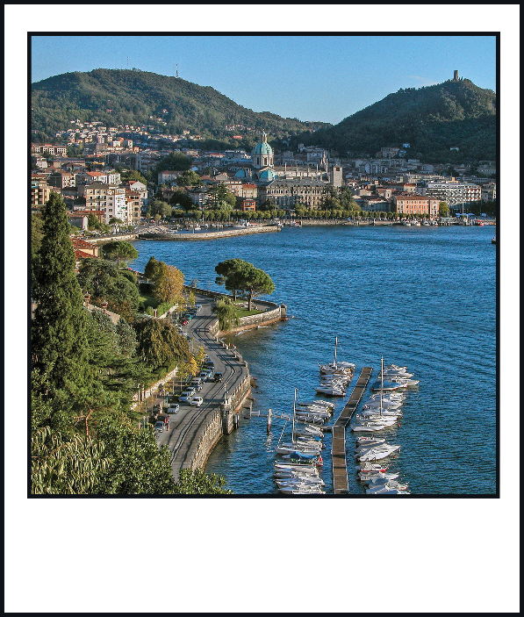
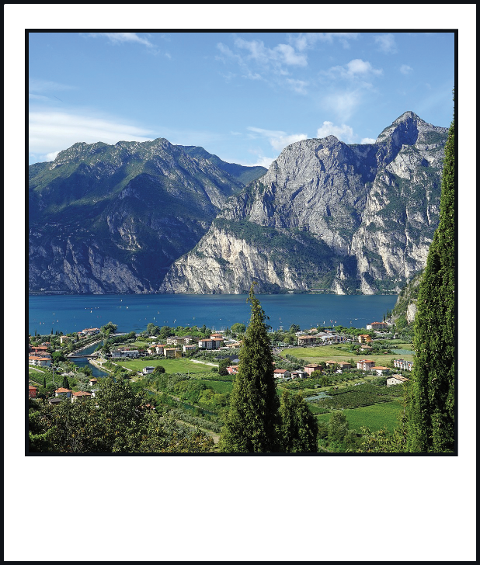
Geography
Italy has a Mediterranean climate, which means it has hot, dry summers and cool, wet winters.
There are numerous rivers that flow through Italy, the longest of which is the Po, which is 405 miles long.
There are many picturesque lakes which are popular tourist destinations, including Lake Garda and Lake Como.

Slide 7
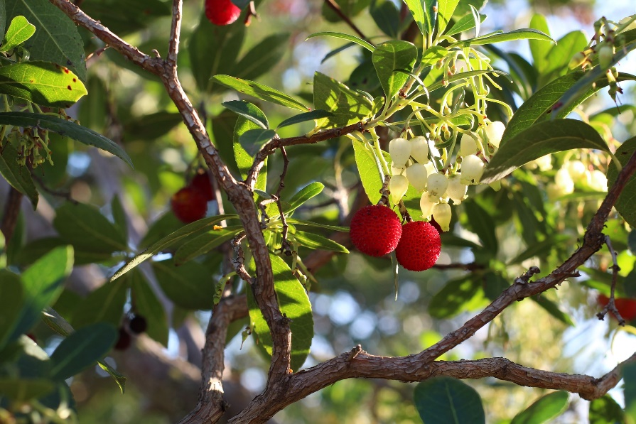
Plants
Italian plants are varied across the country. Some plants, such as rhododendrons, are more suited to the alpine terrain whereas others, such as bay trees, thrive better in the hotter southern areas of the country.
Many fruits and vegetables, such as olives, grapes and broccoli, originate from Italy.
The national tree of Italy is the strawberry tree as the red berries, white flowers and green leaves resemble the colours of the Italian flag.

Slide 8
Animals
“BOREON (06): ALPHA " Le temps du loup"” by [Giles PRETET] is licensed under CC BY 2.0
Italian wolf
Italy is home to a wide range of creatures.
There are over 100 mammal species, including the Eurasian lynx, alpine marmot, Sardinian long-eared bat and the Corsican hare.
Alongside these, Italy has hundreds of birds, reptiles, amphibians and insects.
“Italian Sparrow” by [Mike Prince] is licensed under CC BY 2.0
Italian sparrow
“Plecotus sardus” by [Mauro Mucedda] is licensed under CC BY 2.0
Sardinian long-eared bat

Slide 9
Italian History
Click on each period of history to find out more about what was happening in Italy at that time.
Early History
The Roman Empire
The Middle Ages
The Renaissance
19th Century
The World Wars
Post-War Italy
Next

Slide 10
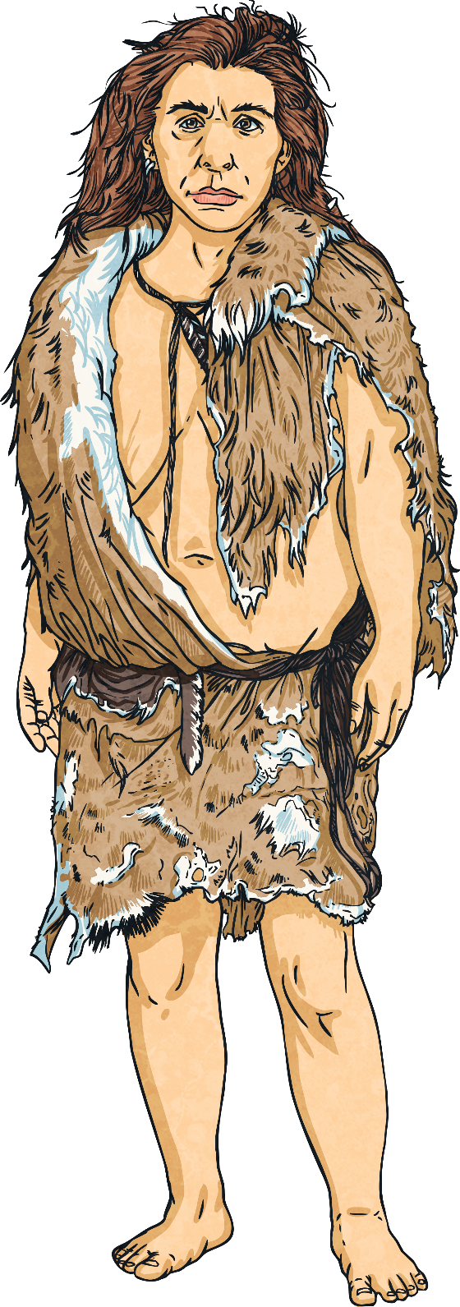
Early History
Italy has a very rich history. The earliest evidence of humans living on Italian soil date from around 45,000 years ago.
The first major civilisation to thrive in Italy was founded around 800 BC by people from ancient Greece. This civilisation was heavily influenced by Greek culture.
Other civilisations also settled in other areas around the country, such as the Etruscans, who settled near to where Rome would go on to be settled and had a significant influence on the development of Roman culture.

Slide 11
Early History
From 753 BC, Rome was ruled by kings. According to Roman history, there were seven kings, each of which was elected by the people for life and acted as the leader of the government and religion. The first king elected was Romulus, one of the founders of the city of Rome.
The last king of Rome was called Tarquin the Proud. Tarquin was a violent and cruel king and was very unpopular. Eventually, the Roman people rose up and expelled him from the city, creating the Roman Republic in 509 BC.
As a republic, Rome no longer had a king and instead had two elected leaders called consuls.
back

Slide 12
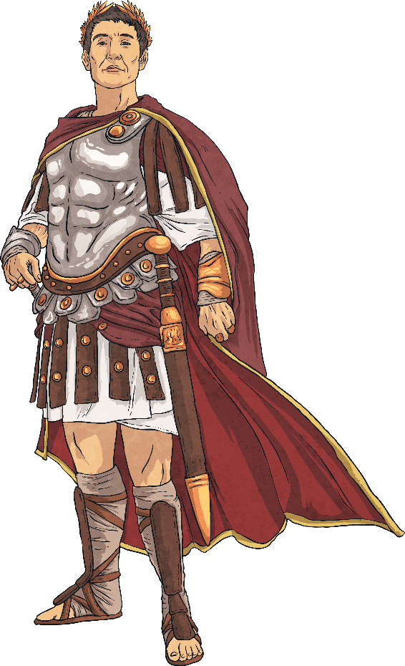
The Roman Empire
The most famous period of Italian history is that of the Roman Empire, which dates from 27 BC to 476 AD. The powerful Empire spanned a large area of Europe, as well as lands in north Africa and Asia.
The expansion of the Roman Empire outside of Italy meant that the culture of Roman society grew and changed significantly, especially through trade contact with societies such as the Greeks.
back
Eventually, the sheer size of the empire led to its demise; the cost of maintaining such a widespread presence was unsustainable and invasions from enemies, such as the Germanic tribes, meant that Rome’s strong reputation was shaken.
In AD 476, a Germanic prince called Odoacer won control of the Roman Empire and was crowned King of Italy, signalling the end of the empire.

Slide 13
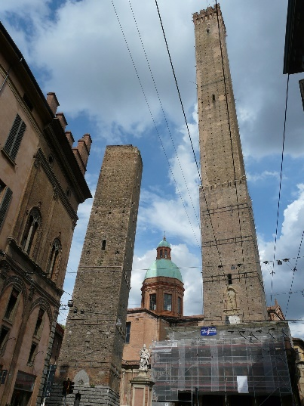
Middle Ages
After the fall of the Roman Empire, there were many more invasions of Italy. In the late 6th century, it became part of the Byzantine Empire and was divided into independent regions, each with a separate capital city.
The spreading influence of the Roman Catholic church meant that the pope became one of the most powerful people in Italy. Some of the separate regions came together again as Papal lands with Rome at its centre; however others, such as Sicily, remained independent.
Despite this, the amount of trade that Italy had with other countries had significantly decreased since the time of the Roman Empire and the amount of international trade stayed low until around the 9th century. The increase of trade brought prosperity to Italian towns and cities and allowed the building of more impressive buildings, such as the Two Towers in Bologna and the Ponte Vecchio in Florence.
back

Slide 14
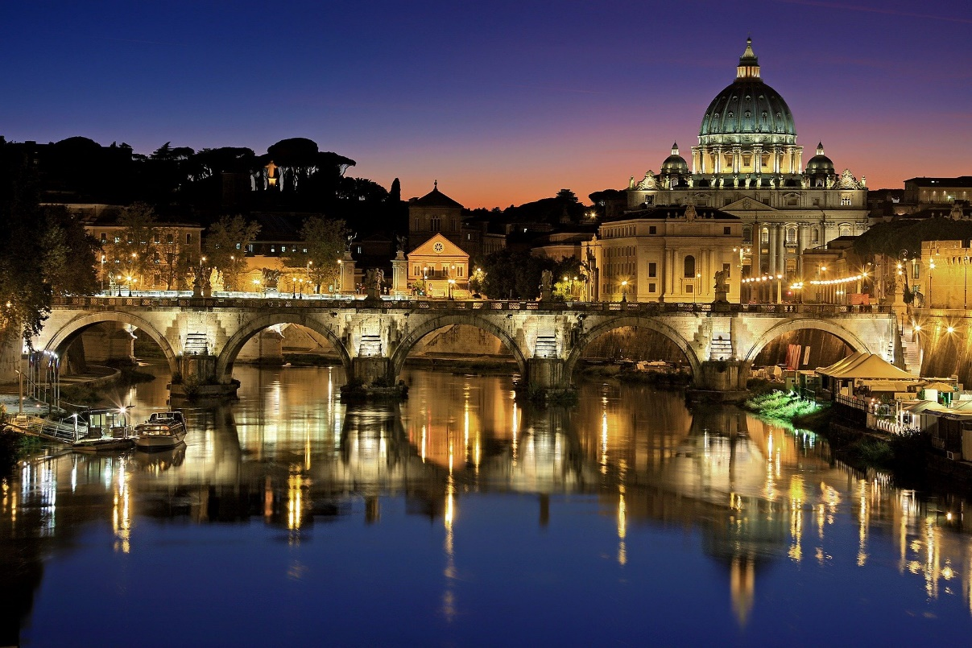
The Renaissance
Italy had another revival of cultural significance during the Renaissance period, which began around the 14th century. During the Renaissance, the artists, inventors, scientists and architects of the country were seen as being at the forefront of technological and cultural advances.
The Renaissance period peaked in the 16th century, with influential figures such as Leonardo da Vinci and Michelangelo, buildings such as St Peter’s Basilica and the Sistine Chapel, and the Venetian school of music showcasing the very best of Italian culture.
back

Slide 15
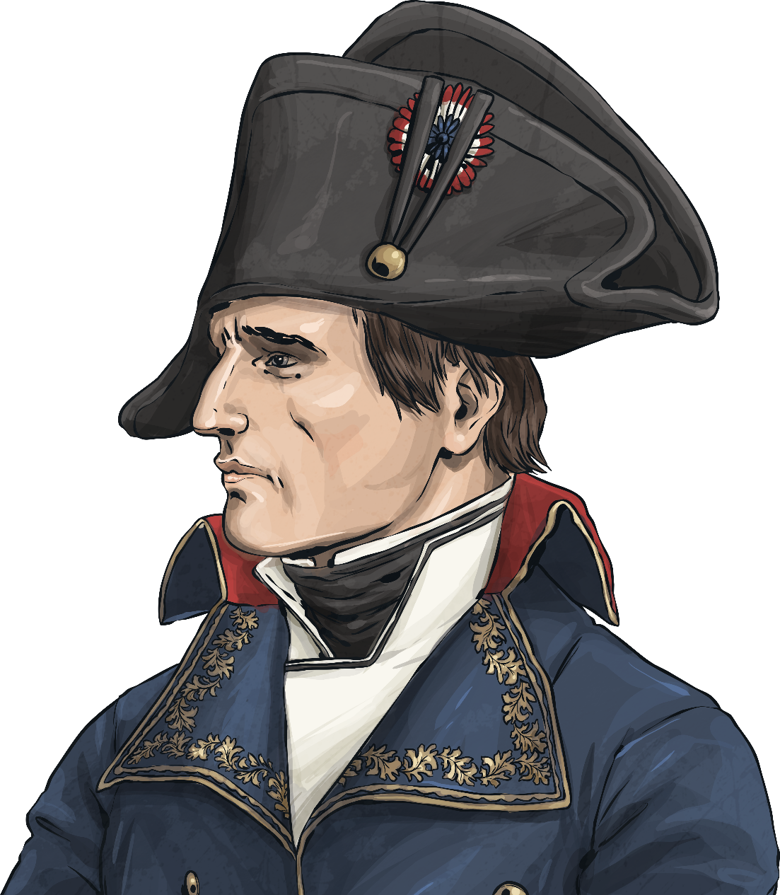
19th Century
A French invasion of Italy by Napoleon Bonaparte during the Napoleonic Wars led to the French leader being crowned King of Italy in 1805.
In 1814, Napoleon agreed to cede control of Italy as part of a peace treaty with his enemies.
The end of Napoleonic rule triggered the start of reunification of all the Italian states and gradually they began to join together as a single nation. By 1860, all parts of Italy had joined together again and ‘The Kingdom of Italy’ was proclaimed in parliament in 1861.
back

Slide 16
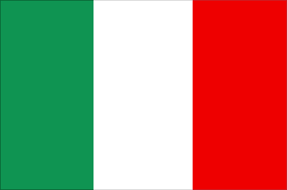
The World Wars
The early 20th century was marred by the two world wars.
During the First World War, Italy initially stayed neutral between the two sides; however in April 1915, they signed a treaty to join France, Britain and Russia in the war against Austria-Hungary, entering the conflict a month later. Involvement in the war was unpopular with the troops and civilian population, causing major divisions and by the end of the war, around 600,000 Italians had died and a further 950,000 had been wounded.
Prior to the Second World War, fascism was gaining support in Italy with the rise of Mussolini and his National Fascist Party. Mussolini was appointed Prime Minister by the King of Italy in 1922.
At the outbreak of war in 1939, the Italian forces joined with Nazi Germany. Mussolini and the Axis forces were defeated by the Allies in 1945 and Mussolini was executed for high treason.
back

Slide 17
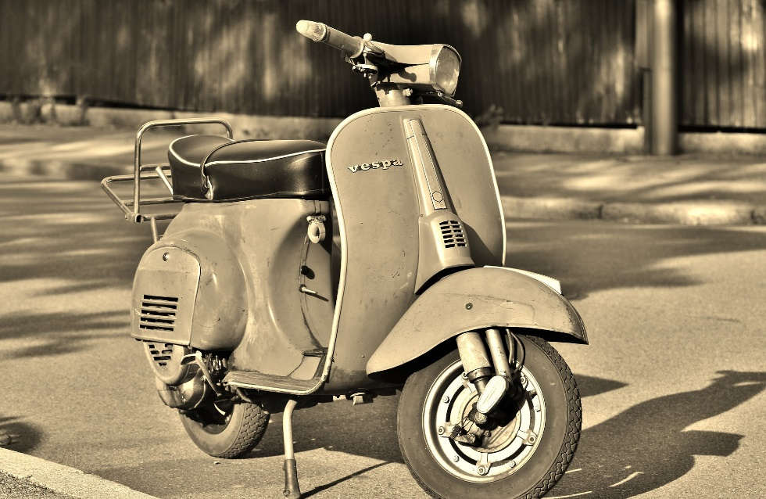
Post-War Italy
After the Second World War, Italy became a republic. King Victor Emmanuel III had abdicated leaving his son, Umberto II, under pressure for the country to become a republic. After a referendum, 54% of the vote backed Italy to become a republic and Umberto was exiled to Portugal.
The 1950s and 1960s brought a great economic boom to Italy. Affordable household goods, such as televisions, sewing machines, cars and Vespa scooters, were popular in many countries. The improved economy meant that cities such as Milan were able to modernise and the country transformed into one of the world’s most vibrant industrial nations in just a couple of decades.
back

Slide 18
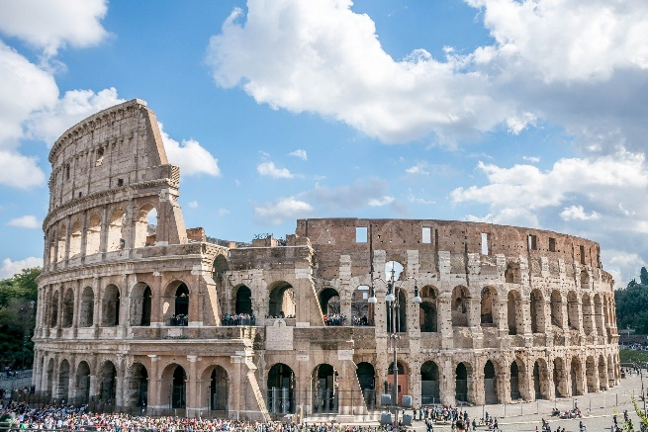
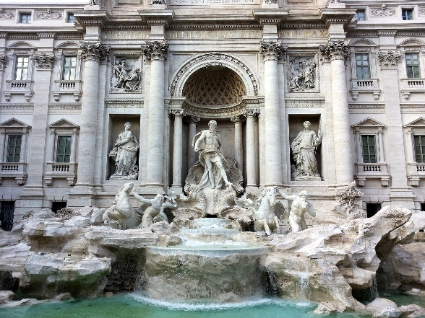
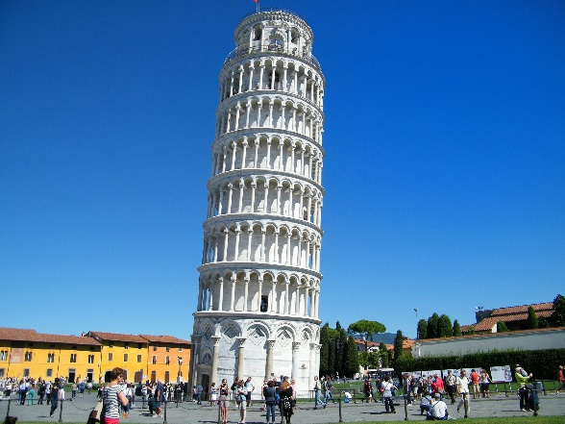
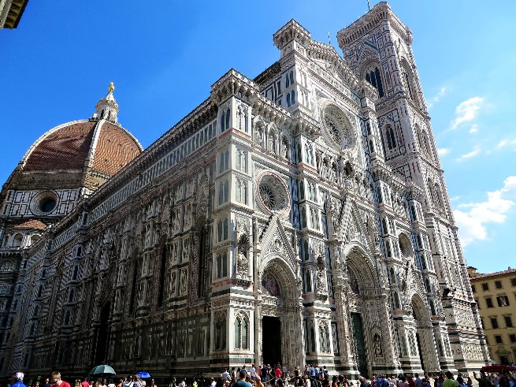
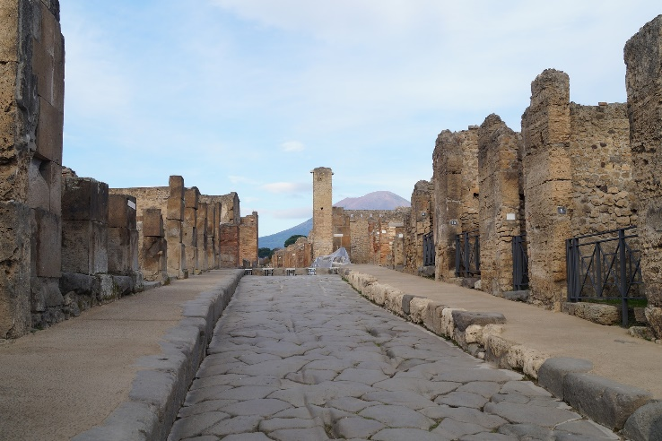
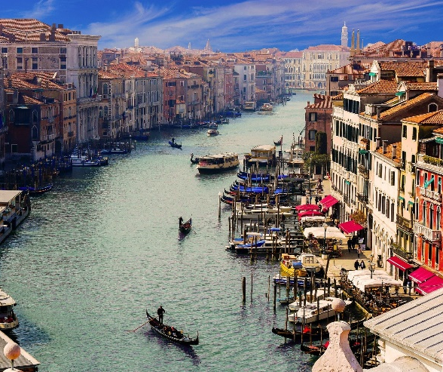
Landmarks
Click on each landmark to find out more about it.
Colosseum
Trevi Fountain
Leaning Tower of Pisa
Cathedral of Santa Maria del Fiore
Ruins of Pompeii
Grand Canal
Next

Slide 19
The Colosseum
Location: Rome
Date built: 71 - 80 AD
Information:
The Colosseum was a large arena built during the time of ancient Rome. It was the largest amphitheatre built, measuring 188 metres long, 156 metres wide and 57 metres high.
The Colosseum was used for large spectacles, such as gladiator fights, exotic animals and the execution of prisoners. It remained in use for over 500 years and later was used as a storehouse, church, cemetery and even a castle for nobility before falling into disrepair. It is one of the Seven Wonders of the Modern World.
back

Slide 20
Trevi Fountain
Location: Rome
Date built: 1762 AD (final completion)
Information:
The name ‘Trevi’ comes from ‘tre vie’, which means ‘three ways’, as the fountain stands at a meeting point between three streets.
The fountain had a number of older versions in the same location before the current one was completed by Nicola Salvi and Giuseppe Pannini.
Many people throw coins into the fountain to make wishes and, each year, the money is collected and donated to charities.
back

Slide 21
Leaning Tower of Pisa
Location: Pisa
Date built: 1174 AD (construction began)
1350 AD (completion)
Information:
The Leaning Tower of Pisa is the campanile tower of the Pisa cathedral and baptistery at the Piazza dei Miracoli. It stands around 56 metres tall.
It was originally intended to stand up straight; however as the tower was built, the south side began to sink. Builders tried to compensate for this by making the columns on the south slightly taller than the ones on the north side. Despite this, the tower was still leaning.
Today, the top of the tower is about 17 feet away from where it is at the base.
back

Slide 22
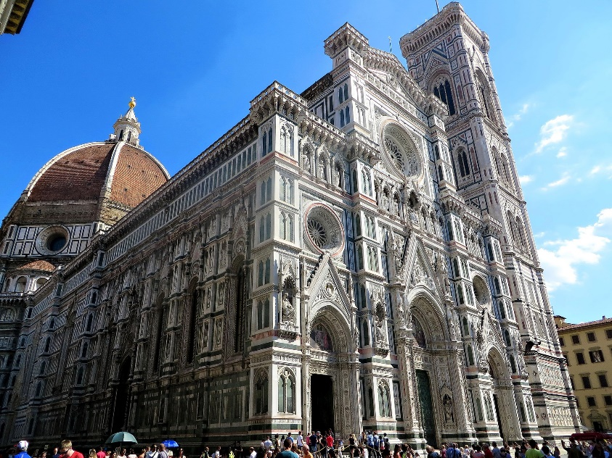
Cathedral of Santa Maria del Fiore
Location: Florence
Date built: 1296 AD (construction began)
1436 AD (completion)
Information:
The Cathedral of Santa Maria del Fiore is located in the centre of the city of Florence. At the time it was built, it was the third largest church in the world.
The dome of the cathedral was designed and built by the architect Brunelleschi and was created using no mechanical devices. It is regarded as an architectural masterpiece. Today, it remains the largest masonry dome in the world; its base covers around half the size of a football pitch!
back

Slide 23
Ruins of Pompeii
Location: Pompeii, near Naples.
Date built: 6 - 7th century (founded)
79 AD (destroyed)
Information:
Pompeii was a thriving city in ancient Roman times, home to around 11,000 people. It was destroyed after the nearby Mount Vesuvius erupted in 79 AD, burying the city in between 4 and 6 metres of volcanic ash.
Today, the ruins of Pompeii are an archaeological site and have given a unique insight into ancient Roman life as many elements of the city were well preserved, including some of the people caught in the eruption.
back

Slide 24
Grand Canal
Location: Venice
Information:
The Grand Canal is the main waterway that flows through the city of Venice. It follows a natural channel which divides the city into two parts.
The Grand Canal is around 2 miles long and between 30 and 70 metres wide. It joins with many of the smaller canals which make up Venice’s waterways.
The canals are the main form of transportation in Venice, with water buses, gondolas, cargo barges and emergency service boats using it to access all parts of the city. There are four bridges which cross the Grand Canal, the oldest and most famous of which is the Rialto Bridge, which dates from the late 16th century.
back

Slide 25
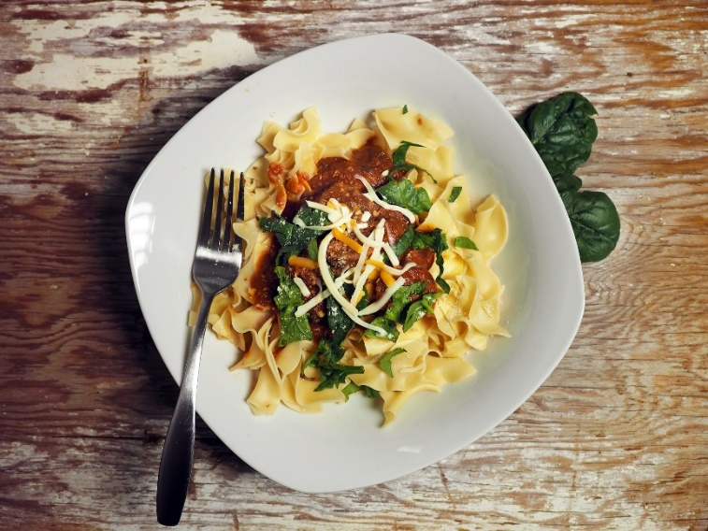
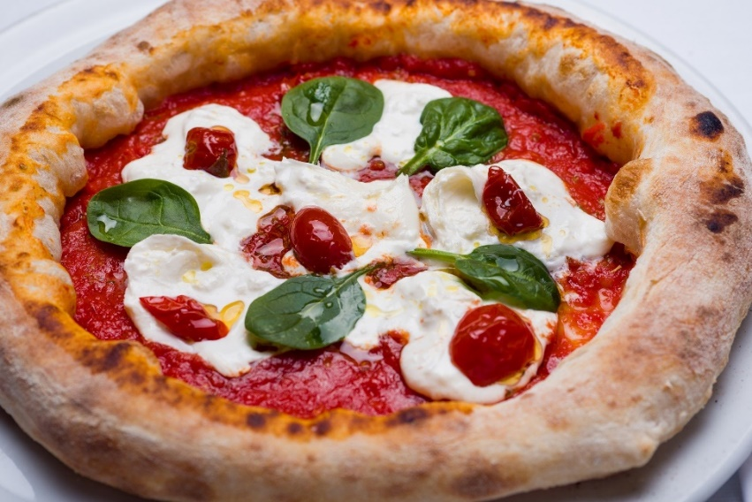
Food and Drink
Italy is famous around the world for its cuisine which has developed over centuries. Different areas are known for their regional specialities, especially in the north and south of the country.
Italian food is generally known for its simplicity, with dishes commonly only being comprised of a few ingredients.
Foods include pasta dishes, risotto, pizza, a variety of meats, cheeses (such as mozzarella), olives and seafood.

Slide 26
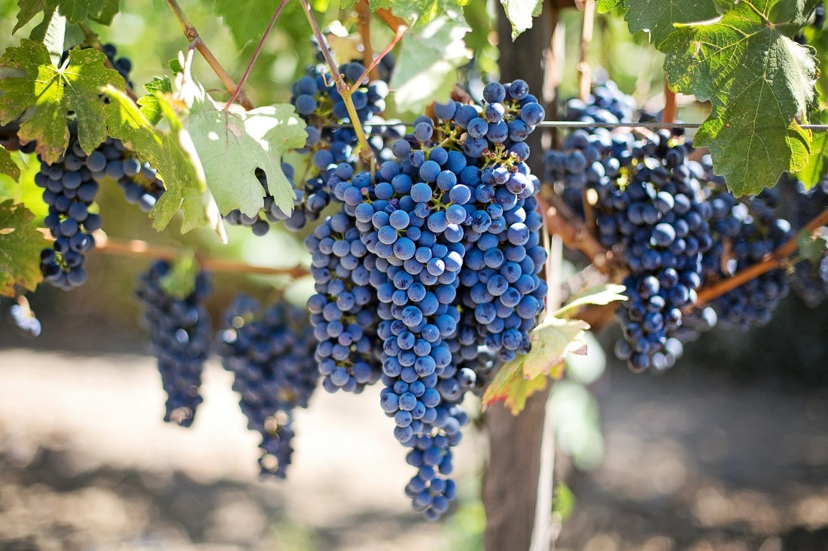
Food and Drink
Italy has a proud heritage of wine making, with some of the oldest wine-producing regions in the world, and every region of the country produces it.
Wine was made by the Etruscans and Greeks before the Roman Empire, but it was the Romans who increased Italy’s wine production, grew large vineyards across the country and improved storage techniques, such as barrel making and bottling.
Today, Italy’s wine counts for almost 20% of the entire world’s production.

Slide 27
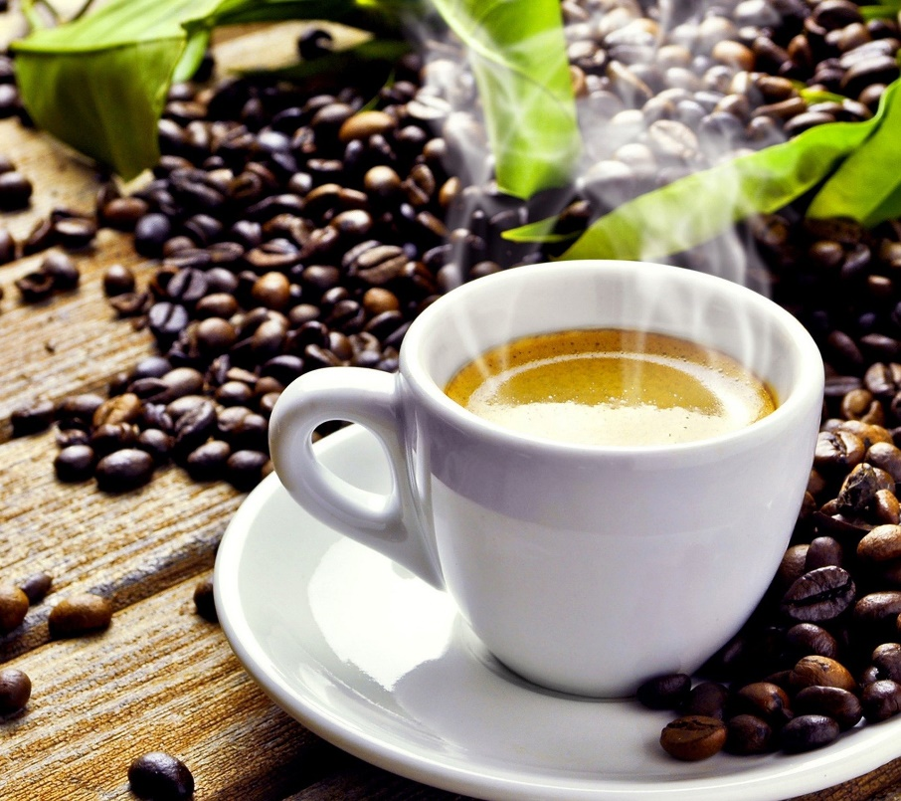
Food and Drink
As well as wine, Italy is also well known for its coffee. Venice was one of the first European places to import coffee beans in the 16th century.
Today, Italy is known as the ‘coffee capital’ of the world and there are numerous coffee houses spread across the country which are popular places for social gatherings.
Many Italian techniques, such as ‘espresso’, ‘cappuccino’ and ‘latte’, are used worldwide for different types of coffee or styles of coffee.

Slide 28
Education
In Italy, education is free for all those that live in the country.
Many children go to a non-compulsory kindergarten before starting primary school at age six. Primary education lasts for five years.
Secondary education lasts eight years and schools are separated into three different types:
Lyceum – These schools focus on more theoretical subjects, such as the humanities, sciences, languages or arts.
Technical Institute – These schools specialise in subjects such as economics and technology. Students also often complete internships during their study.
Professional Institute – These schools specialise in more practical subjects, such as engineering, agriculture, culinary and crafts.
After graduating high school, students have the choice of going to university or entering into employment.

Slide 29
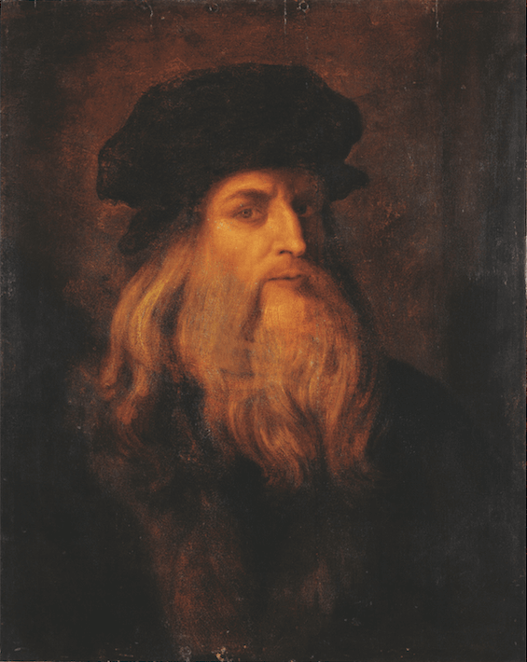
Famous Italians
Leonardo Da Vinci
1452 – 1519
Painter, sculptor, scientist, inventor and engineer.

Slide 30
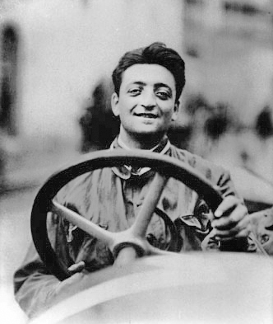
Famous Italians
Enzo Ferrari
1898 - 1988
Race car driver and founder of Ferrari.

Slide 31
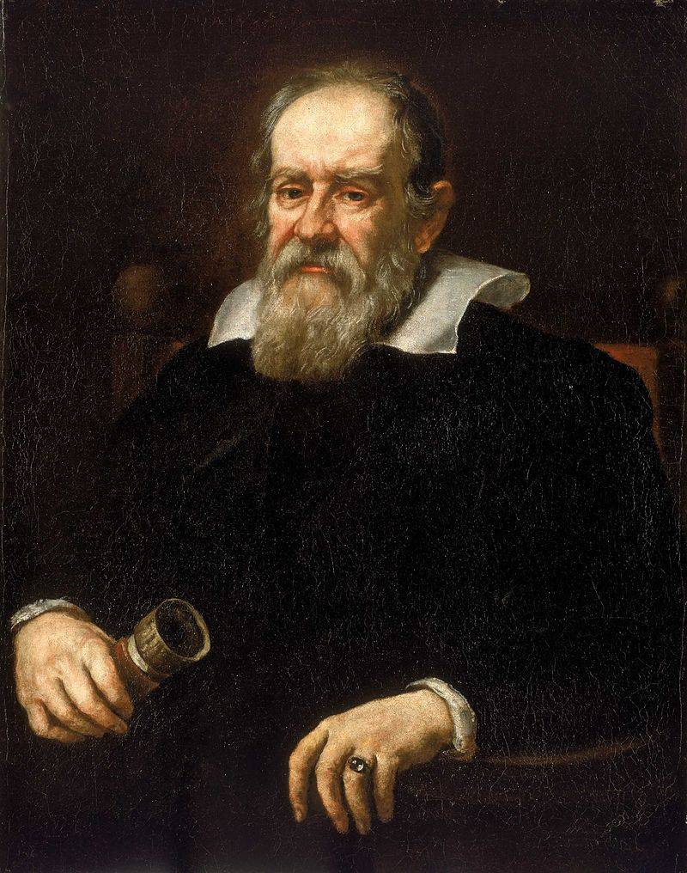
Famous Italians
Galileo Galilei
1564 - 1642
Astronomer, physicist and engineer.

Slide 32
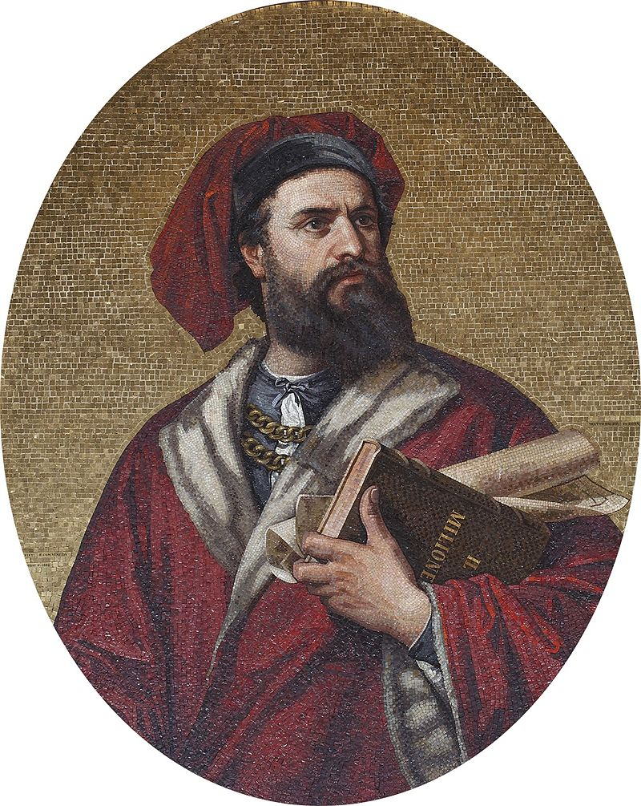
Famous Italians
Marco Polo
1254 - 1324
Merchant, explorer and writer.

Slide 33
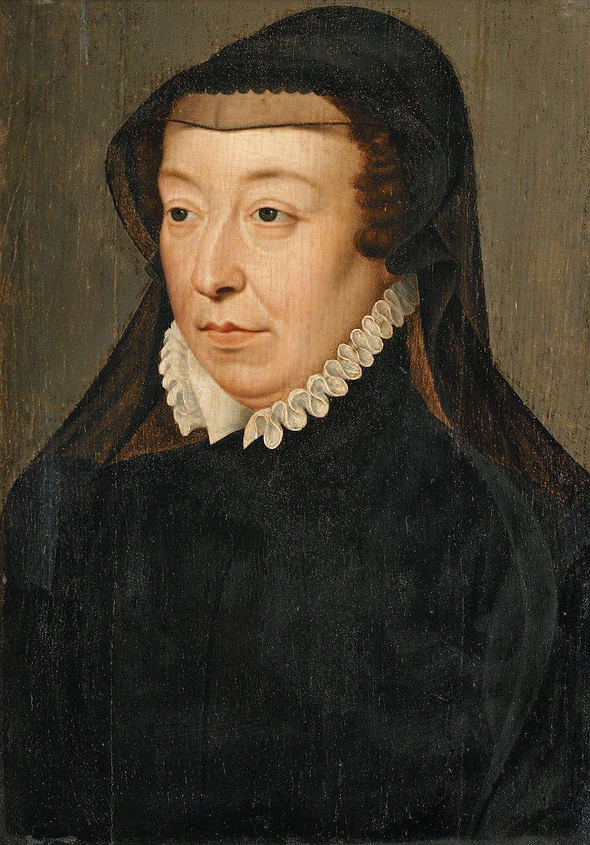
Famous Italians
Catherine de’ Medici
1519 - 1589
Noblewoman and Queen of France.

Slide 34
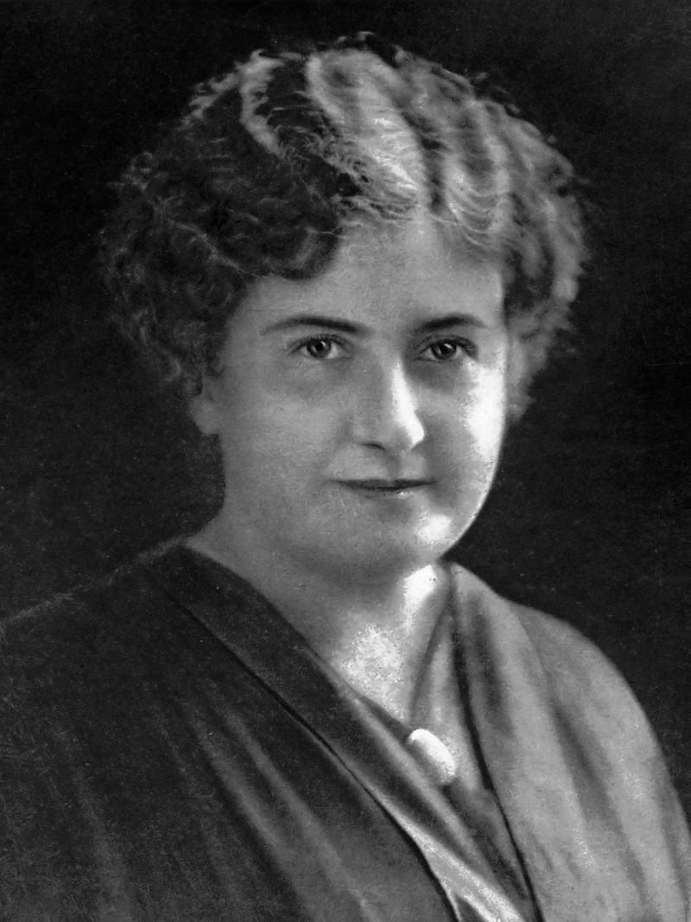
Famous Italians
Maria Montessori
1870 - 1952
Physician and educator.

Slide 35
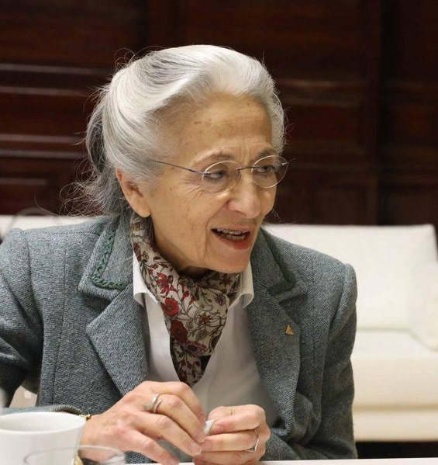
Famous Italians
Rita Levi Montalcini
1909 - 2012
Scientist and politician.
This file was produced by Ayuntamiento of Madrid, the City Council of Madrid, and provided through Diario de Madrid.

