Slide 3
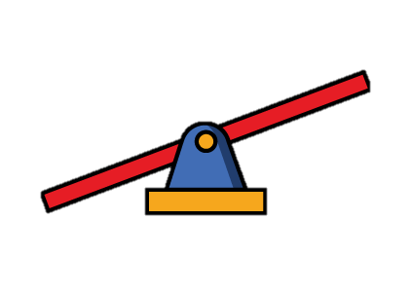
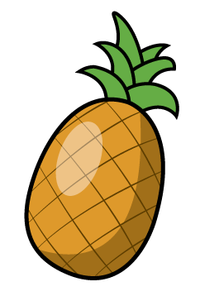
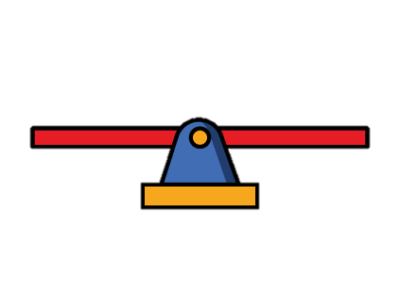
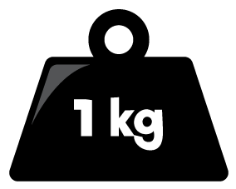
1) Which is heavier, 1 g or 1 kg?
2) Which is heavier, the apple or the pear?
3) Which is lighter, the cabbage or the pineapple?

Slide 4
1) Which is heavier, 1 g or 1 kg?
2) Which is heavier, the apple or the pear?
3) Which is lighter, the cabbage or the pineapple?
1 kg
The apple is heavier.
The cabbage is lighter.

Slide 6
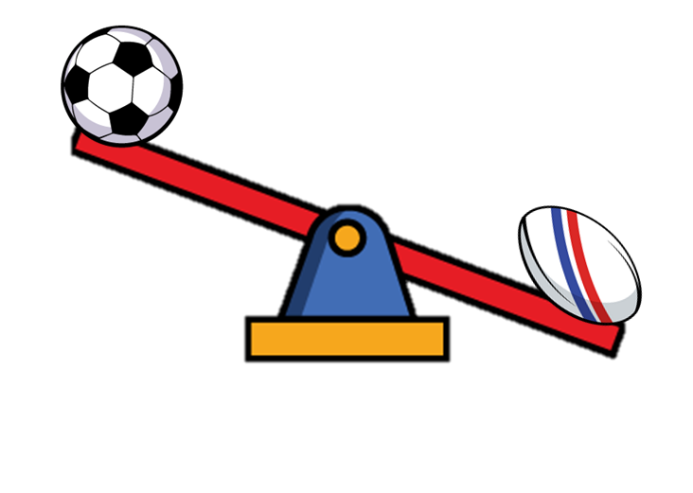
A football weighs 300 g and a rugby ball weighs 350 g
Which image shows how the balls would look on the balance scale?
a)
b)
c)
300 g
350 g
Have a think

Slide 7
Have a go at questions 1 – 3 on the worksheet

Slide 8
What do you notice? What can you find out?
The scale is balanced.
6 cubes have the same mass as 2 cuboids.
Each cuboid has a mass of 3 cubes.
A cuboid is heavier than a cube.
Have a think

Slide 9
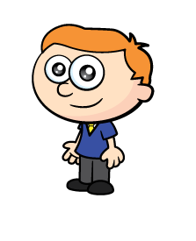
What would happen to the balance scale…
If Ron removed 1 cube?
If Ron added 1 cuboid to the yellow cuboids?
If Ron removed 3 cubes and 1 cuboid?
Have a think

Slide 10
What would happen to the balance scale…
If Ron added 1 cuboid to the yellow cuboids?

Slide 11
What would happen to the balance scale…
If Ron removed 3 cubes and 1 cuboid?

Slide 12
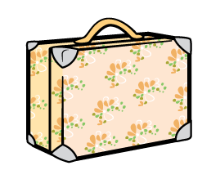
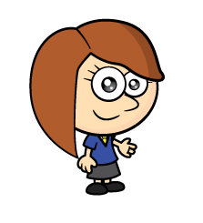
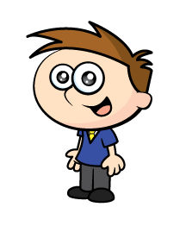
The children are checking the mass of their suitcases.
12 kg 750 g
13 kg 200 g
12 kg 600 g
Can you order the cases from lightest to heaviest?
Have a think

Slide 13
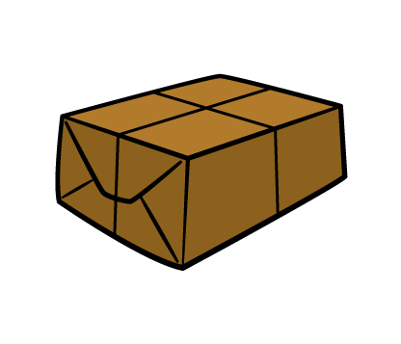
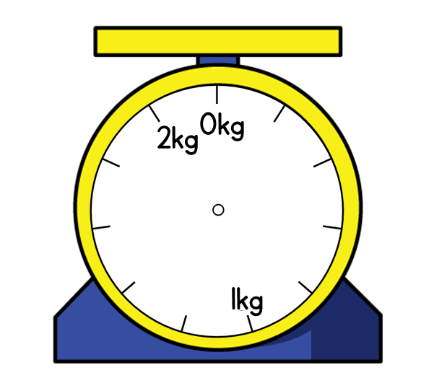
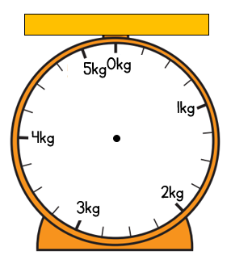
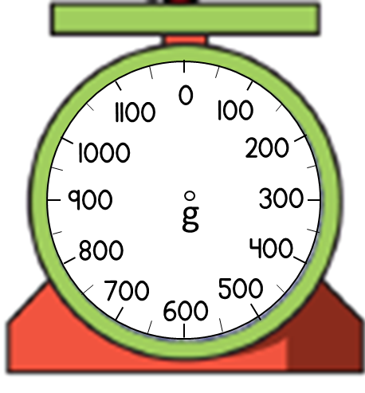
Order the parcels from heaviest to lightest.
A B C
1 kg 800 g
3 kg 250 g
900 g
Have a think
Parcel B is the heaviest, then parcel A then parcel C.

Slide 14
Have a go at the rest of the questions on the worksheet

