Slide 3
1) How many grams are there in 1 kilogram?
Continue the sequence
100, 150, 200, 250, ____, ____, ____, ____
3) What number is indicated by each arrow?
0
2
4
6
8
10
12
14
16
18
20
0
10
20
30
40
50
60
70
80
90
100

Slide 4
1) How many grams are there in 1 kilogram?
Continue the sequence
100, 150, 200, 250, ____, ____, ____, ____
3) What number is indicated by each arrow?
kilo means 1000 so 1 kg $=$ 1000 g
300
350
400
450
12
0
2
4
6
8
10
12
14
16
18
20
70
0
10
20
30
40
50
60
70
80
90
100

Slide 6
We measure mass in grams (g) and kilograms (kg)
The mass of the cereal box is 500 g
500 g
The mass of the banana is 110 g
The mass of an average 8 year old is 22 kg

Slide 7
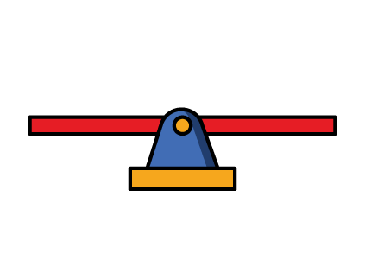
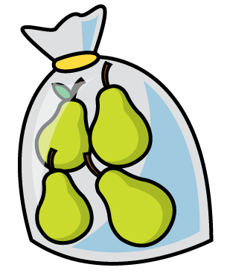
What is the mass of the pears?
Have a think
100
100 $+$ 50 $+$ 50 $+$ 50
$=$ 250
The mass of the pears is 250 g

Slide 8
What is number is indicated by each arrow?
10
10 $÷$ 2 $=$ 5
0
10
20
30
40
50
60
70
80
90
100
25
10
10 $÷$ 5 $=$ 2
0
10
20
22
24
28
30
40
26
100 $÷$ 2 $=$ 50
100
0
100
200
300
400
500
600
700
800
900
1,000
450
Have a think

Slide 9
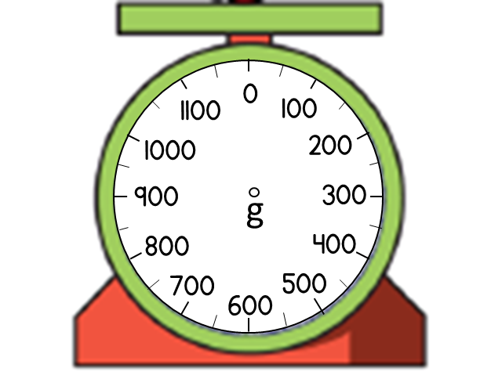
Have a think
What is the mass of the football?
The mass of the football is 300 g
0 g
100 g
200 g
300 g
400 g
500 g
600 g
700 g
800 g
900 g
1,000 g

Slide 10
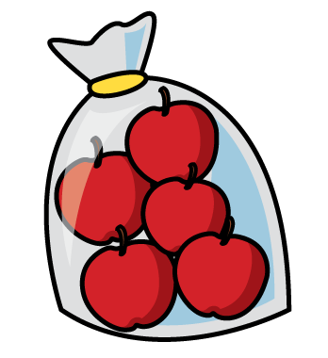
Have a think
What is the mass of the apples?
The mass of the apples is 750 g
0 g
100 g
200 g
300 g
400 g
500 g
600 g
700 g
800 g
900 g
1,000 g

Slide 11
Have a go at questions 1 and 2 on the worksheet

Slide 12
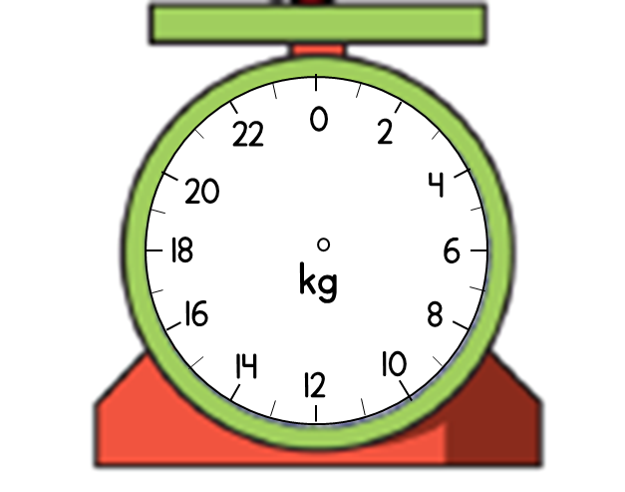
Have a think
What is the mass of the pumpkin?
The mass of the pumpkin is 13 kg
0
2
4
6
8
10
12
14
16
18
20

Slide 13
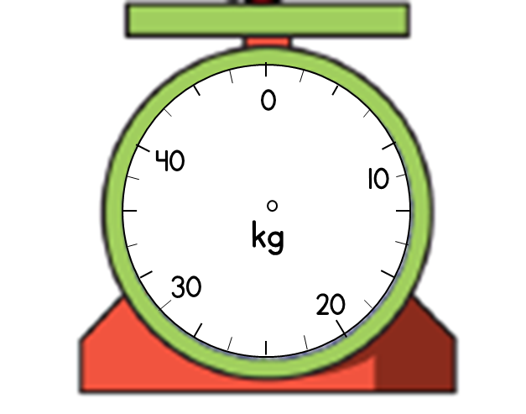
Have a think
What is the mass of the suitcase?
The mass of the suitcase is 18 kg
10 $÷$ 5 $=$ 2
0
10
20
30
40
12
14
16
18
10

Slide 14
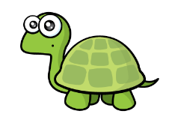
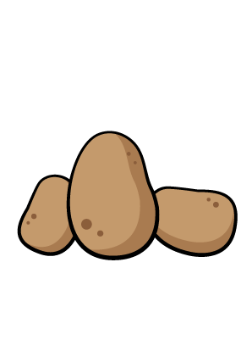
The grapes are heavier than the potatoes.
Have a think
Is Tiny correct? Can you explain why?
2 kg
200 g
$=$ 2000 g

Slide 15
Have a go at the rest of the questions on the worksheet

