Slide 3
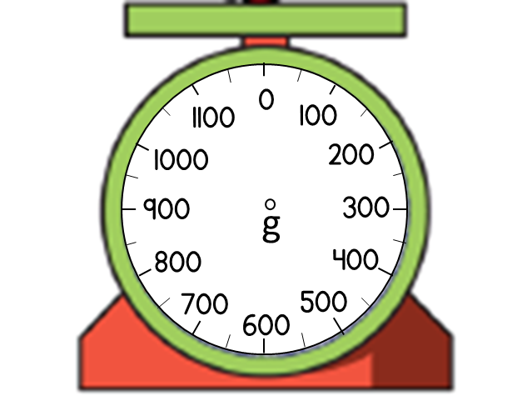
1) How many grams are there in 1 kilogram?
What number is indicated by each arrow?
What is the mass of
the pineapple?
0
10
20
30
40
0
100
200
300
400
500
600
700
800
900
1,000

Slide 4
1) How many grams are there in 1 kilogram?
What number is indicated by each arrow?
What is the mass of
the pineapple?
kilo means 1000 so 1 kg $=$ 1000 g
0
10
20
30
40
38
0
100
200
300
400
500
600
700
800
900
1,000
250
850 g

Slide 6
6,500
_______ g $=$ 6 kg and 500 g
6,500 g
1 kg $=$ 1,000 g
6 kg
500 g
6,000 g
6,500 g
6,000 g $+$ 500 g $=$

Slide 7
1 kg $=$ 1,000 g
Have a think
5,000
1) 5 kg $=$ ______ g
12
2) 12,000 g $=$ ___ kg
2,200
3) _______ g $=$ 2 kg and 200 g
8
100
4) 8,100 g $=$ ___ kg and ______ g

Slide 8
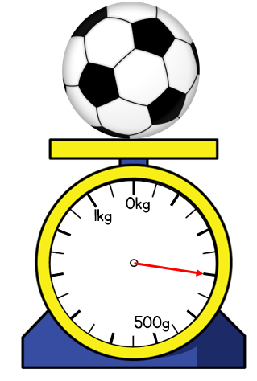
What is the mass of the football?
The football has a mass of 300 g
500g ÷ 5 = 100 g
0 kg
100 g
200 g
300 g
400 g
500 g
600 g
700 g
800 g
900 g
1 kg
500 g

Slide 9
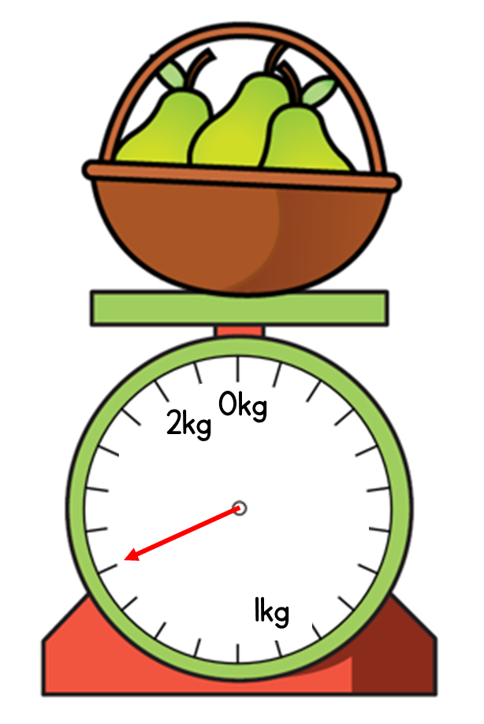
What is the mass of the basket of pears?
1 kg and 500 g
1,000 g ÷ 10 = 100 g
1 kg
2 kg
1,000 g
1 kg

Slide 10
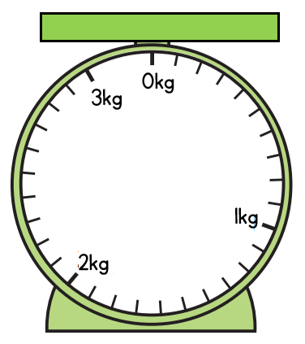
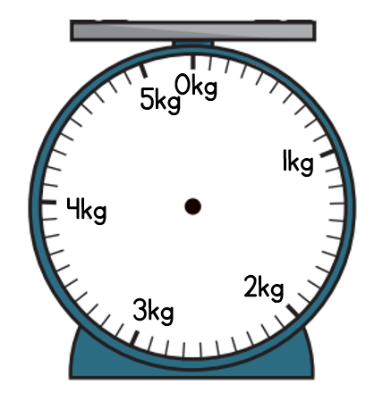
Have a think
4
800
__ kg and ____ g
__ kg and ____ g
2
100

Slide 11
Have a go at questions 1 and 2 on the worksheet

Slide 12
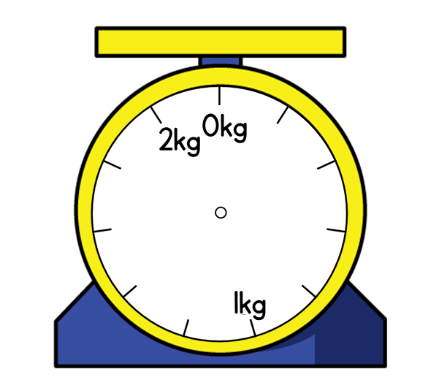
What is the mass of the pumpkin?
I think it’s 1 kg and 200 g
1 kg and 400g
1,000 g ÷ 5 $=$
200 g
1 kg
200 g
400 g
600 g
800 g
2 kg
1,000 g

Slide 13
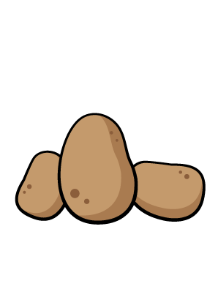
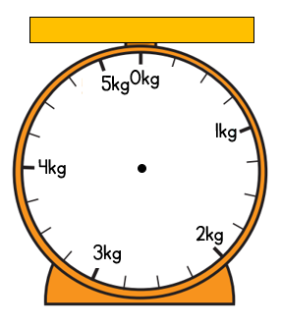
What is the mass of the potatoes?
750g
600 g
1,000 g ÷ 4 =
250 g
0 kg
250 g
500 g
750 g
1 kg
1,000 g

Slide 14
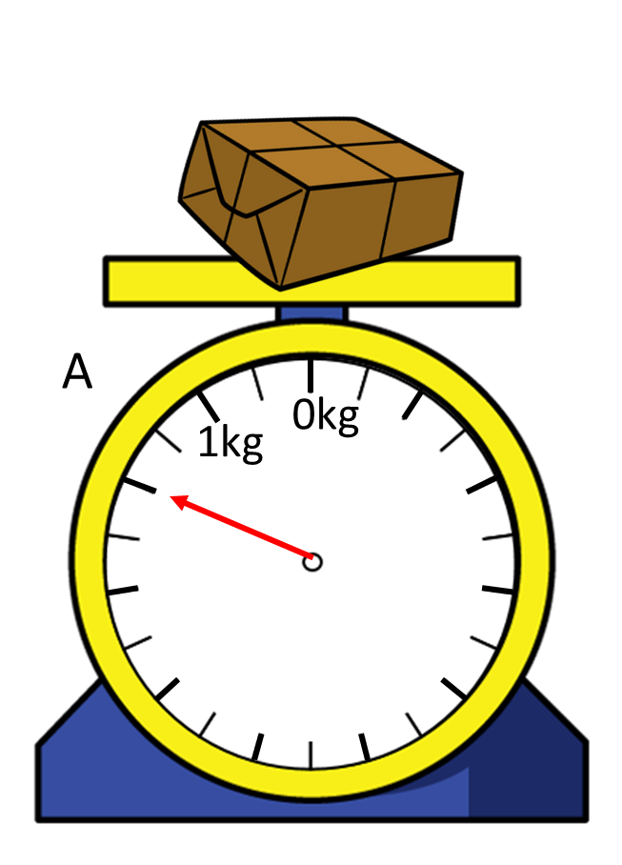
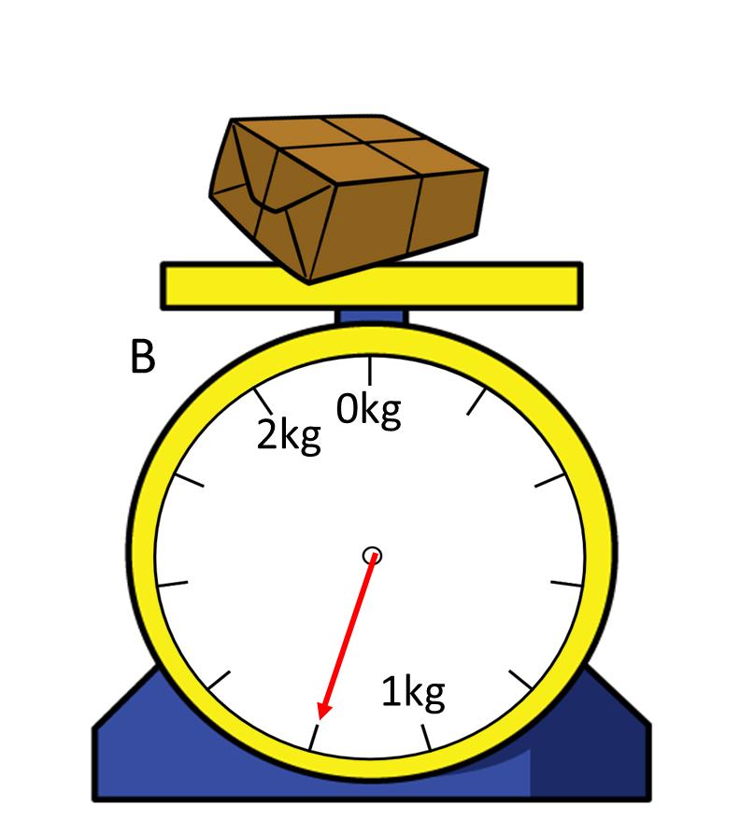
Which parcel has the greater mass?
B
A

Slide 15
Have a go at the rest of the questions on the worksheet

