Slide 3
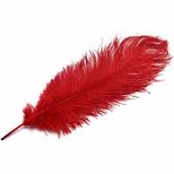
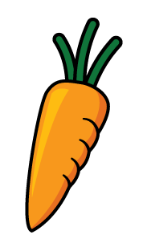
What language is used to describe mass?
full and empty, long and short, heavy and light
2) Which item would you expect to have a greater mass?
or
Which units are used to measure mass?
Kilograms and grams
Litres and millilitres
Metres and centimetres

Slide 4
What language is used to describe mass?
full and empty, long and short, heavy and light
2) Which item would you expect to have a greater mass?
or
Which units are used to measure mass?
Kilograms and grams
Litres and millilitres
Metres and centimetres

Slide 6
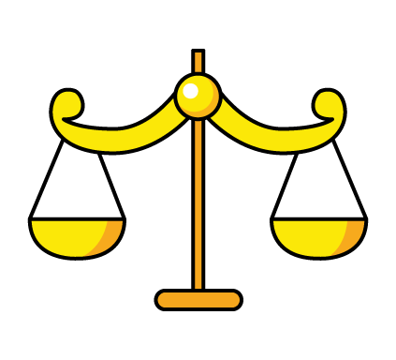
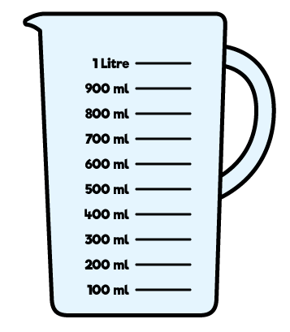
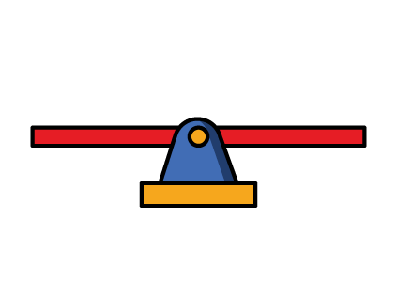
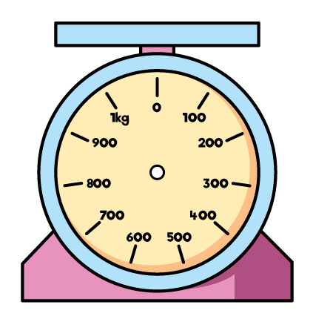
Which equipment do we use to measure mass?

Slide 7
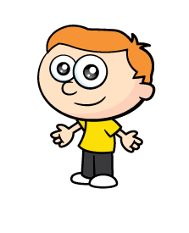
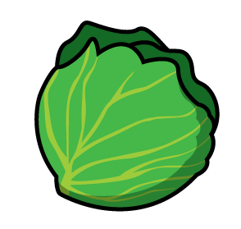
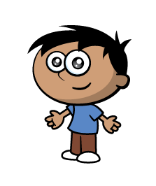
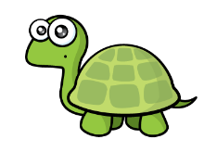
The cabbage feels heavier.
I can’t tell which feels heavier.
Let’s use the balance scales to check.

Slide 8
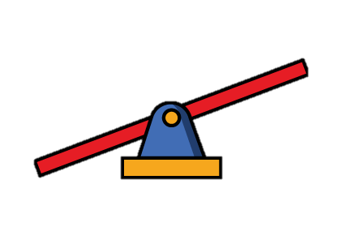
Have a think
The cabbage is heavier than the apple.
The apple is lighter than the cabbage.

Slide 9
Have a think
The banana has the same mass as the apple.

Slide 10
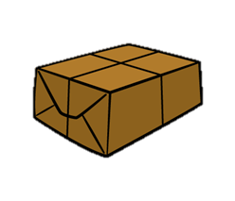
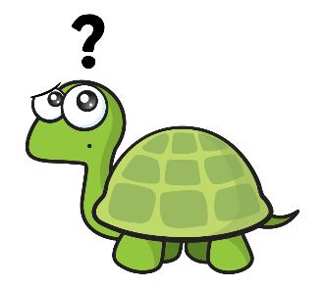
Which parcel is heavier?
Have a think
The small parcel is heavier.

Slide 11
Have a think
Find some objects to compare
Which do you think is heavier?
Can you use the balance scales to check?

Slide 12
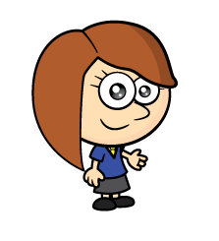
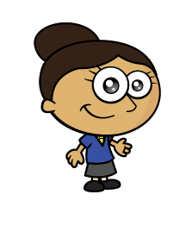
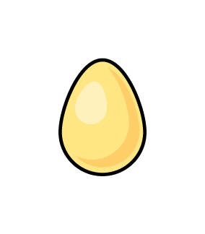
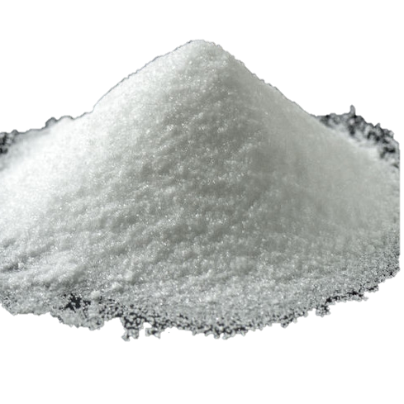
Rosie and Dora are making cupcakes.
They need the same mass of eggs, sugar, butter and flour.
I can use the eggs to measure each ingredient.

Slide 13
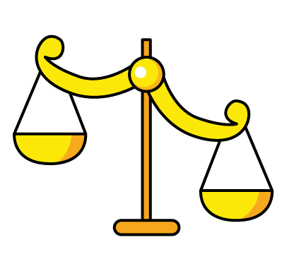
Rosie and Dora are making cupcakes.
They need the same mass of eggs, flour, margarine and sugar.
Does Rosie need to add more flour or remove some?
This is not the correct amount of flour.
Have a think

Slide 14
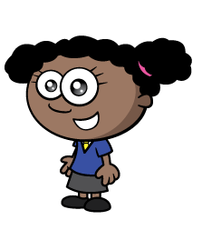
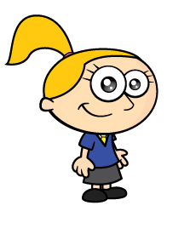
Whitney and Eva have a balance scale,
a 50 g weight and a 20 g weight.
They want to make a ball of playdough with a mass of exactly 30 g
Can you find more than one way to do this?
Have a think

Slide 15
20 g $+$ 30 g $=$ 50 g
So the dough has a mass of 30 g
First I made 2
20 g balls.
I divided one ball into 2 equal 10 g balls
Then I combined a 10g and a 20 g ball to make 30 g

Slide 16
What other masses of dough could you make using only these weights?
I wonder if you can make each multiple of 10 g up to 100 g…

