Slide 3
Draw a horizontal line.
Draw a vertical line.
Draw a diagonal line.
Find a mirror to use.

Slide 4
Draw a horizontal line.
Draw a vertical line.
Draw a diagonal line.
Find a mirror to use.

Slide 7
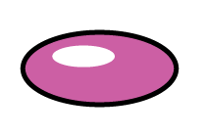
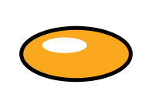
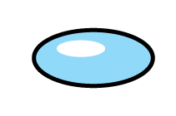
Which images are reflections? Which images are not?
Have a think

Slide 11
A
B
1)
Have a think
2)
A
B
3)
A
B

Slide 12
Have a go at questions 1 - 2 on the worksheet

Slide 13
How many other ways can you fold the square so that it fits perfectly on top?
Have a think

Slide 14
What do you notice about all of these shapes?
2 lines of symmetry
5 lines of symmetry
Infinite lines
of symmetry
They all have more than 1 line of symmetry.

Slide 15
A
B
C
D
E
F
G
Have a think
0 lines | 1 line | More than 1 line
A
F
C
D
B
E
G

Slide 16
Shade exactly 6 squares on each grid to make a symmetrical shape.
Have a think

Slide 17
Place 5 squares on the grids
to make a symmetrical shape.
Have a think

Slide 18
Have a go at questions 4 - 7 on the worksheet

