Slide 3
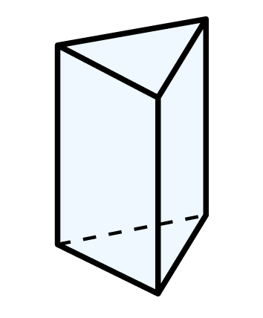
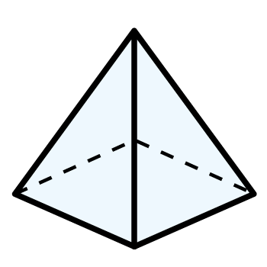
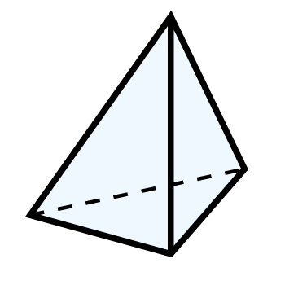
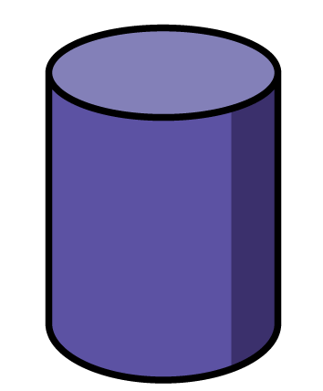
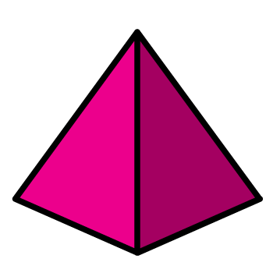
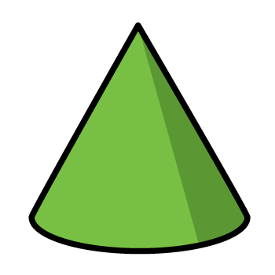
1) Can you name these 3D shapes?
2) How many square faces does a cube have?
Which of the 3D shapes below
did not make this print?

Slide 4
1) Can you name these 3D shapes?
2) How many square faces does a cube have?
Which of the 3D shapes below
did not make this print?
square-based pyramid
triangular-based pyramid
triangular
prism
6

Slide 6
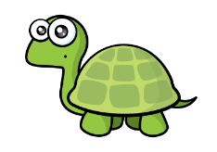
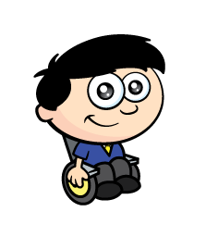
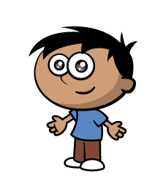
Dexter and Amir are investigating how many different cuboids they can build with 8 cubes.
I think some of these are the same.
We’ve made 6 different cuboids.
Have a think
Is Tiny correct?

Slide 7
I think some of these are the same.
We’ve made 3 different cuboids.
These 2 are definitely different.
If we turn these 4 around, they will match.

Slide 8
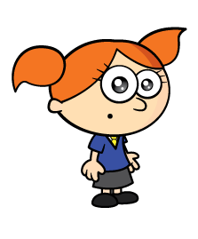
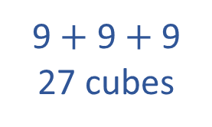
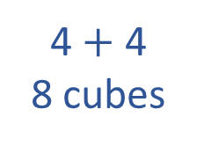
Whitney and Alex are also building 3D shapes.
1 cube
4 $+$ 4
8 cubes
9 $+$ 9 $+$ 9
27 cubes
Have a think
How many small cubes have they used to build each cube?

Slide 9
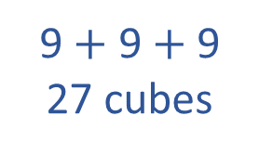
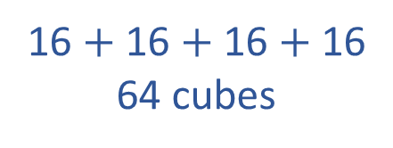
Have a think
1 cube
4 $+$ 4
8 cubes
9 $+$ 9 $+$ 9
27 cubes
16 $+$ 16 $+$ 16 $+$ 16
64 cubes
How many small cubes would you need to build the next cube in the pattern?

Slide 10
Have a go at questions 1 – 4 on the worksheet

Slide 11
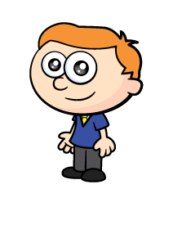
Ron is using marshmallows and straws to build 3D shapes.
Have a think
He starts by making a rectangular base.
What shape do you think Ron is making?
Ron has made a cuboid.
I can see 8 vertices and 12 edges.

Slide 12
Have a go at the rest of the questions on the worksheet

