Slide 1
Key vocabulary
synonym
word pair
a word that means exactly or nearly the same as another word
like merry and happy
words that often appear together,
like a bright sun or bright moon or bright light
adjective
noun
a person, place, or thing
a describing word

Slide 2
Our first ‘feeling bad’ word…

Slide 3
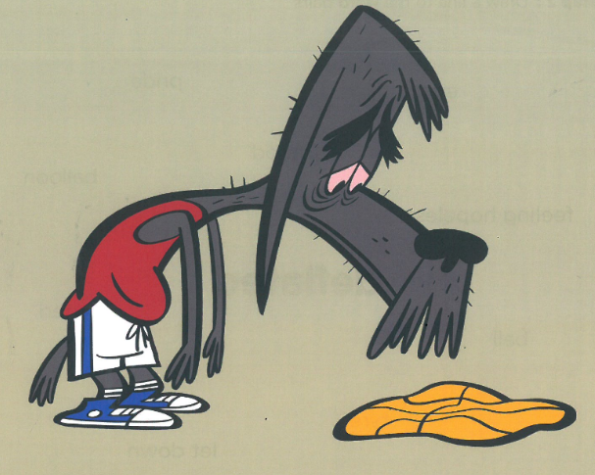
What is happening in this picture?
I can see …
I notice a …
I think the character is feeling …
The atmosphere is…
Resources from Mrs Wordsmith

Slide 4
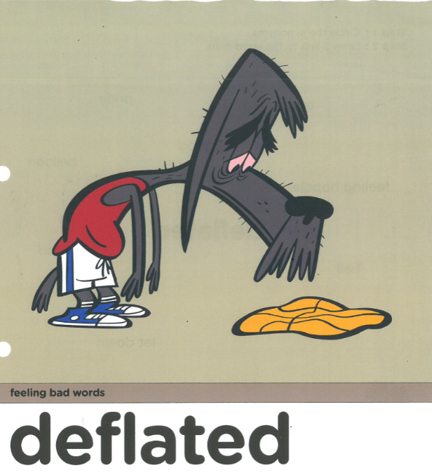
adjective
-feeling hopeless or let down; when you feel sad and empty like a ball with the air let out
Resources from Mrs Wordsmith.com

Slide 5
Which words
are synonyms?
ball
feeling hopeless
mood
let down
balloon
saddened
pride
ego
tyre
The boy stared sadly at his deflated balloon that his friend had popped.
Resources from Mrs Wordsmith

Slide 6
Word pairs
deflated
ball
mood
balloon
pride
ego
tyre
deflated
deflated
deflated
deflated
deflated
Resources from Mrs Wordsmith

Slide 7
What does deflated mean?
-feeling hopeless or let down; when you feel sad and empty like a ball with the air let out
Resources from Mrs Wordsmith

Slide 8
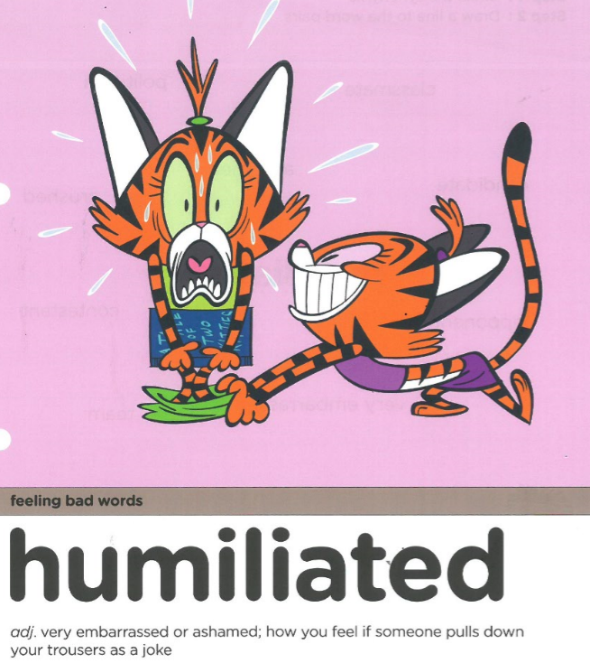
What is happening in this picture?
I can see …
I notice a …
I think the character is feeling …
The atmosphere is…
Resources from Mrs Wordsmith

Slide 9
adjective
-very embarrassed or ashamed; how you feel if someone pulls down your trousers as a joke
Resources from Mrs Wordsmith

Slide 10
Which words
are synonyms?
ashamed
classmate
crushed
politician
candidate
opponent
contestant
team
pride
very embarrassed
The children laughed at their humiliated classmate when he forgot his line in the play.
Resources from Mrs Wordsmith

Slide 11
Word pairs
humiliated
classmate
politician
candidate
opponent
contestant
team
pride
humiliated
humiliated
humiliated
humiliated
humiliated
humiliated
Resources from Mrs Wordsmith

Slide 12
What does humiliated mean?
-very embarrassed or ashamed; how you feel if someone pulls down your trousers as a joke
Resources from Mrs Wordsmith

Slide 13
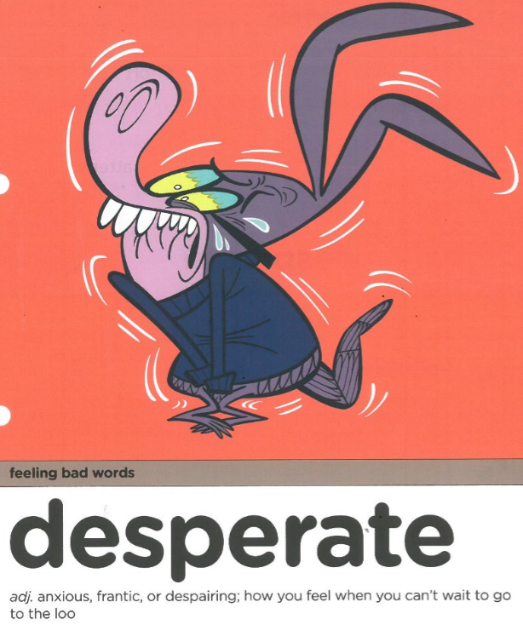
What is happening in this picture?
I can see …
I notice a …
I think the character is feeling …
The atmosphere is…
Resources from Mrs Wordsmith

Slide 14
adjective
- anxious, frantic or despairing; how you feel when you can’t wait to go to the loo
Resources from Mrs Wordsmith

Slide 15
Which words
are synonyms?
battle
frantic
measure
fight
anxious
need
attempt
situation
effort
despairing
After lockdown, I was in desperate need of a haircut!
Resources from Mrs Wordsmith

Slide 16
Word pairs
desperate
need
attempt
situation
effort
battle
measure
fight
desperate
desperate
desperate
desperate
desperate
Resources from Mrs Wordsmith
desperate

Slide 17
deflated
humiliated
desperate
desperate
deflated
humiliated
Resources from Mrs Wordsmith

Slide 18
-feeling hopeless or let down; when you feel sad and empty like a ball with the air let out
- anxious, frantic or despairing; how you feel when you can’t wait to go to the loo
-very embarrassed or ashamed; how you feel if someone pulls down your trousers as a joke
Resources from Mrs Wordsmith

Slide 19
-feeling hopeless or let down; when you feel sad and empty like a ball with the air let out
-very embarrassed or ashamed; how you feel if someone pulls down your trousers as a joke
- anxious, frantic or despairing; how you feel when you can’t wait to go to the loo
Resources from Mrs Wordsmith

Slide 20
The peach crayon felt ____________ because her wrapper had peeled off and she was naked!
humiliated
deflated
humiliated
desperate
20

Slide 21
deflated
The beige crayon felt_________ because he was never chosen to colour anything fun.
deflated
humiliated
desperate
21

Slide 22
desperate
The blue crayon was _____________ to be sharpened because she was nothing more than a tiny stub!
deflated
humiliated
desperate
22

Slide 23
Have a go at writing a sentence, using the word deflated. Use the word pairs to help you!
pride
ego
tyre
ball
mood
balloon
Resources from Mrs Wordsmith

Slide 24
Have a go at writing a sentence, using the word humiliated. Use the word pairs to help you!
classmate
politician
candidate
opponent
contestant
team
pride
Resources from Mrs Wordsmith

Slide 25
Have a go at writing a sentence, using the word desperate. Use the word pairs to help you!
need
attempt
situation
effort
battle
measure
fight
Resources from Mrs Wordsmith

Slide 26
Share your work with Oak National
If you'd like to, please ask your parent or carer to share your work on Twitter tagging @OakNational and #LearnwithOak

