Slide 2
Are these wholes equal?
0
4
1
3
8
4
1
4
7
7
5
9

Slide 3
Are these wholes equal?
0
4
1
3
4
$$=$$
4
8
4
9
8
1
4
$$=$$
14
14
7
7
5
9

Slide 5
3
There are _____ plates.
There are _____ strawberries on each plate.
There are ____ equal groups of ____
5
3
5

Slide 6
5
There are _____ dice.
There are _____ spots on each dice.
There are ____ equal groups of ____
4
5
4
Have a think

Slide 7
Have a think
4 groups of 5
4 groups of 4
5 groups of 4

Slide 8
Are the groups equal or not equal?
Not equal

Slide 9
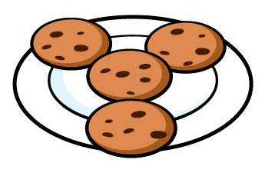
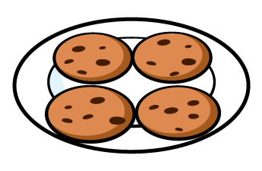
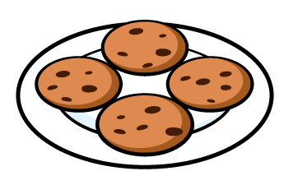
Are the groups equal or not equal?
Equal

Slide 10
Are the groups equal or not equal?
Not equal

Slide 11
Have a go at the questions on the worksheet

