Slide 2
To be aware of and be able to recognise different types of sentences.

Slide 3
Statements
1
Statements are sentences which tell you a fact, opinion or idea.
Example:
A rainbow has 7 colours.
They are beautiful to look at.

Slide 4
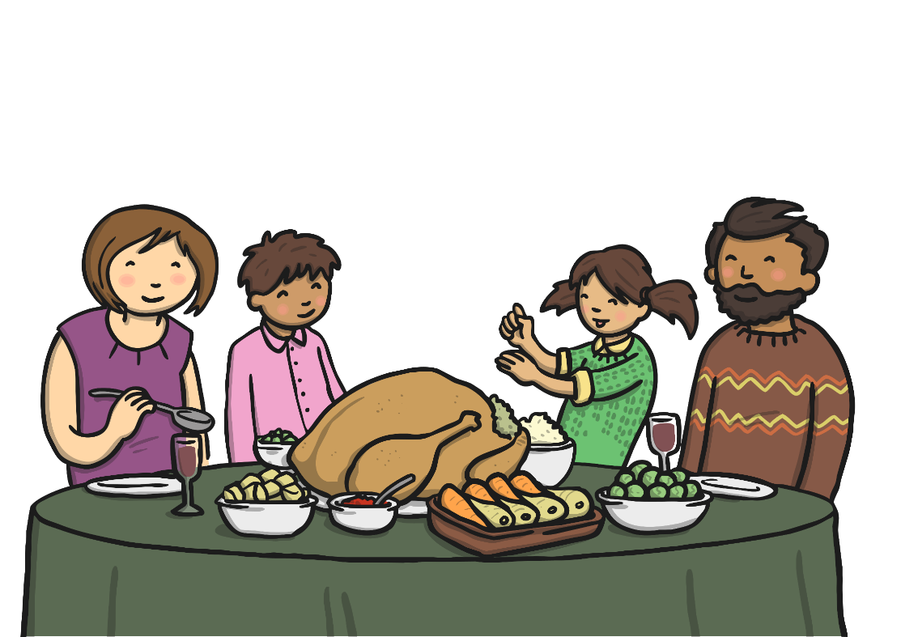
Questions
2
Questions are sentences that ask you something.
They usually end with a question mark.
Example:
What did you have for dinner?

Slide 5
Commands
3
They are often urgent or angry, can be very short and contain an imperative verb. Commands Imperative verbs are also known as ‘bossy verbs’- they tell people what to do.
Example:
Help me! Stop it.

Slide 6
Exclamations
4
An exclamation is used when someone is surprised.
It always starts with ‘How’ or ‘What’ and contains a noun and a verb.
Example:
What big feet you have!

Slide 7
Can you match the sentence with the correct sentence type?
Sentence
Type of Sentence
It is a beautiful day.
statement
question
Where should we have our picnic?
command
question
Take the sandwiches out of the lunch box.
exclamation
command
What a mess we have made!
statement
exclamation
show answer

Slide 8
Oh no, these aliens have got lost in space! Can you help them to get back to their home planets? Each planet is a different sentence type. Read the alien’s sentences to work out where they live.
show answer
Bow down before me, weak humans!
Will I be home in time for tea?
My eye is huge.
What pointy ears I have!
Planet Command
Planet Question
Planet Statement
Planet Exclamation

Slide 9
To be aware of and be able to recognise different types of sentences.

