Slide 1
YEAR 2
Money
Recap – value
Compare money
Find the total
Find the difference
Find change
Two-step problems
Block 3 – Week 10

Slide 2
Short Lesson 1 Monday - Recap
Step: Compare money

Slide 3
Fluency
How many coins are there?
What does the word value mean?

Slide 4
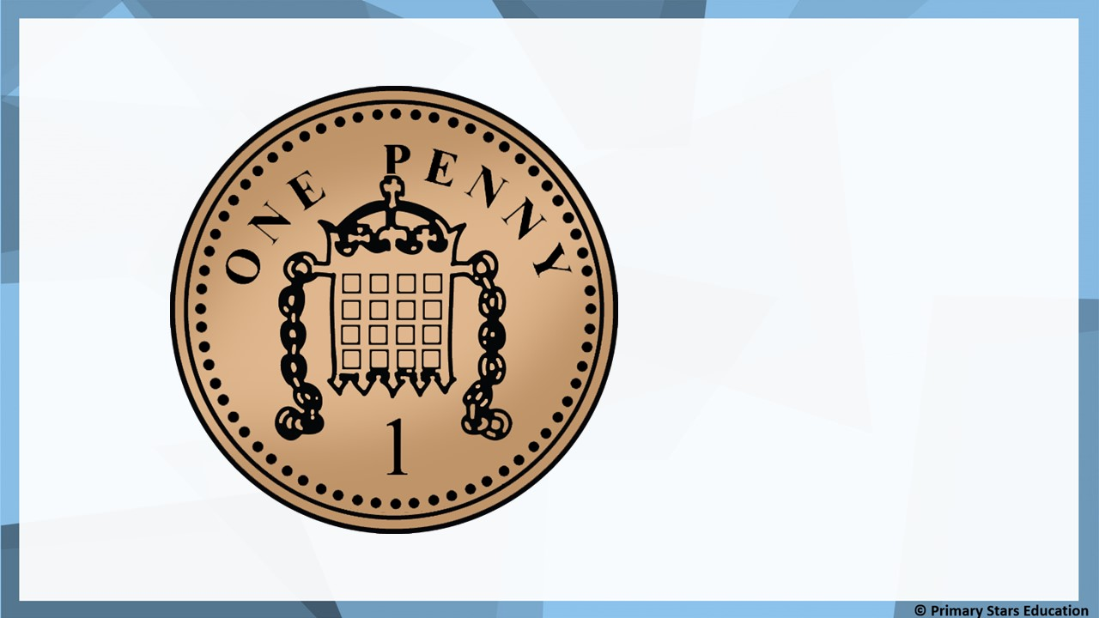
Fluency
1p

Slide 5
Fluency
2p

Slide 6
Fluency
5p

Slide 7
Fluency
10p

Slide 8
Fluency
20p

Slide 9
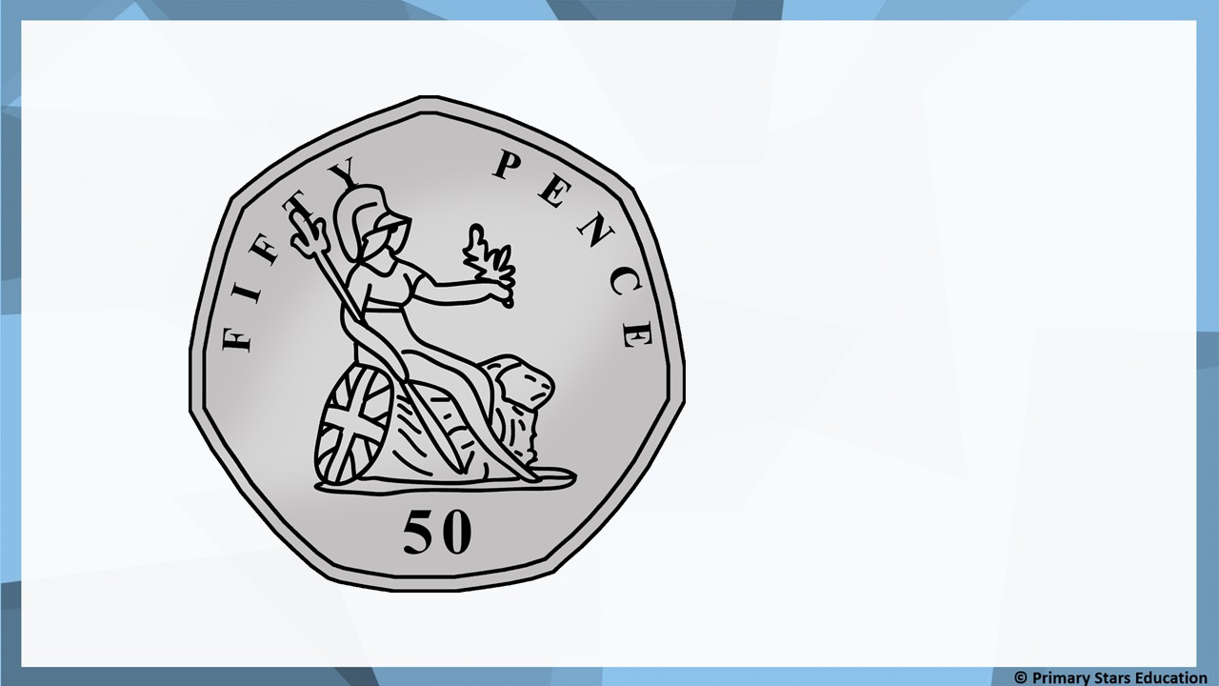
Fluency
50p

Slide 10
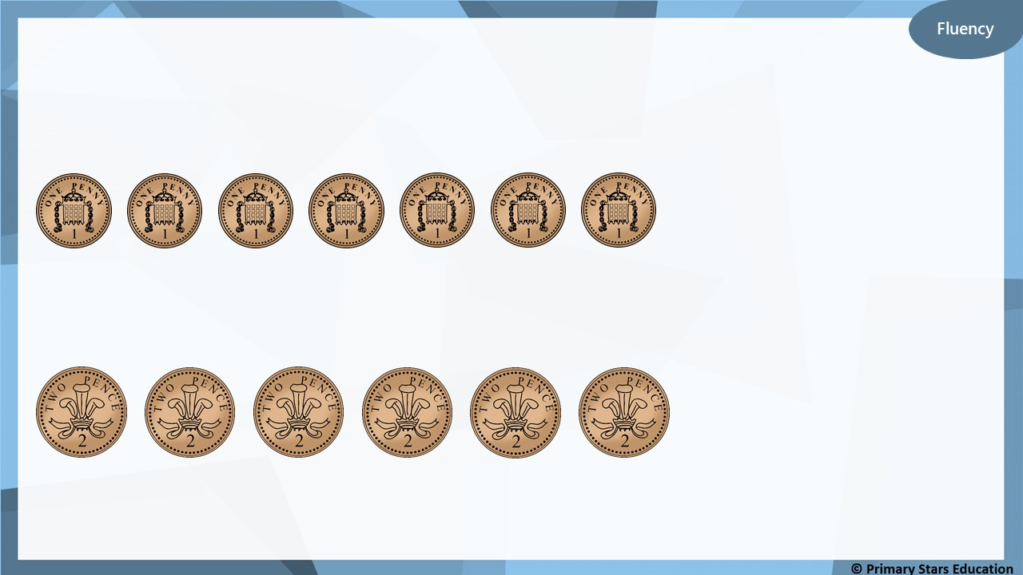
What amounts are shown?
7p
12p

Slide 11
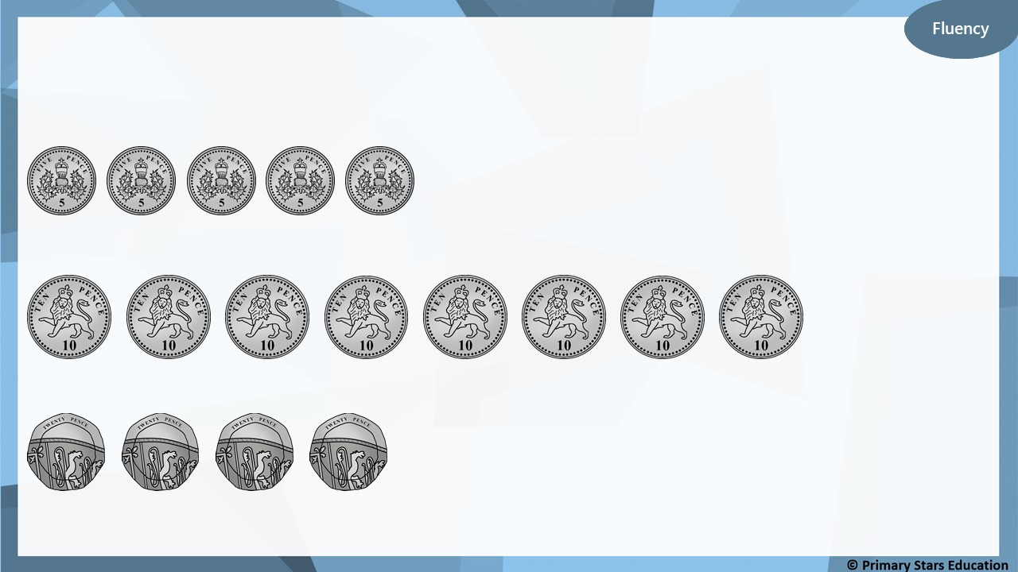
What amounts are shown?
25p
80p
80p

Slide 12
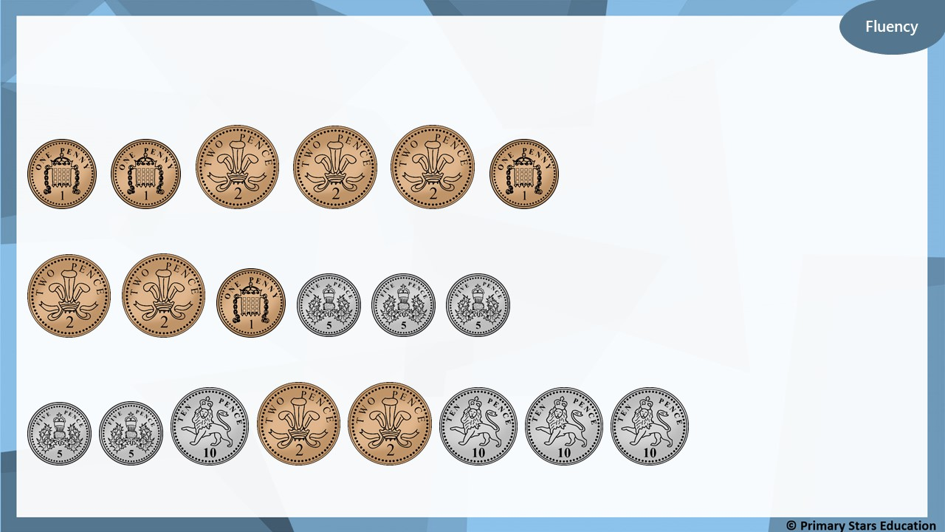
What amounts are shown?
9p
20p
54p

Slide 13
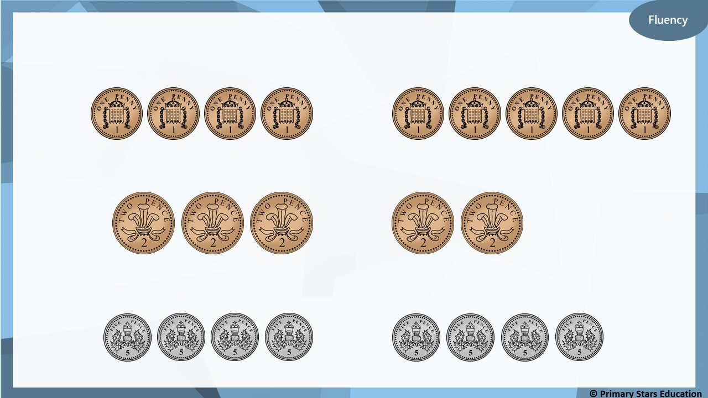
Use <, > or = to compare the money.
<
>
=

Slide 14
Use <, > or = to compare the money.
<
>
=

Slide 15
Fluency
£1

Slide 16
Fluency
£2

Slide 17
Fluency
£5

Slide 18
Fluency
£10

Slide 19
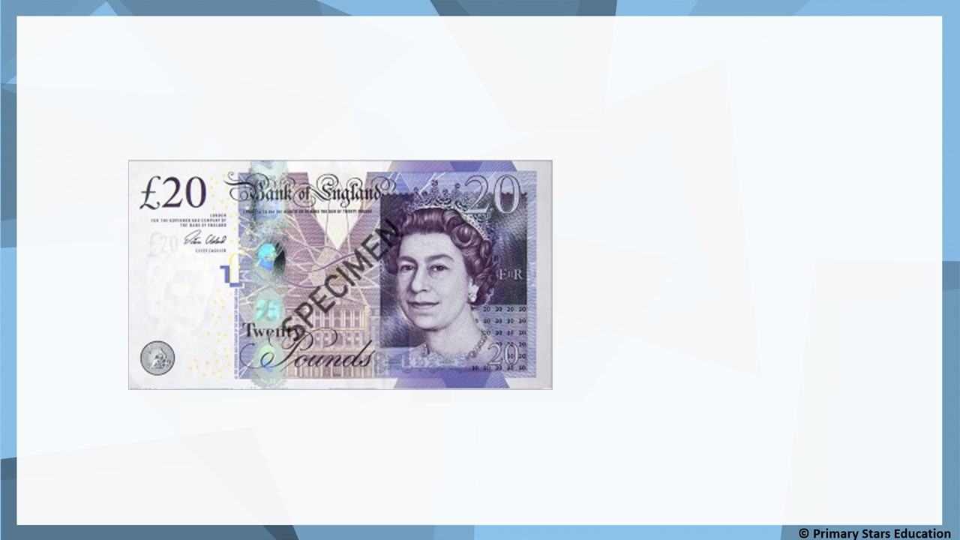
Fluency
£20

Slide 20
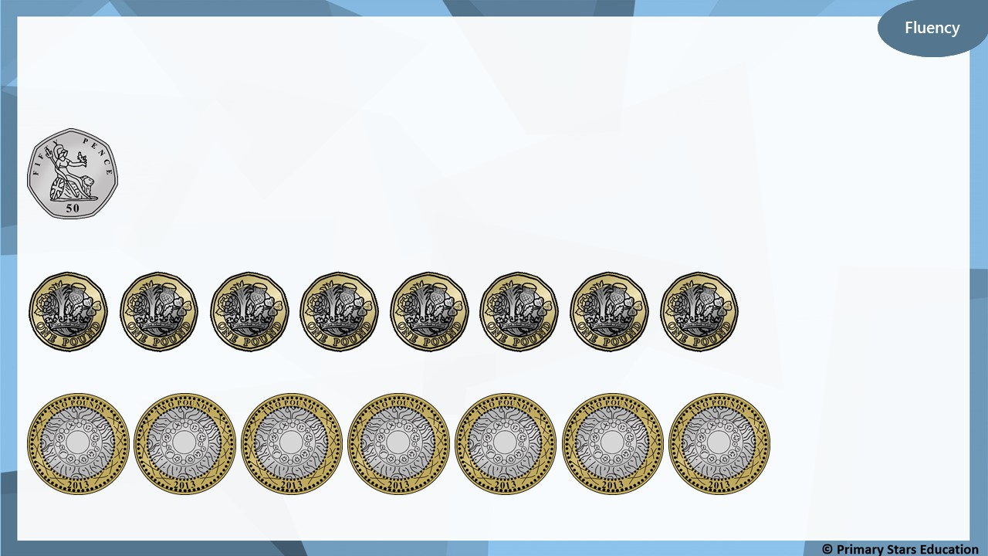
What amounts are shown?
50p
£8
£14

Slide 21
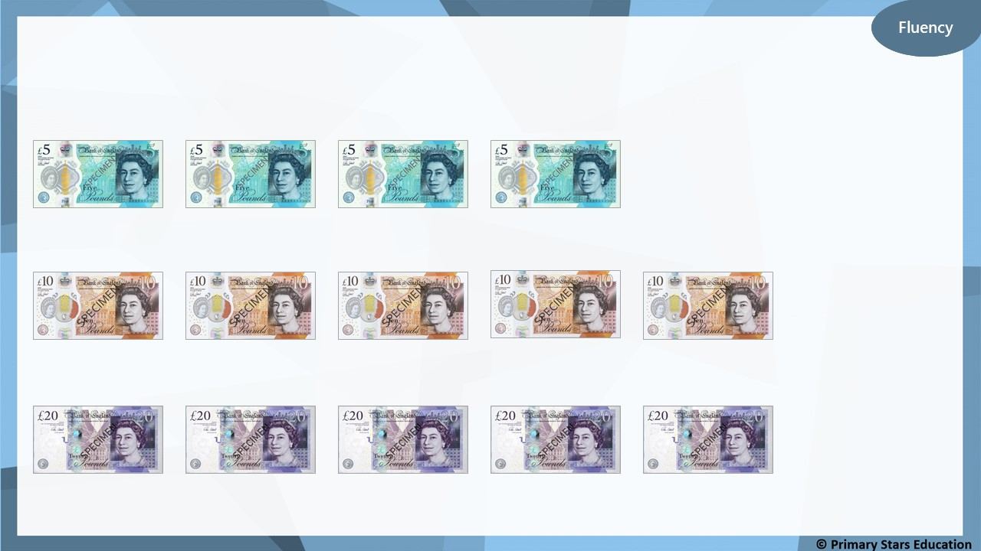
What amounts are shown?
£20
£50
£100

Slide 22
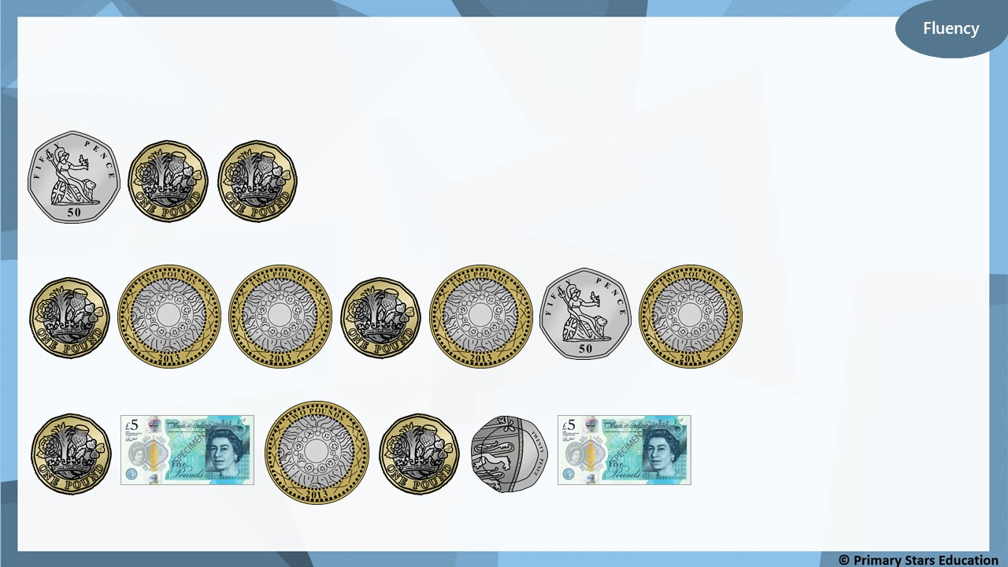
What amounts are shown?
£2 and 50p
£10 and 50p
£14 and 20p

Slide 23
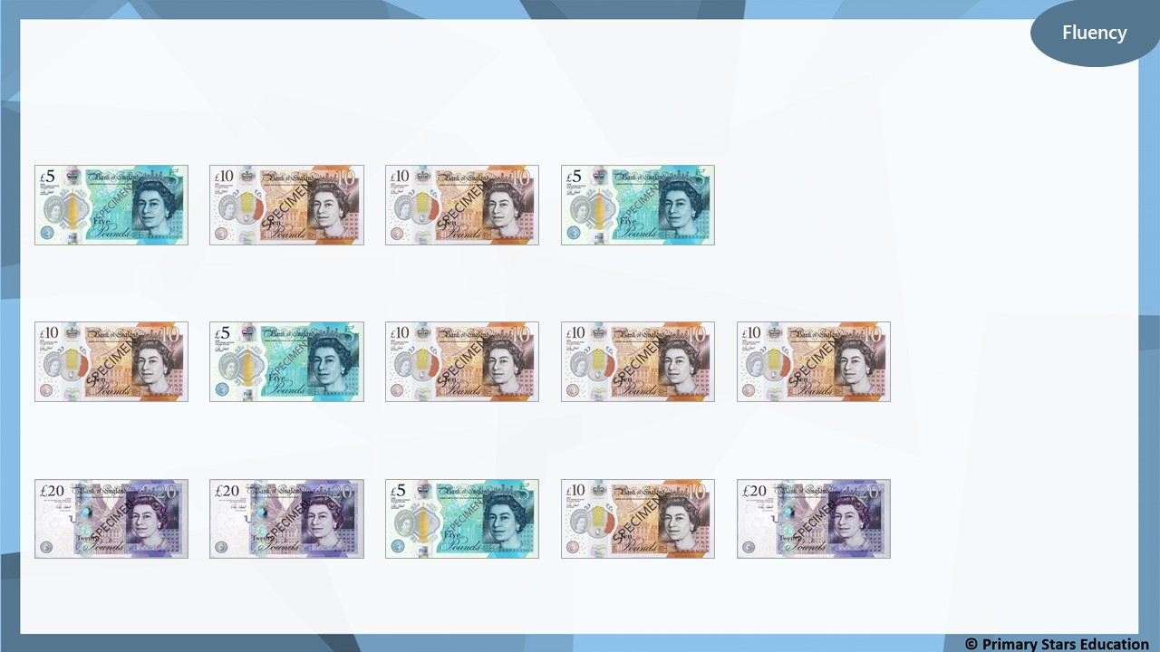
What amounts are shown?
£30
£45
£75

Slide 27
>
<

Slide 28
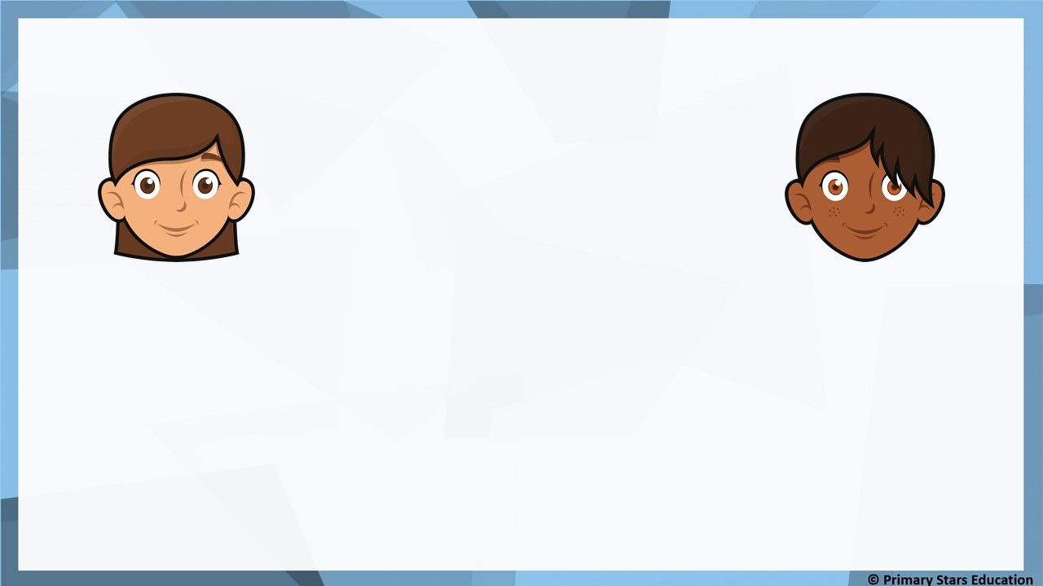
Reasoning
Who has the most and who has the least?
I have £10.
I have 10p.
Beth
Gina
How do you know?
Beth has the most and Gina has the least.
Beth’s amount is in pounds whereas Gina’s is in pence.
£10 is more than 10p.

Slide 29
Problem solving
Put coins in the boxes to show…
3 copper coins > 1 silver coin
>
How many different ways are there?

Slide 30
Short Lesson 2 Wednesday
Step: Find the total

Slide 31
Fluency
Complete the table.
Pounds | Pence | Total
£1 | 10p | £________ and ________p
£2 | 35p | £________ and ________p
£________ | 75p | £2 and ________p
£________ | 50p | £3 and ________p
£4 | ________p | £________ and 5p
£5 | ________p | £________ and 60p
1
10
2
35
2
75
3
50
5
4
60
5

Slide 32
Fluency
Mo buys an apple and a banana.
30p
45p
0
75
How much does he spend? £________ and ________p

Slide 33
Fluency
Sue buys an doughnut, slice of cake and a cookie.
50p
80p
30p
1
60
How much does she spend? £________ and ________p

Slide 34
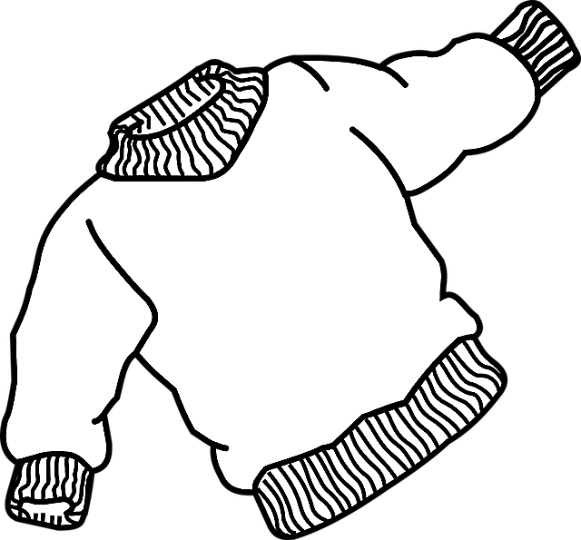
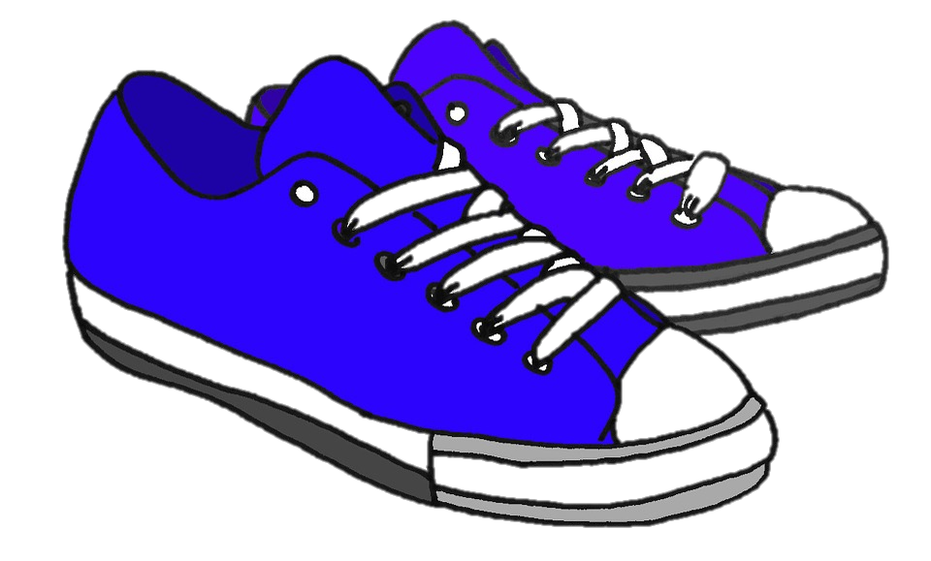
Fluency
Kat buys a shoes, a t-shirt and a jumper.
£10
£7
£5 and 75p
22
75
How much does she spend? £________ and ________p

Slide 35
Fluency
Complete the bar models.
10p | 5p | 5p
20p
£1 | £1 | 10p
£2 and 10p

Slide 36
Fluency
Complete the bar models.
£17
£2
£5
£10
£45
£15
£15
£15

Slide 37
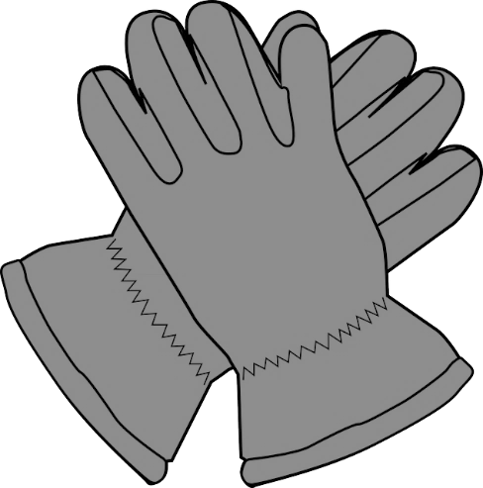
Reasoning
What is the total of:
£1 and 50p
£1 and 25p
£2
a) Hat and the socks? £________ and ________p.
3
50
b) Gloves and the socks? £_______ and _______p.
2
75
c) The total of all the items is £5 and 75p. True or false?
False, the total of all the items is £4 and 75p.

Slide 38
Any combinations of the above coins and note that amount to more than £5 but less than £10, for example:
£5, £2 = £7 OR £2, £2, £2 = £6 OR £1, £1, £1, £5 = £8

Slide 39
Fluency
a) Mo has £1 and 50p.
Asha has £1 and 65p.
How much more money does Asha have than Mo?
Asha has 15p more than Mo.
b) Rob has £1 and 75p.
Gina has £2 and 25p.
How much more money does Gina have than Rob?
Gina has 50p more than Rob.

Slide 40
I have £1 and 40p.
I have £1 and 20p.
Tam
Dom
Tam says she has 30p more than Dom.
Is Tam correct? How do you know?
No. Tam has 20p more than Dom.
£1 and 40p - £1 and 20p = 20p.

Slide 41
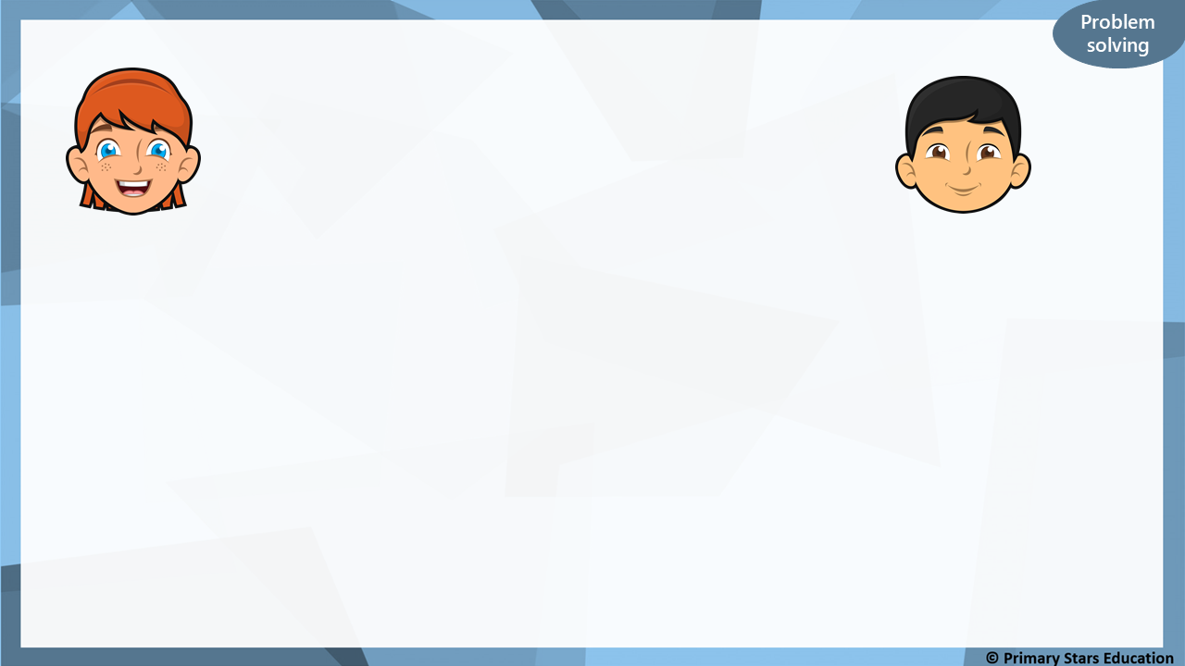
I have 10p.
I have 30p.
Sue
Che
Both children have a 10p coin. Che only has silver coins.
What other silver coins could Che have?
Any combination of silver coins to make 20p, for example:
4 x 5p 2 x 5p and 1 x 10p 2 x 10p 1 x 20p

