Slide 1
YEAR 2
Multiplication & Division
Making equal groups
Adding equal groups
Make arrays
R
R
R
Block 4 – Week 11

Slide 2
MondayShort Lesson 1
Step: Making equal groups

Slide 3
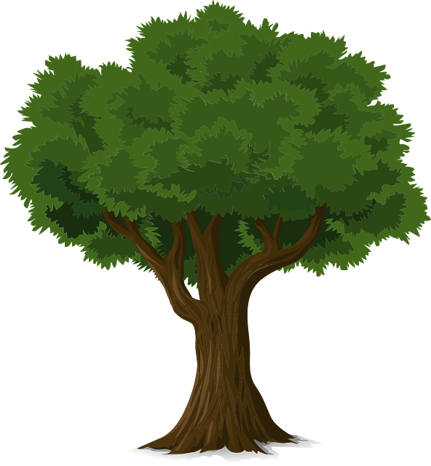
Fluency
Equal or unequal?
equal
unequal

Slide 4
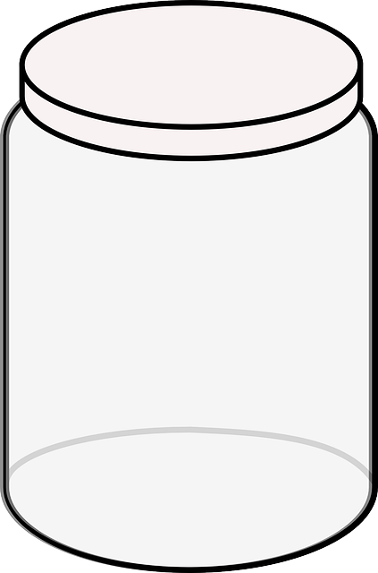
Fluency
Equal or unequal?
unequal
equal

Slide 5
Fluency
Complete the sentences.
5
2
There are _____ groups, each with _____ ice cream scoops.

Slide 6
Fluency
Complete the sentences.
4
10
There are _____ groups of _____ apples.

Slide 7
Fluency
Complete the sentences.
3
10
There are _____ groups of _____ fish.

Slide 8
Fluency
Complete to make equal groups.

Slide 9
Fluency
Complete to make equal groups.

Slide 10
True or false?
Reasoning
There are 4 groups of 5 pencils.
Explain your answer.
False, there are five groups of 4 pencils.

Slide 11
Kat says,
I have 3 unequal groups.
On your whiteboards, draw what the
groups could look like.

Slide 12
Wednesday Short Lesson 2
Step: Adding equal groups

Slide 13
Fluency
How many cherries altogether?
2 + 2 + 2 = _____
There are _____ groups of _____ cherries
which is equivalent to _____.
6
3
2
6

Slide 14
Fluency
How many doughnuts altogether?
2 + 2 + 2 + 2 + 2= _____
There are _____ groups of _____ doughnuts
which is equivalent to _____.
10
5
2
10

Slide 15
Fluency
How many pencils altogether?
5 + 5 + 5 + 5 = _____
There are _____ groups of _____ pencils
which is equivalent to _____.
20
4
5
20

Slide 16
Fluency
How many fish altogether?
10 + 10= _____
There are _____ groups of _____ fish
which is equivalent to _____.
20
2
10
20

Slide 17
Fluency
How many apples altogether?
10 + 10 + 10 + 10= _____
There are _____ groups of _____ apples
which is equivalent to _____.
40
4
10
40

Slide 18
Fluency
Complete the table.
Picture | Repeated addition | Bar model | Stem sentence
There are ____ groups of ____ which is equivalent to ____.
2 | 2 | 2
3
6
2 + 2 + 2
2
6
There are ____ groups of ____ which is equivalent to ____.
10
5 | 5
2
5 + 5
5
10
There are ____ groups of ____ which is equivalent to ____.
10 | 10 | 10
3
30
10 + 10 + 10
10
30

Slide 19
Fluency
Complete the table.
Picture | Repeated addition | Bar model | Stem sentence
There are ____ groups of ____ which is equivalent to ____.
10
2 | 2 | 2 | 2 | 2
5
2 + 2 + 2 +
2 + 2
2
10
There are ____ groups of ____ which is equivalent to ____.
5 | 5 | 5 | 5 | 5
5
5 + 5 + 5 +
5 + 5
25
5
25
There are ____ groups of ____ which is equivalent to ____.
10 | 10 | 10 | 10
4
10 + 10 +
10 + 10
40
10
40

Slide 20
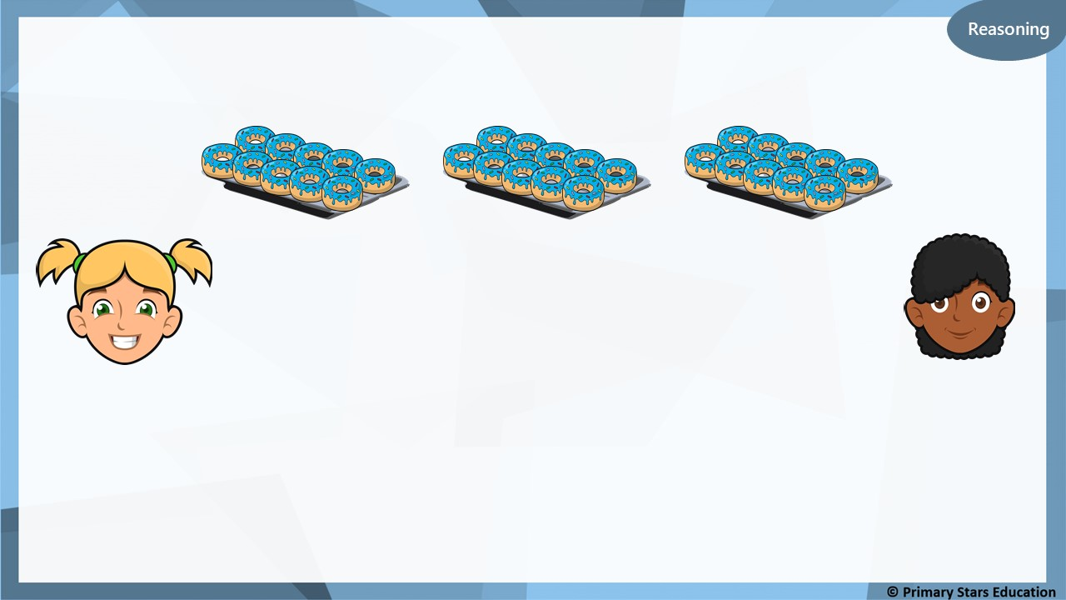
Kat and Asha are making equal groups of doughnuts.
We need one more group to make 40.
We need 10 more doughnuts to make 40.
Kat
Asha
Who do you agree with? Explain why.
Both are correct. One more group of ten is the same as adding 10 more doughnuts.

Slide 21
I have nine groups of 2.
I have 2 groups of 10.
Jack
Matt
Who has the most? Explain how you know.
Matt has the most. 2 groups of 10 = 20.
Jack has 9 groups of 2 = 18.

Slide 22
Friday Short Lesson 3
Step: Make arrays

Slide 23
Fluency
What is a row?
5
How many in each row? ________ How many rows are there? ________
2

Slide 24
Fluency
Complete the sentences.
2
There are _____ in each row. There are _____ rows. _____ + _____ + _____ = _____ There are _____ altogether.
3
2
2
2
6
6

Slide 25
Fluency
Complete the sentences.
5
There are _____ in each row. There are _____ rows. _____ + _____ = _____ There are _____ altogether.
2
5
5
10
10

Slide 26
Fluency
Complete the sentences.
2
There are _____ in each row. There are _____ rows. _____ + _____ = _____ There are _____ altogether.
2
2
2
4
4

Slide 27
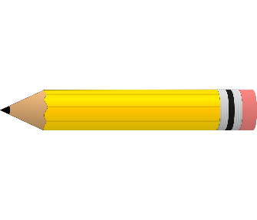
Fluency
Complete the sentences.
10
There are _____ in each row. There are _____ rows. _____ + _____ + _____ = _____ There are _____ altogether.
3
10
10
10
30
30

Slide 28
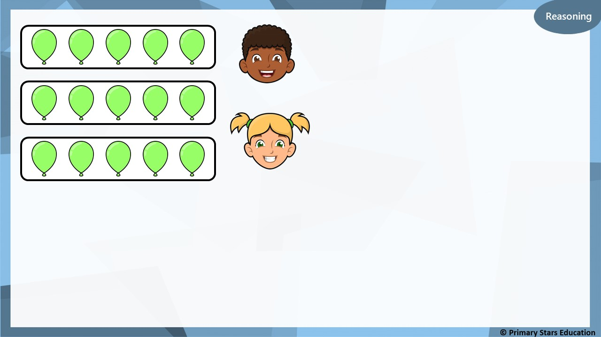
The matching number sentence is 5 + 5 + 5.
Dom
The matching number sentence is 3 + 3 + 3.
Kat
Who do you agree with? Explain your answer.
Dom is correct. There are 5 in each row and there are 3 rows.

Slide 29
Problem solving
What array could be built with 6 cubes?
Build, draw and describe the array.
or
2 in each row. 3 rows.
3 in each row. 2 rows.

Slide 30
Problem solving
The number sentence that represents the array is:
10 + 10 + 10 Complete the array to show this.

