Slide 1
Monday Short Lesson 1
Step: Adding equal groups

Slide 2
Fluency
How many cherries altogether?
2 + 2 + 2 = _____
There are _____ groups of _____ cherries
which is equivalent to _____.
6
3
2
6

Slide 3
Fluency
How many doughnuts altogether?
2 + 2 + 2 + 2 + 2= _____
There are _____ groups of _____ doughnuts
which is equivalent to _____.
10
5
2
10

Slide 4
Fluency
How many pencils altogether?
5 + 5 + 5 + 5 = _____
There are _____ groups of _____ pencils
which is equivalent to _____.
20
4
5
20

Slide 5
Fluency
How many fish altogether?
10 + 10= _____
There are _____ groups of _____ fish
which is equivalent to _____.
20
2
10
20

Slide 6
Fluency
How many apples altogether?
10 + 10 + 10 + 10= _____
There are _____ groups of _____ apples
which is equivalent to _____.
40
4
10
40

Slide 7
Fluency
Complete the table.
Picture | Repeated addition | Bar model | Stem sentence
There are ____ groups of ____ which is equivalent to ____.
2 | 2 | 2
3
6
2 + 2 + 2
2
6
There are ____ groups of ____ which is equivalent to ____.
10
5 | 5
2
5 + 5
5
10
There are ____ groups of ____ which is equivalent to ____.
10 | 10 | 10
3
30
10 + 10 + 10
10
30

Slide 8
Fluency
Complete the table.
Picture | Repeated addition | Bar model | Stem sentence
There are ____ groups of ____ which is equivalent to ____.
10
2 | 2 | 2 | 2 | 2
5
2 + 2 + 2 +
2 + 2
2
10
There are ____ groups of ____ which is equivalent to ____.
5 | 5 | 5 | 5 | 5
5
5 + 5 + 5 +
5 + 5
25
5
25
There are ____ groups of ____ which is equivalent to ____.
10 | 10 | 10 | 10
4
10 + 10 +
10 + 10
40
10
40

Slide 9
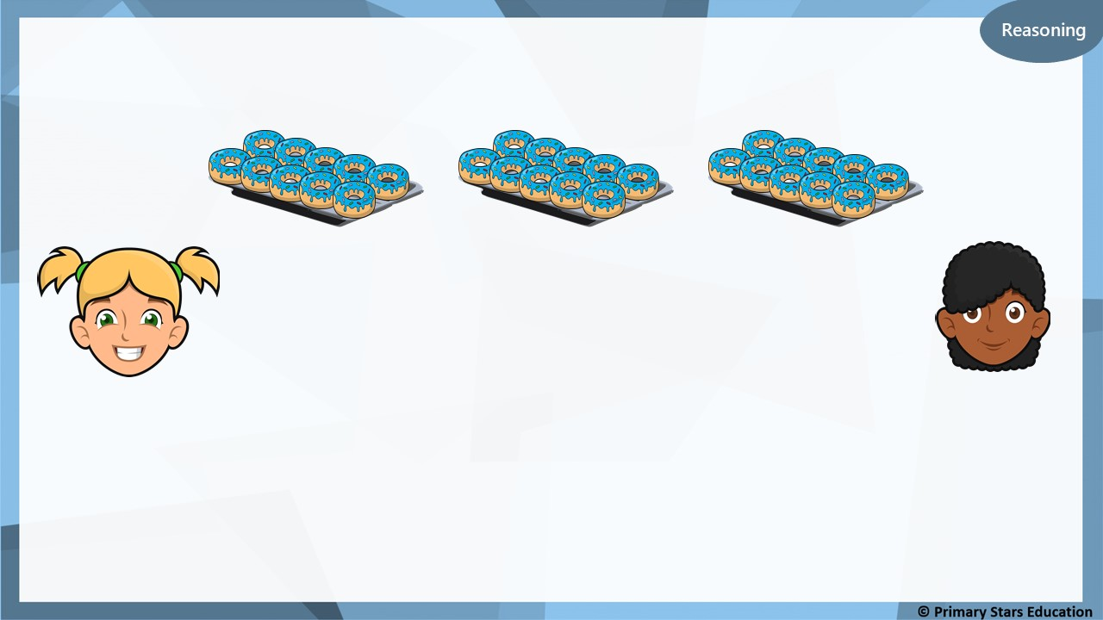
Kat and Asha are making equal groups of doughnuts.
We need one more group to make 40.
We need 10 more doughnuts to make 40.
Kat
Asha
Who do you agree with? Explain why.
Both are correct. One more group of ten is the same as adding 10 more doughnuts.

Slide 10
I have nine groups of 2.
I have 2 groups of 10.
Jack
Matt
Who has the most? Explain how you know.
Matt has the most. 2 groups of 10 = 20.
Jack has 9 groups of 2 = 18.

Slide 11
Wednesday Short Lesson 4
Step: Make arrays

Slide 12
Fluency
What is a row?
5
How many in each row? ________ How many rows are there? ________
2

Slide 13
Fluency
Complete the sentences.
2
There are _____ in each row. There are _____ rows. _____ + _____ + _____ = _____ There are _____ altogether.
3
2
2
2
6
6

Slide 14
Fluency
Complete the sentences.
5
There are _____ in each row. There are _____ rows. _____ + _____ = _____ There are _____ altogether.
2
5
5
10
10

Slide 15
Fluency
Complete the sentences.
2
There are _____ in each row. There are _____ rows. _____ + _____ = _____ There are _____ altogether.
2
2
2
4
4

Slide 16
Fluency
Complete the sentences.
10
There are _____ in each row. There are _____ rows. _____ + _____ + _____ = _____ There are _____ altogether.
3
10
10
10
30
30

Slide 17
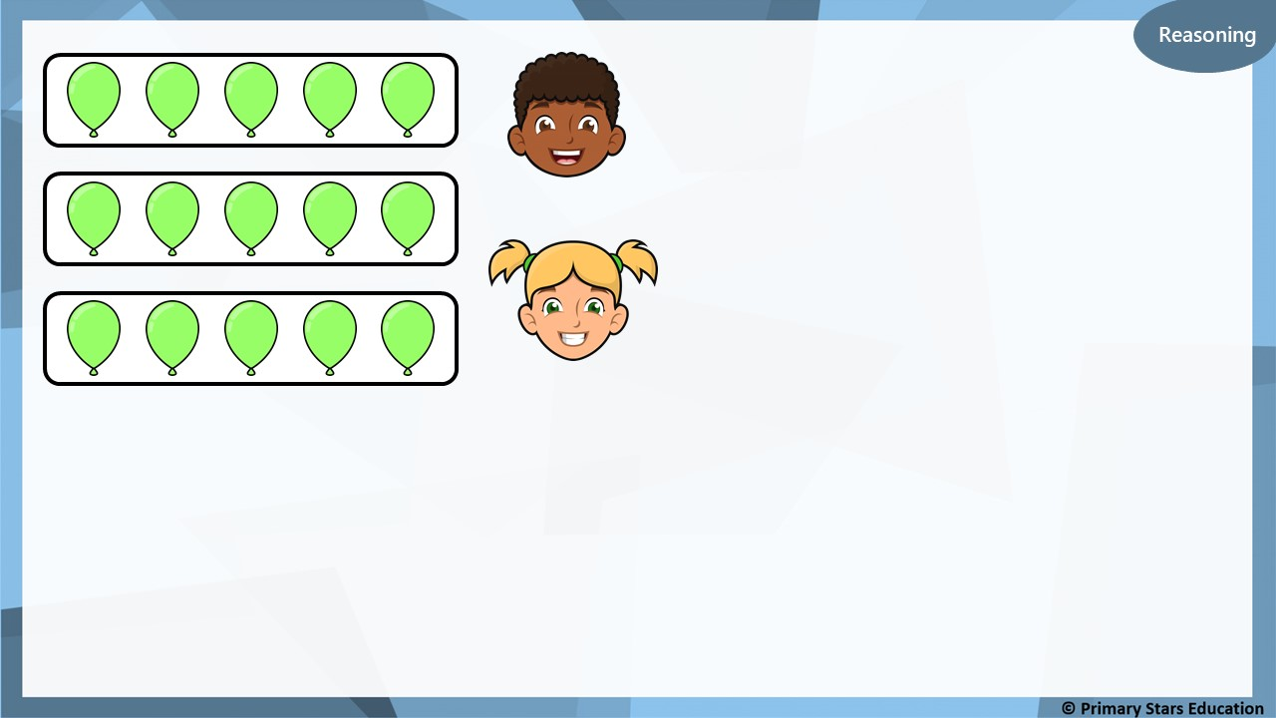
The matching number sentence is 5 + 5 + 5.
Dom
The matching number sentence is 3 + 3 + 3.
Kat
Who do you agree with? Explain your answer.
Dom is correct. There are 5 in each row and there are 3 rows.

Slide 18
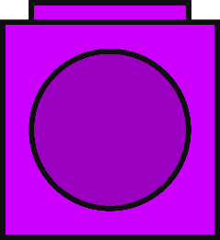
Problem solving
What array could be built with 6 cubes?
Build, draw and describe the array.
or
2 in each row. 3 rows.
3 in each row. 2 rows.

Slide 19
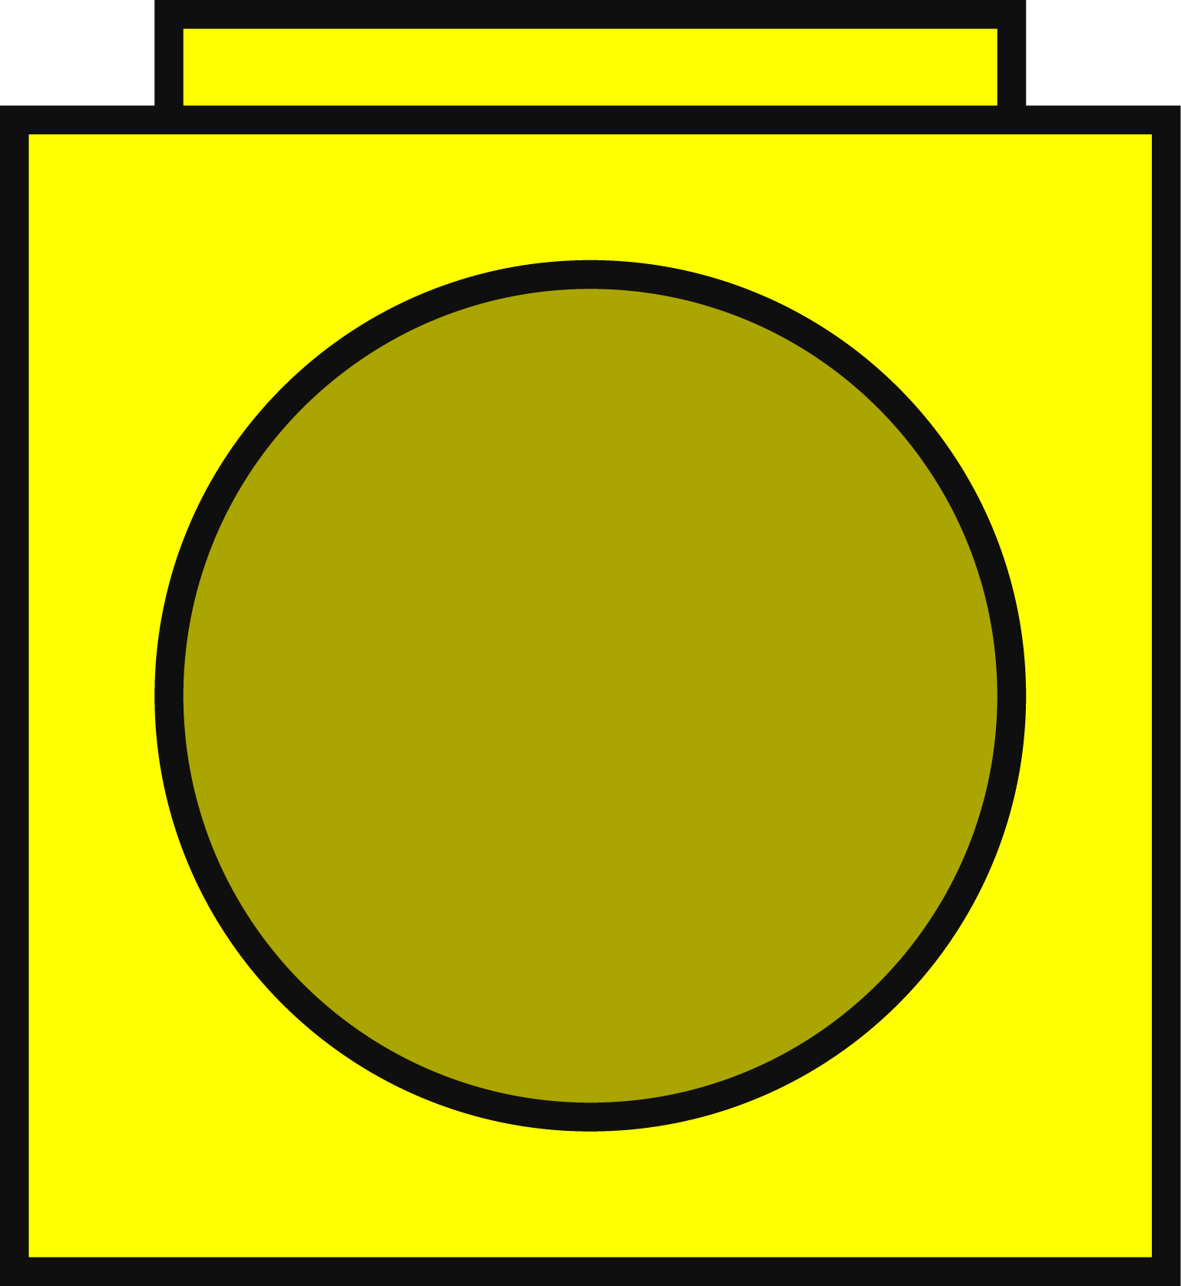
Fluency
Match the array to its number sentence.
2 + 2 + 2
2 + 2
2 + 2 + 2 + 2

Slide 20
Fluency
Complete the sentences.
2
There are _____ in each row. There are _____ rows. _____ + _____ + _____ + _____ = _____ There are _____ altogether.
4
2
2
2
2
8
8

Slide 21
Fluency
Complete the sentences.
5
There are _____ in each row. There are _____ rows. _____ + _____ + _____ = _____ There are _____ altogether.
3
5
5
5
15
15

Slide 22
Fluency
Complete the sentences.
10
There are _____ in each row. There are _____ rows. _____ + _____ + _____ + _____ = _____ There are _____ altogether.
4
10
10
10
10
40
40

Slide 23
Reasoning
What mistake has been made in the array above?
There are an unequal amount of squares in the array. One of the row contains 4 instead of 5.

Slide 24
Problem solving
Build and draw an array to match the description.
There are 5 rows. There are 2 on each row.

Slide 25
Fluency
What is the difference between a row and column?
Rows go across
Columns go down
2
5
There are _______ rows. _______ in each row.
There are _______ columns. _______ in each column.
5
2

Slide 26
Fluency
Complete the sentences.
4
_______ rows.
_______ in each row.
_______ columns.
_______ in each column.
2
2
4

Slide 27
Fluency
Complete the sentences.
3
_______ rows.
_______ in each row.
_______ columns.
_______ in each column.
10
10
3

Slide 28
Fluency
Complete the sentences.
4
_______ rows.
_______ in each row.
_______ columns.
_______ in each column.
5
5
4

Slide 29
Fluency
Complete the table.
Array | Describe: Rows | Describe: Columns | Number sentence
 | _____ rows. _____ in each row. | _____ columns. _____ in each column.
 | _____ rows. _____ in each row. | _____ columns. _____ in each column.
3
2
2 + 2 + 2
3+ 3
2
3
2
5
5 + 5
2 + 2 + 2 + 2 + 2
5
2

Slide 30
Fluency
Complete the table.
Array | Describe: Rows | Describe: Columns | Number sentence
 | _____ rows. _____ in each row. | _____ columns. _____ in each column.
 | _____ rows. _____ in each row. | _____ columns. _____ in each column.
2
2
2 + 2
2
2
3
5
5 + 5 + 5
3 + 3 + 3 + 3 + 3
5
3

Slide 31
My array has 3 rows and 2 columns. The total number of counters must be an odd number.
True or false?
False.
An array with 2 rows and 3 columns will use 6 counters. 6 is an even number.

Slide 32
Problem solving
The number sentence that represents the array is:
10 + 10 + 10 Complete the array to show this.

