Slide 1
YEAR 2
Multiplication & Division
Arrays Make doubles
2x tables
5x tables
10x tables
Block 1 – Week 2

Slide 2
Monday Short Lesson 1
Step: Arrays

Slide 3
Fluency
Write number sentences to match the array.
2
3
3
2
________ x ________ and ________ x ________

Slide 4
Fluency
Write number sentences to match the array.
3
5
5
3
________ x ________ and ________ x ________

Slide 5
Fluency
Write number sentences to match the array.
4
10
10
4
________ x ________ and ________ x ________

Slide 6
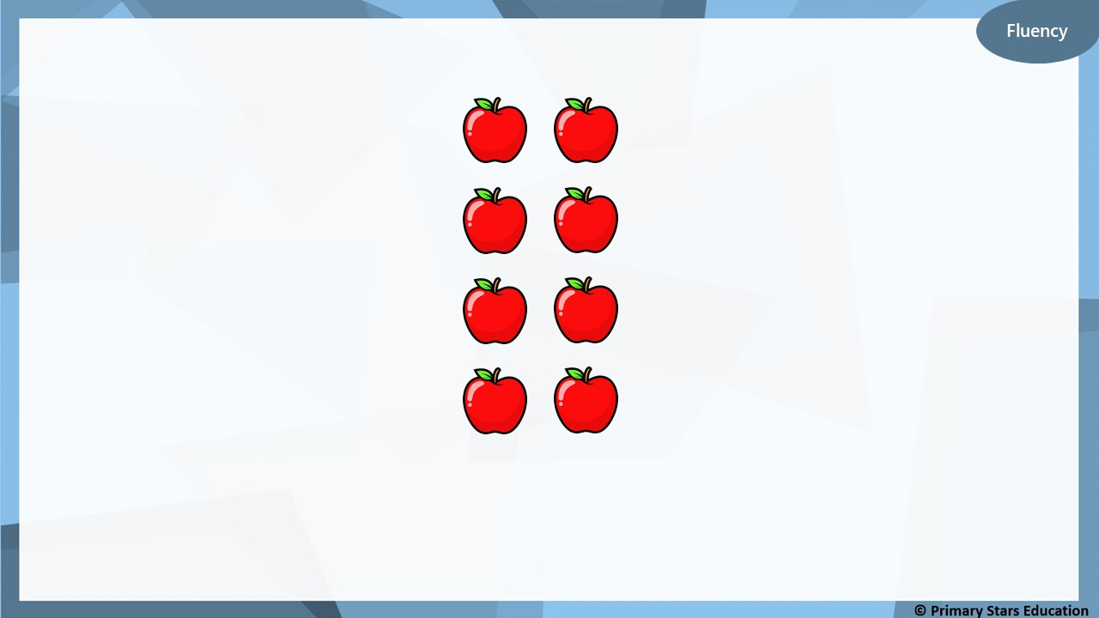
Write number sentences to match the array.
4
2
2
4
________ x ________ and ________ x ________

Slide 7
Fluency
Write number sentences to match the array.
6
5
5
6
________ x ________ and ________ x ________

Slide 8
Fluency
Write number sentences to match the array.
5
10
10
5
________ x ________ and ________ x ________

Slide 9
Fluency
Draw an array that will show 3 x 2.
2
3
How else could you describe this array? ________ x ________

Slide 10
Fluency
Draw an array that will show 5 x 3.
3
5
How else could you describe this array? ________ x ________

Slide 11
Fluency
Match the arrays to their multiplication.
2 x 8
4 x 5
2 x 10

Slide 12
Reasoning
The array below shows 3 x 10.
True or false? Example how you know.
False. The array shows 3 x 9.

Slide 13
Problem solving
Part of the array is hidden.
The total is less than 12.
What could the array be?
List all possibilities as number sentences.
2 x 3
2 x 4
2 x 5

Slide 14
Wednesday Short Lesson 2
Step: Make doubles

Slide 15
Fluency
Has this representation been doubled?
No

Slide 16
Fluency
Has this representation been doubled?
No

Slide 17
Has this representation been doubled?
Yes

Slide 18
Fluency
Has this representation been doubled?
No

Slide 19
Has this representation been doubled?
No

Slide 20
2
Double 1 is _______

Slide 21
4
Double 2 is _______

Slide 22
7
14
Double _____ is _____

Slide 23
5
10
Double _____ is _____

Slide 24
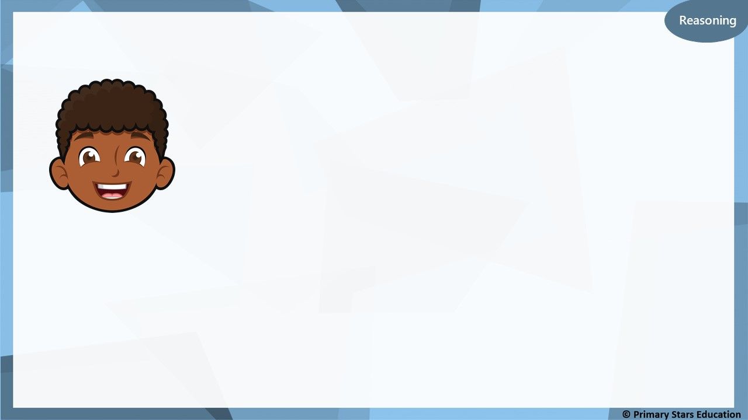
Dom says,
If I double 4, the answer will be equal to 12 – 6.
Do you agree with Dom?
No, double 4 is 8. 12 – 6 = 6.

Slide 25
8
Double is 16
?

Slide 26
3
6
Double _____ is _____

Slide 27
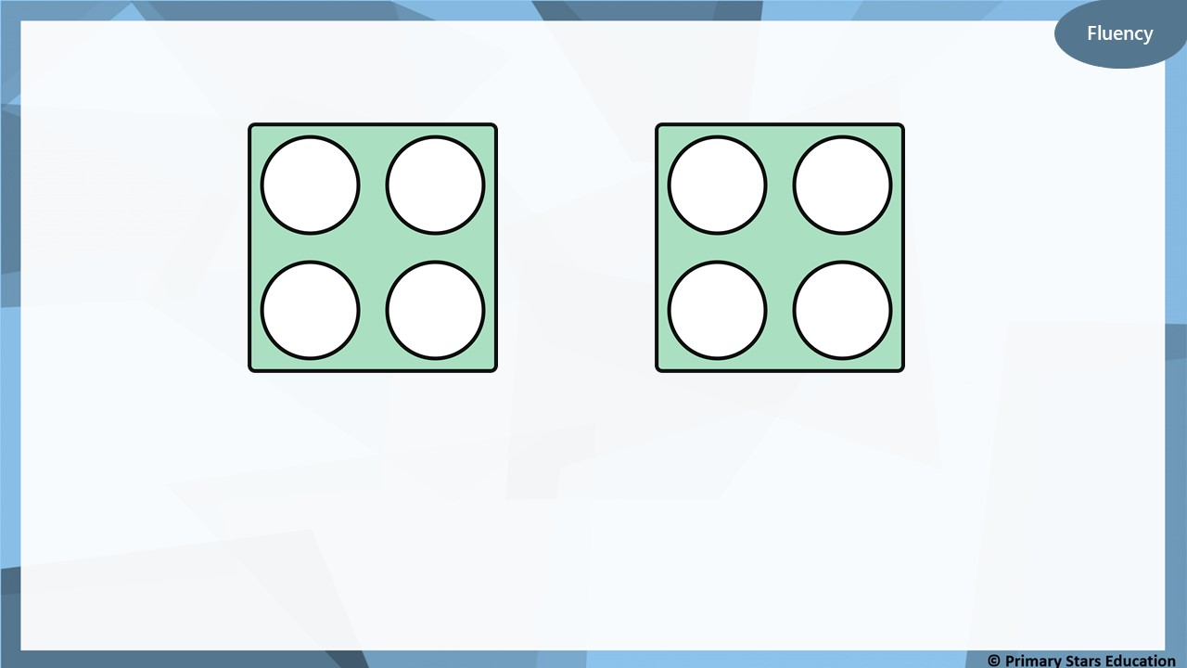
4
8
Double _____ is _____

Slide 28
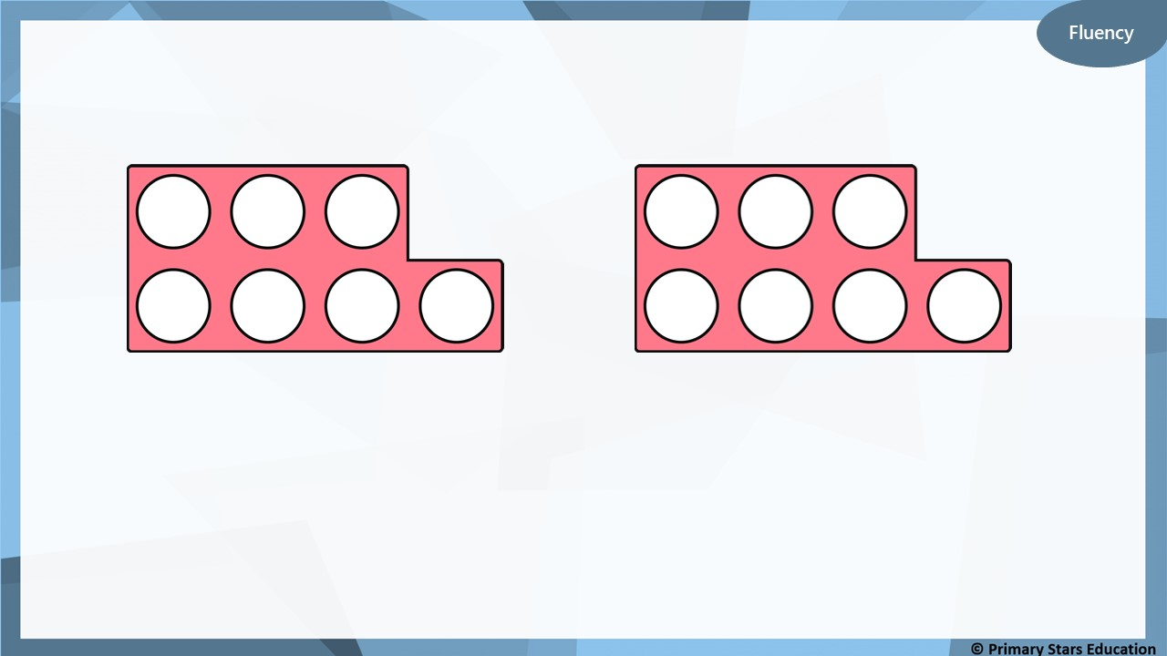
7
14
Double _____ is _____

Slide 29
10
20
Double _____ is _____

Slide 30
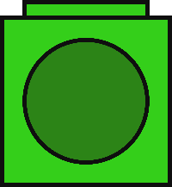
Fluency
Complete the table.
Build | Represent | Add | Double
 |  |  | Double 1 = ______
 |  |  | Double 2 = ______
1 + 1 = 2
2
2 + 2 = 4
4

Slide 31
Fluency
Complete the table.
Build | Represent | Add | Double
 |  |  | Double 3 = ______
 |  |  | Double 4 = ______
3 + 3 = 6
6
4 + 4 = 8
8

Slide 32
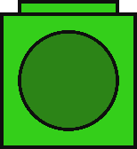
Reasoning
Spot and explain the mistake.
Build | Represent | Add | Double
 |  |  | Double 5 = 10
5 + 5 = 10
There are 12 cubes in total (6 have been doubled). There should be 10 cubes in total (5 doubled).

Slide 33
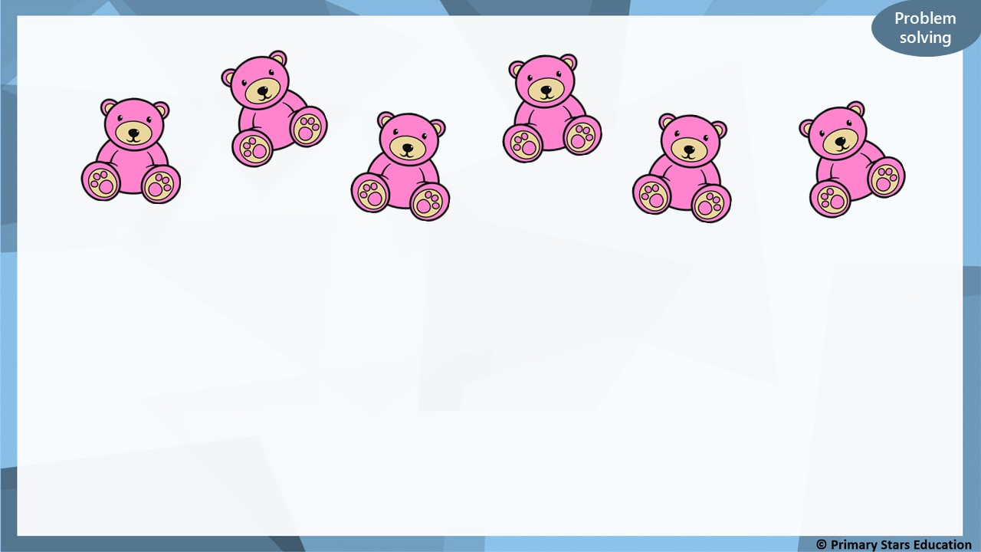
Double the amount shown will give an even number.
True or false? Explain how you know.
True. Double 6 = 12.

