Slide 1
YEAR 2
Multiplication & Division
Odd and even numbers
Divide by 5
Divide by 10
Block 1 – Week 4

Slide 2
Monday Short Lesson 1
Step: Odd and even numbers

Slide 3
Fluency
Put the numbers under the correct heading.
Odd | Even
1
11
6
14
3
15
8
16
9
17
12
20
3
17
20
6
14
11
16
8
15
9
12
1

Slide 4
Fluency
Which numbers are even?
15 1 60 19 22
40 29 50 9 5
58 25 3 10 7
30 87 12 11

Slide 5
Fluency
23? _______________
39? _______________
42? _______________
14? _______________
27? _______________
54? _______________
11? _______________
28? _______________
13? _______________
36? _______________
Are these numbers odd or even?
odd
even
odd
odd
even
even
even
odd
odd
even

Slide 6
Which number frames are odd?

Slide 8
Reasoning
Jack has coloured 3 odd numbers yellow and 3 even numbers red. What mistake has Jack made?
36 | 28 | 17 | 11 | 3 | 44
10 | 26 | 5 | 8 | 13 | 29
15 | 9 | 48 | 39 | 37 | 50
Jack has coloured 44 yellow. It should not be yellow as it not an odd number.
44 is an even number.

Slide 9
Kat says,
I am thinking of an odd number between 16 and 28.
What could Kat’s numbers be?
17, 19, 21, 23, 25, 27

Slide 10
Wednesday Short Lesson 2
Step: Divide by 5

Slide 11
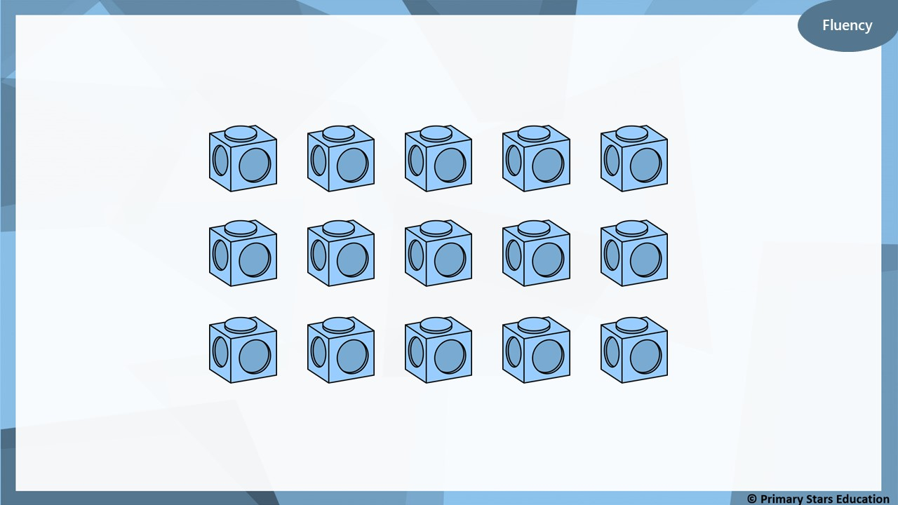
How many groups of 5 can you make?
3 groups of 5

Slide 12
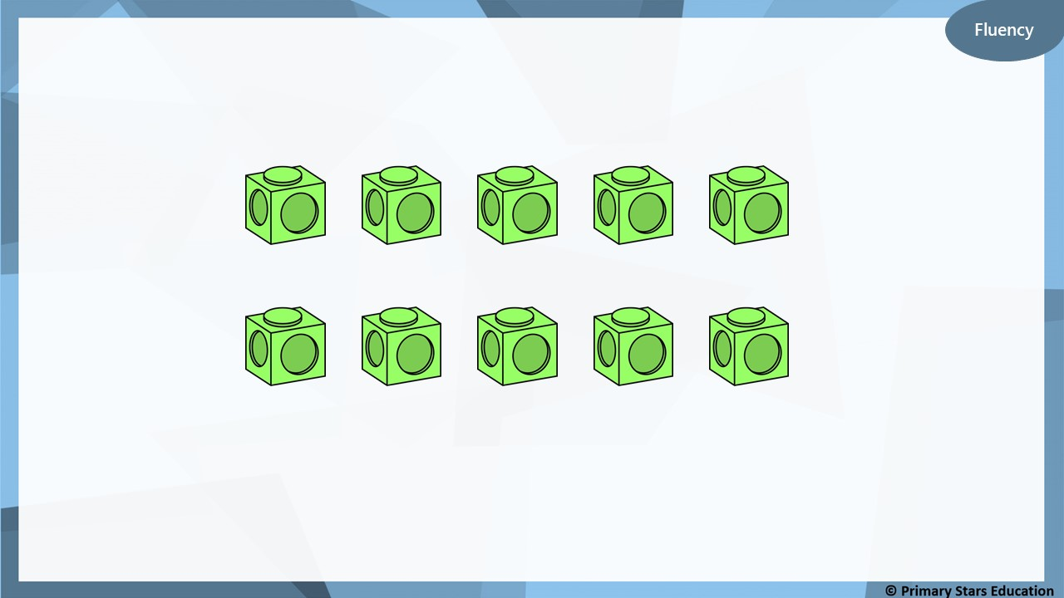
How many groups of 5 can you make?
2 groups of 5

Slide 13
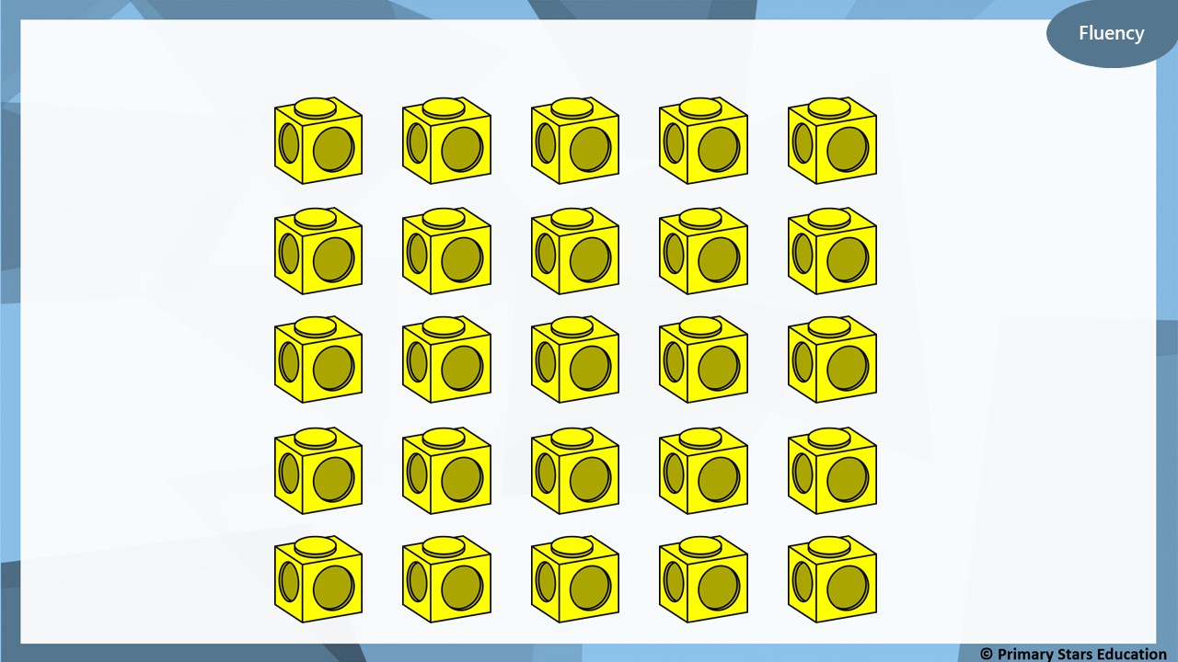
How many groups of 5 can you make?
5 groups of 5

Slide 14
30 cubes will make 7 towers of 5.
True or false?
Explain your answer.
False. 30 cubes will make 6 towers of 5 as 30 ÷ 5 = 6 (not 7).

Slide 15
Dom built a number of towers that are 5 cubes high.
How many towers could Dom have built? List all possible answers.
The amount of cubes I started with was between 40 and 60.
9, 10 or 11 towers.

Slide 16
Take 20 cubes.
How many towers of 5 can you make?
4
You can make _____ towers of 5.
_____ towers of 5 is the same as 20.
20 is the same as _____ towers of 5.
4
4

Slide 17
Take 30 cubes.
How many towers of 5 can you make?
6
You can make _____ towers of 5.
_____ towers of 5 is the same as 30.
30 is the same as _____ towers of 5.
6
6

Slide 18
How many towers of 5 can you make from 45 cubes?
9
You can make _____ towers of 5.
_____ towers of 5 is the same as 45.
45 is the same as _____ towers of 5.
9
9

Slide 19
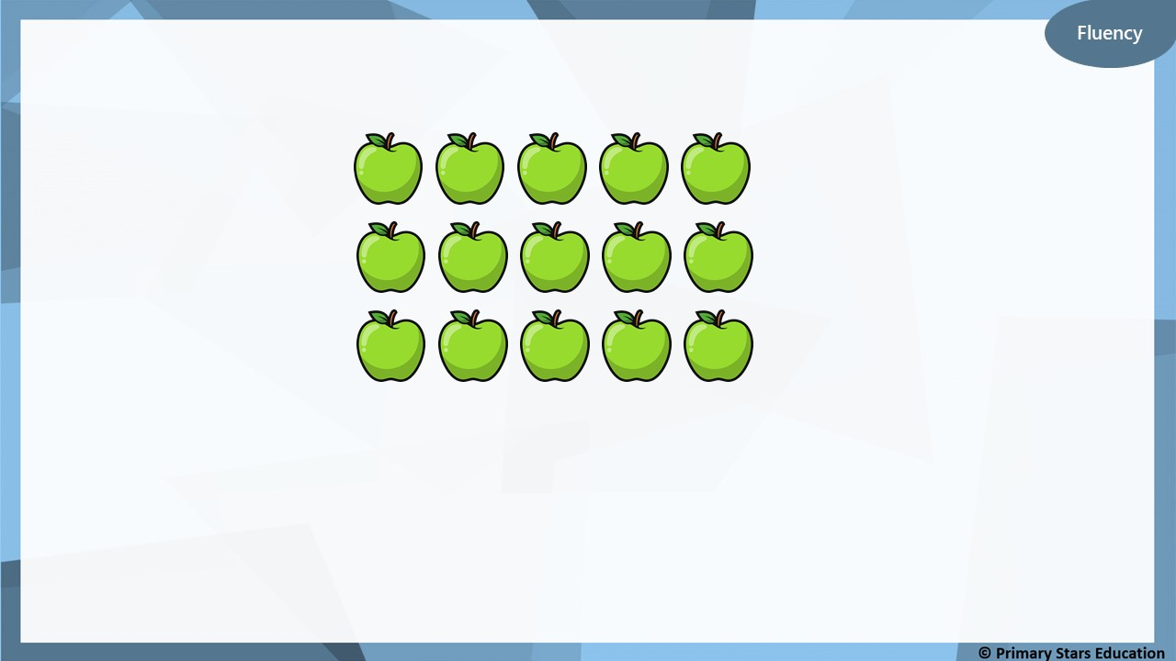
15 apples are shared between 5 horses.
3
How many apples will each horse get? _____
15
÷
5
=
3

Slide 20
50 pencils are shared between 5 children.
10
How many pencils will each child get? _____
50
÷
5
=
10

Slide 21
Group the 1p coins into 5s.
How many groups of 5 do we need to make 15p?
3
_____ groups of 5 1ps = 15 x 1p coins.
_____ groups of 5p = 15p.
15p = _____ x 5p.
15p ÷ 5p = _____.
3
3
3

Slide 22
Group the 1p coins into 5s.
How many groups of 5 do we need to make 25p?
5
_____ groups of 5 1ps = 25 x 1p coins.
_____ groups of 5p = 25p.
25p = _____ x 5p.
25p ÷ 5p = _____.
5
5
5

Slide 23
50 ÷ 5 = 10 (not 12).

Slide 24
My number is greater between 10 and 40. I have 5 equal groups.
What number could Ben have started with and how many
would be in each group?
Start with 35 ÷ 5 = 7 in each group.
Start with 30 ÷ 5 = 6 in each group.
Start with 25 ÷ 5 = 5 in each group.
Start with 20 ÷ 5 = 4 in each group.
Start with 15 ÷ 5 = 3 in each group.

Slide 25
Thursday/ Friday Short Lesson 3
Step: Divide by 10

Slide 26
Fluency
How many 10s in 30?
10
10
10
÷
10
=
3
30
10
3
_____ ÷ _____ = _____
3
There are _____ tens in 30.

Slide 27
Fluency
How many 10s in 60?
10
10
10
10
10
10
÷
10
=
6
60
10
6
_____ ÷ _____ = _____
6
There are _____ tens in 60.

Slide 28
Fluency
How many 10s in 70?
10
10
10
10
10
10
10
÷
10
=
7
70
10
7
_____ ÷ _____ = _____
7
There are _____ tens in 70.

Slide 29
Fluency
How many 10s in 90?
10
10
10
10
10
10
10
10
10
÷
10
=
9
90
10
9
_____ ÷ _____ = _____
9
There are _____ tens in 90.

Slide 30
Fluency
How many 10s in 40?
10
10
10
10
÷
10
=
4
40
10
4
_____ ÷ _____ = _____
4
There are _____ tens in 40.

Slide 31
This representation shows there are 5 tens in 50.
True or false?
Reasoning
10
10
10
10
10
÷
10
=
50
False
The answer should be 5 (not 50).
50 ÷ 10 = 5 tens.

Slide 32
Problem solving
Use the counters below to make division calculations: ______ ÷ 10 = ____
How many calculations can you make? List them.
10
10
10
10
10
10
60 ÷ 10 = 6
50 ÷ 10 = 5
40 ÷ 10 = 4
30 ÷ 10 = 3
20 ÷ 10 = 2
10 ÷ 10 = 1
0 ÷ 10 = 0

Slide 33
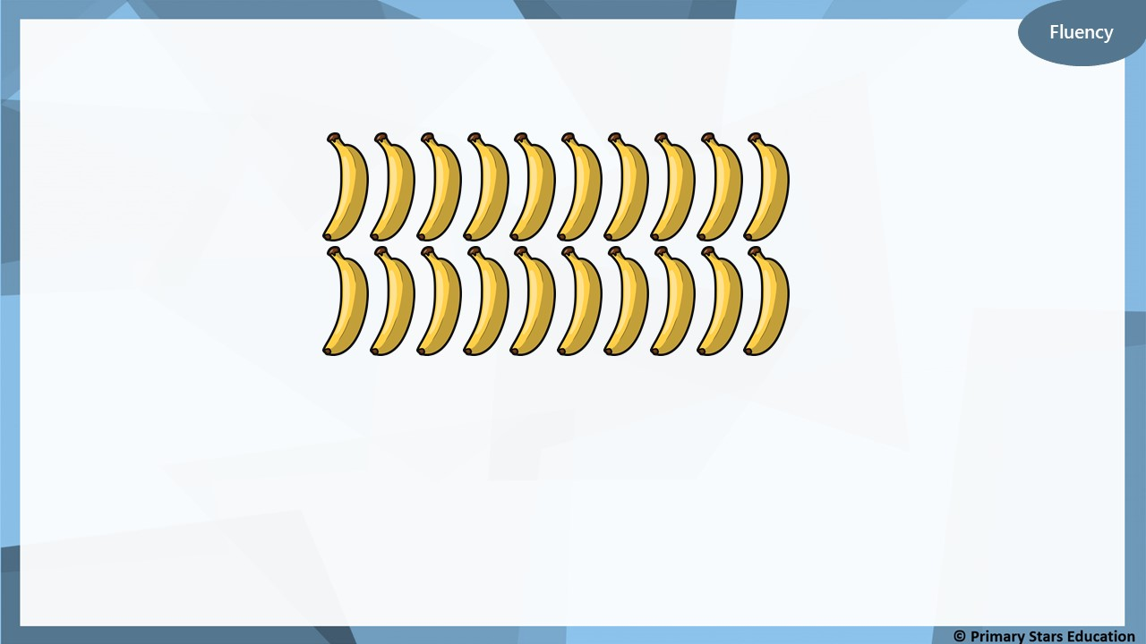
Bananas can be sold in packs of 10. How many packs can be made?
2
When 20 bananas are sold in packs of 10, _____ packs of bananas can be made.
20
10
10

Slide 34
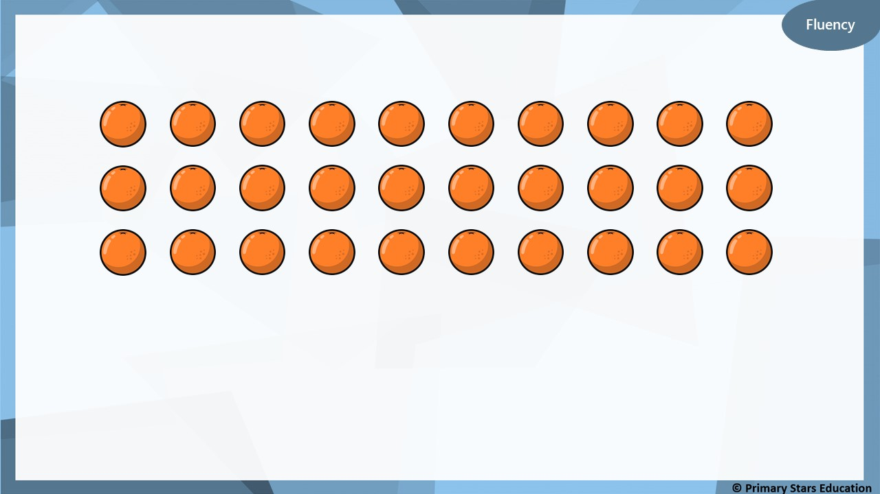
Oranges can be sold in packs of 10
How many packs can be made?
3
When 30 oranges are sold in packs of 10, _____ packs of
bananas can be made. Complete the bar model.
30
10
10
10

Slide 35
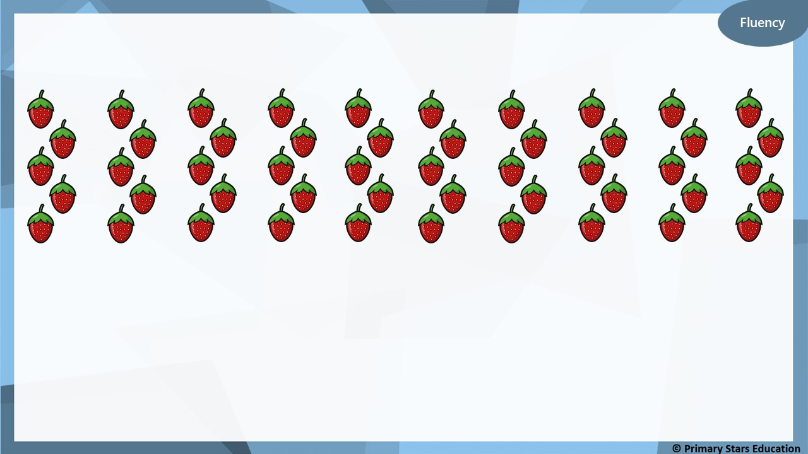
Strawberries can be sold in packs of 10
How many packs can be made?
5
When 50 strawberries are sold in packs of 10, _____ packs of
bananas can be made. Complete the bar model.
50
10
10
10
10
10

Slide 36
4
7

Slide 37
6
10

Slide 38
Fluency
Use the multiplication calculation to create a division
calculation.
3
x
10
=
30
9
x
10
=
90
30
÷
10
=
3
90
÷
10
=
9

Slide 39
Fluency
Use the multiplication calculation to create a division
calculation.
1
x
10
=
10
10
x
10
=
100
10
÷
1
=
10
100
÷
10
=
10

Slide 40
Which number sentence is incorrect and how do you know?
A) 4 x 10 = 40
B) 4 lots of 10 = 40
C) 40 ÷ 10 = 4
D) Forty ÷ ten = three
D is incorrect. Forty divided by ten is 4 (not 3).

Slide 41
Problem solving
How many multiplication and division calculations can you make?
List your calculations.
4
10
40
40 ÷ 10 = 4 40 ÷ 4 = 10
4 x 10 = 40
10 x 4 = 40

