Slide 3
1) 24 ÷ 4 =
2) How many tenths is in 1 whole?
3) How many tenths are in 2 wholes?
4) How many hundredths are in 5 wholes?

Slide 4
1) 24 ÷ 4 =
2) How many tenths is in 1 whole?
3) How many tenths are in 2 wholes?
4) How many hundredths are in 5 wholes?
6
10
20
500

Slide 6
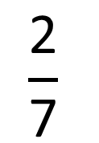
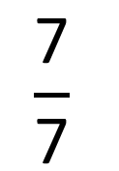
$$\frac{\text{7}}{\text{7}}$$
$$\frac{\text{2}}{\text{7}}$$
There are 9 sevenths altogether.

Slide 7
7 sevenths = 1 whole
2 sevenths
There are 9 sevenths altogether.
9 sevenths = 1 whole + 2 sevenths

Slide 8
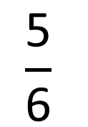
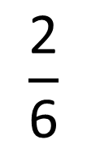
$$\frac{\text{2}}{\text{6}}$$
$$\frac{\text{5}}{\text{6}}$$
There are 7 sixths altogether.

Slide 9
1 whole
1 sixth
There are 7 sixths altogether.
7 sixths = 1 whole + 1 sixth

Slide 10
1)
Have a think
11
There are ____ fifths altogether.
____ fifths = ____ wholes + ____ fifth.
11
2
1
2)
3
There are ____ halves altogether.
____ halves = ____ whole + ____ half.
3
1
1

Slide 11
Have a go at questions 1 - 2 on the worksheet

Slide 12
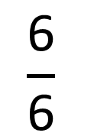
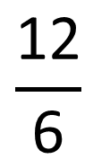
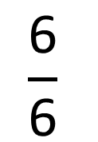
$$\frac{\text{12}}{\text{6}}$$
Improper fraction
= 2 wholes
$$\frac{\text{6}}{\text{6}}$$
$$\frac{\text{6}}{\text{6}}$$

Slide 13
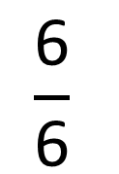
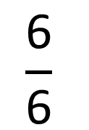
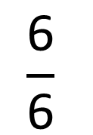
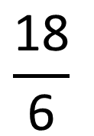
$$\frac{\text{18}}{\text{6}}$$
= 3 wholes
$$\frac{\text{6}}{\text{6}}$$
$$\frac{\text{6}}{\text{6}}$$
$$\frac{\text{6}}{\text{6}}$$

Slide 14
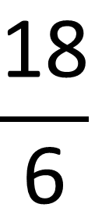
$$\frac{\text{18}}{\text{6}}$$
÷ 3
× 3
= 3 wholes
18 is 3 times greater than 6

Slide 15
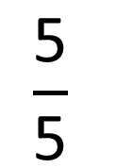
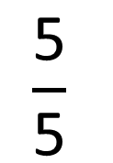
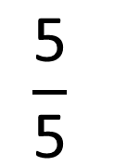
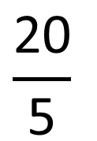
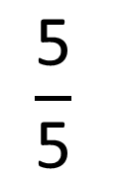
$$\frac{\text{20}}{\text{5}}$$
= 4 wholes
$$\frac{\text{5}}{\text{5}}$$
$$\frac{\text{5}}{\text{5}}$$
$$\frac{\text{5}}{\text{5}}$$
$$\frac{\text{5}}{\text{5}}$$

Slide 16
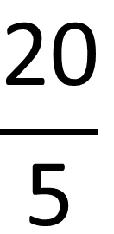
$$\frac{\text{20}}{\text{5}}$$
÷ 4
× 4
= 4 wholes
20 is 4 times greater than 5

Slide 17
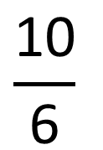
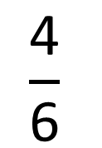
$$\frac{\text{10}}{\text{6}}$$
= 1 whole
+ 4 sixths
$$\frac{\text{6}}{\text{6}}$$
$$\frac{\text{4}}{\text{6}}$$

Slide 18
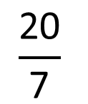
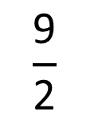
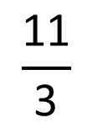
1)
Have a think
$$\frac{\text{11}}{\text{3}}$$
3
2
= ____ wholes
+ ____ thirds
2)
$$\frac{\text{9}}{\text{2}}$$
4
1
= ____ wholes
+ ____ half
3)
$$\frac{\text{20}}{\text{7}}$$
2
6
= ____ wholes
+ ____ sevenths

Slide 19
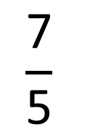
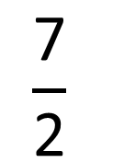
$$\frac{\text{7}}{\text{2}}$$
$$\frac{\text{7}}{\text{5}}$$
>
When the numerators are the same, the greater the denominator the smaller the fraction.

Slide 20
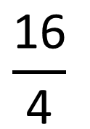
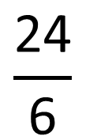
$$\frac{\text{24}}{\text{6}}$$
$$\frac{\text{16}}{\text{4}}$$
=

Slide 21
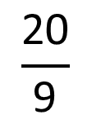
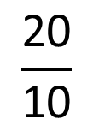
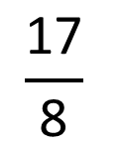
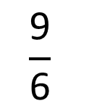
Have a think
1)
2 wholes and 3 fifths
>
9 fifths
2)
28 sevenths
=
12 thirds
3)
$$\frac{\text{9}}{\text{6}}$$
<
$$\frac{\text{17}}{\text{8}}$$
4)
$$\frac{\text{20}}{\text{10}}$$
<
$$\frac{\text{20}}{\text{9}}$$

Slide 22
Have a go at questions 3 - 6 on the worksheet

